Slide 1

Internet Programming

Slide 2
Content
Course Objectives
Course Outcome
Syllabus
Textbooks and References
Assessment
Guideline for Mini Project

Slide 3
Internet Programming
Course Code: CSDLO5012
Number of Credits: 3
Prerequisites: Data Structure, Programming Languages – Java, Python

Slide 4
Course Objectives
To get familiar with the basics of Internet Programming.
To acquire knowledge and skills for creation of web site considering both client and server-side programming
To gain ability to develop responsive web applications and explore different web extensions and web services standards
To learn characteristics of RIA and React Js

Slide 5
Course Outcomes
Implement interactive web page(s) using HTML and CSS.
Design a responsive web site using JavaScript and demonstrate database connectivity using JDBC
Demonstrate Rich Internet Application using Ajax and demonstrate and differentiate various Web Extensions
Demonstrate web application using Reactive Js

Slide 6
Introduction to Web Technology
Web Essentials:
Clients, Servers and Communication
The Internet
Basic Internet protocols,
World Wide Web,
HTTP Request Message, HTTP Response Message
Web Clients, Web Servers
Module 1

Slide 7
Introduction to Web Technology
HTML5
Fundamental syntax and semantics,
Tables, Lists, Image,
HTML5 control elements,
Semantic elements,
Drag and Drop,
Audio –Video controls
Module 1

Slide 8
Introduction to Web Technology
CSS3
Inline, embedded and external style sheets – Rule cascading,
Inheritance,
Backgrounds, Border Images,
Colors, Shadows,
Text
Transformations, Transitions, Animation,
Basics of Bootstrap.
Module 1

Slide 9
Front End Development
Java Script:
An introduction to JavaScript
JavaScript DOM Model
Date and Objects
Regular Expressions
Exception Handling
Validation
Built-in objects
Event Handling
Module 2

Slide 10
Front End Development
DHTML with JavaScript
JSON introduction
Syntax
Function Files
Http Request
SQL
Module 2

Slide 11
Back End Development
Servlets:
Java Servlet Architecture,
Servlet Life Cycle,
Form GET and POST actions,
Session Handling,
Understanding Cookies,
Installing and Configuring Apache Tomcat Web Server
Module 3

Slide 12
Back End Development
Database Connectivity:
JDBC perspectives,
JDBC program example
Form GET and POST actions,
JSP
Understanding Java Server Pages,
JSP Standard Tag Library (JSTL),
Creating HTML forms by embedding JSP code.
Module 3

Slide 13
Rich Internet Application (RIA)
Characteristic of RIA
AJAX
Introduction to AJAX:
AJAX design basics,
AJAX vs Traditional Approach,
Rich User Interface using Ajax,
jQuery framework with AJAX
Module 4

Slide 14
Web Extensions: PHP and XML
XML
DTD (Document Type Definition),
XML Schema,
Document Object Model,
Presenting XML,
Using XML Parsers: DOM and SAX,
XSL-eXtensible Stylesheet Language
Module 5

Slide 15
Web Extensions: PHP and XML
Introduction to PHP
Data types,
Control structures,
Built in functions
Building web applications using PHP
Tracking users,
PHP and MySQL database connectivity with example
Module 5

Slide 16
React js
Introduction
React features,
App “Hello World” Application,
Introduction to JSX,
Simple Application using JSX
Module 6

Slide 17
Textbooks
Ralph Moseley, M.T. Savliya, “Developing Web Applications”, Willy India, Second Edition, ISBN: 978-81-265-3867-6
“Web Technology Black Book”, Dremtech Press, First Edition, 978-7722-997
Robin Nixon, "Learning PHP, MySQL, JavaScript, CSS & HTML5" Third Edition, O'REILLY, 2014. (http://www.ebooksbucket.com/uploads/itprogramming/javascript/Learning_PHP_MySQL_Javascript_CSS_HTML5__Robin_Nixon_3e.pdf)
Dana Moore, Raymond Budd, Edward Benson, Professional Rich Internet Applications: AJAX and Beyond, Wiley publications. https://ebooks-it.org/0470082801-ebook.htm
Alex Banks and Eve Porcello, Learning React Functional Web Development with React and Redux, OREILLY, First Edition

Slide 18
References
Harvey & Paul Deitel & Associates, Harvey Deitel and Abbey Deitel, Internet and World Wide Web - How To Program, Fifth Edition, Pearson Education, 2011.
Achyut S Godbole and AtulKahate, ― Web Technologies, Second Edition, Tata McGraw Hill, 2012.
Thomas A Powell, Fritz Schneider, ― JavaScript: The Complete Reference, Third Edition, Tata McGraw Hill, 2013
David Flanagan, ― JavaScript: The Definitive Guide, Sixth Edition, O'Reilly Media, 2011
Steven Holzner ― The Complete Reference - PHP, Tata McGraw Hill, 2008
Mike Mcgrath― PHP & MySQL in easy Steps, Tata McGraw Hill, 2012

Slide 19
Useful Links
https://books.goalkicker.com/ReactJSBook/
https://www.guru99.com/reactjs-tutorial.html
www.nptelvideos.in
www.w3schools.com
https://spoken-tutorial.org/
www.coursera.org

Slide 20
Assessment
Internal Assessment:
Two class tests of 20 marks each.
The first class test: 40% syllabus
The second class test: Additional 40% syllabus
End Semester Theory Examination:
Question paper will comprise a total of six questions.
All question carries equal marks
Questions will be mixed in nature
(for example supposed Q.2 has part (a) from module 3 then part (b) will be from any module other than module 3)
Only Four questions need to be solved.
Weightage of each module will be proportional to number of respective lecture hours

Slide 21
Guideline for Mini Project
Create Simple web page using HTML5
Design and Implement web page using CSS3 and HTML5
Form Design and Client-Side Validation using: a. Javascript and HTML5, b. Javascript and Jquery
Develop interactive web pages using HTML 5 with JDBC database connectivity
Develop simple web page using PHP
Develop interactive web pages using PHP with database connectivity MYSQL
Develop XML web page using DTD, XSL
Implement a web page using Ajax and PHP
Case study based on Reactive js
Installation of the React DOM library.

Slide 22
Questions … ???

Slide 23
Thank You …

Slide 24
Web Essentials
Module 1.1

Slide 25
Content
Client, Server and Communication
The Internet
Basic Internet Protocols
World Wide Web
HTTP Request Message
HTTP Response Message
Web Clients
Web Servers

Slide 26
Client, Server & Communication

Slide 27
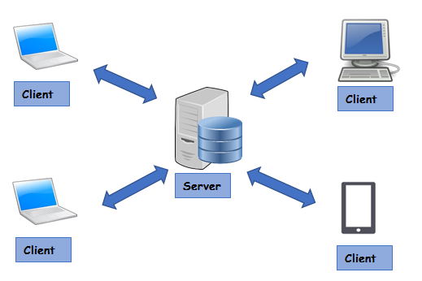
Client, Server and Communication
The Client-server model is a distributed application structure that partitions task or workload
Servers: Providers of a resource or service
Clients: service requesters
There could be many clients (remote processors) request and receive service from a centralized server (host computer).
Client computers provide an interface to allow a computer user to request services of the server and to display the results the server returns.
Servers wait for requests to arrive from clients and then respond to them

Slide 28

Client, Server and Communication
Ideally, a server provides a standardized transparent interface to clients
Clients are often situated at workstations or on personal computers,
Servers are located on the network, usually on more powerful machines.
This computing model is effective when clients and the server each have distinct tasks that they routinely perform.
Example: Data Processing in Hospital Management System
Many clients can access the server’s information simultaneously

Slide 29
Client, Server and Communication
Communication between Clients and Servers
Requests: Requests are sent from the client in order to ask the server for some data like files, or tell the server about things that happen, like that a user wants to login with his credentials
Response: A response is sent from the server to the client and is the reaction of the server to a request of the client. This could for example be an authentication result.
Service: A Service is a specific task that the server provides for the client to use, like downloading image

Slide 30
The Internet

Slide 31
The Internet
The project of US Department of Defense in 1960 known as ARPA (Advanced Research Project Agency)
ARPANET – Networking Project
Heterogeneous Computer Networking Research
In 1969 – First ARPANET Computer Network was launched with four Heterogeneous Nodes
In 1983 – Split Network with 113 Nodes
Mainly for DoD sponsored research
One of the popular Application – Email
SMTP, FTP protocols were developed under ARPANET
Background

Slide 32
The Internet
The other networks were also developed during this time
SURAnet, CSNET, NSFNET
How to communicate between these Networks???
Common Protocol is needed – TCP/IP
CSNET – ARPANET communication is started using this protocol
Background

Slide 33
The Internet
Global Network of Networks
Millions of interconnected networks
Private, Public, academic, Business, Government Networks
What is a network ?
Group of interconnected computer system
To communicate and exchange data
Participating systems are called as Nodes
Systems can be Laptops, Desktops, Mobiles, TV, Cars etc.
Interconnected via cable media or wireless media
INTER NETWORK

Slide 34
The Internet
Definition:
The collection of computers that can communicate with one another using TCP/IP over an open, global communications network
Internet Services:
Mobile Apps
Electronic Mail
World Wide Web
File Sharing
Online Games
Internet Telephony

Slide 35
Basic Internet Protocol

Slide 36
Basic Internet Protocols
Communication protocol:
Detailed specification of how communication between two computers will be carried out in order to serve some purpose.
Fundamental Protocols
IP (Internet Protocol)
TCP (Transmission Control Protocol)

Slide 37
Basic Internet Protocols
The function of IP software: To transfer data from one computer (the source) to another computer (the destination)
Key Element: IP Address
Each device on the Internet has one or more IP addresses associated with it
What is IP Address?
32 bit Number
A sequence of four decimal numbers separated by periods called “dots” E.g. 192.0.34.166
Each decimal number represents one byte of the IP address
IP (Internet Protocol)

Slide 38
Basic Internet Protocols
The application calls IP software on the source machine
Information provided
Data to be Transferred
Source IP Address
Destination IP Address
The IP software creates a packet with above information and header
If destination node is in the same network then the IP software will send the packet to the destination directly via this network.
If the destination is on another network, the IP software will send the packet to a gateway, which is a device that is connected to the source computer’s network as well as to at least one other network.
The gateway will select a computer on one of the other networks to which it is attached and send the packet on to that computer.
This process will continue, with the packet going through perhaps a dozen or more hops, until the packet reaches the destination computer.
IP software on the destination computer will receive the packet and pass its data up to an application that is waiting for the data.
IP (Internet Protocol)
How data is transferred?

Slide 39
Basic Internet Protocols
Route: The sequence of computers that a packet travels through from source to destination
Routing Protocol: Selecting efficient Route i.e. connectivity information between gateways
The current standard is BGP-4, the Border Gateway Protocol)
Checksum: Error detection information with each packet it
Corrupted packets can be detected by recipient
The IP standard calls for IP software to simply discard any corrupted packets.
IP-based communication is unreliable: packets can be lost.
IP (Internet Protocol)
How data is transferred?

Slide 40
Basic Internet Protocols
Higher-level protocol that extends IP to provide additional functionality,
Reliable communication can be implemented based on the concept of a connection.
Establishing/Closing a connection between TCP software running on two machines
Machine A send a TCP connection-request message via IP to the Machine B.
If the connection is accepted by Machine B, then B returns a message to A requesting a connection in the other direction.
If Machine A responds affirmatively, then the connection is established.
Here Machine A and B can both send messages to one another at the same time
This is known as full duplex communication.
TCP
(Transmission Control Protocol)
Connection Establishment

Slide 41
Basic Internet Protocols
TCP provides reliable data transmission by demanding an acknowledgment for each packet it sends via IP.
The software sets a timer after sending each packet.
The TCP software on the receiving side sends a packet containing an acknowledgment for every TCP-based packet it receives that passes the checksum test.
If the TCP software sending a packet does not receive an acknowledgment packet before its timer expires, then it resends the packet and restarts the timer.
TCP
(Transmission Control Protocol)
How data is transferred?

Slide 42
Basic Internet Protocols
The port concept allows TCP to be used to communicate with many different applications on a machine.
Mail Server
Mail Client
TCP
(Transmission Control Protocol)
Concept of PORT
7
3
Send me Port 25 Messages
1
Send to Server Port 25
Data
Data
TCP
TCP
6
2
4
Send me TCP Messages
TCP [25] + Data
TCP [25] + Data
Send TCP Message
IP
IP + TCP [25] + Data
IP
5

Slide 43
Basic Internet Protocols
UDP (User Datagram Protocol)
An alternative protocol to TCP that also builds on IP.
It also uses PORT concept
does not provide the two-way connection or guaranteed delivery
Advantage: Speed for simple tasks.
For example: Sending short messages and waiting for reply
Application which uses UDP protocol: DNS (Domain Name Service)
Other Protocol:
UDP

Slide 44
Basic Internet Protocols
It is easier to refer to machines by names rather than IP Addresses
DNS provides a mechanism for mapping back and forth between IP addresses and host names.
Basically, there are a number of DNS servers on the Internet, each listening through UDP software to a port (port 53 normally).
When a computer on the Internet needs DNS services
it uses the UDP software running on its system to send a UDP message to one of these DNS servers, requesting the IP address.
This server will then send back a UDP message containing the IP address.
UDP is efficient for DNS as it requires only one message (TCP consumes three messages)
UDP referred as a lightweight communication protocol and TCP as a heavyweight protocol,
Domain Name Service

Slide 45
Basic Internet Protocols
Computer Networking similar to Telephone Network
Computer Networking | Telephone Network
UDP | Call a Number and Leave message
DNS | Internet Version of Directory Assistance
TCP | Place a call and wait for other party to answer
Higher Level Protocols (SMTP, FTP etc.) | Decide the protocol for communication Language Who will speak first How to answer
Higher Level Protocols

Slide 46
Basic Internet Protocols
Higher-level protocols are used to communicate once a TCP connection has been established.
Some of the higher level protocols
SMTP: It supports transfer of e-mail between different e-mail servers,
FTP: It is used for transferring files between machines
Telnet
It is used to execute commands typed into one computer on a remote computer
Telnet can also be used to communicate directly (via keyboard entries) with some TCP-based applications.
The protocol which is to be used to communicate over a TCP connection is normally determined by the port number used to establish the connection.
The primary TCP-based protocol used for communication between web servers and browsers is called the Hypertext Transport Protocol (HTTP).
HTTP is a key component in the definition of the World Wide Web.
Higher Level Protocols

Slide 47
World Wide Web

Slide 48
World Wide Web
It was developed in early 1990s
It had advantage over its competitors such as Gopher, WAIS (Wide Area Information System)
The most commonly used service and the most influential application
It is built on top of TCP/IP protocols
The protocol used by WWW is Hypertext Transport Protocol (HTTP)
HTTP supports request response mechanism efficiently
More flexible than WAIS and Gopher
Most web pages are written using Hypertext Mark-up Language (HTML) where HTTP is fundamental technology
HTML pages can contain familiar web links (Hyperlinks)
Advanced Features
Extensive Page layout facilities
Inline graphics
Commercially appealing medium

Slide 49
World Wide Web
A system that interconnect resources over internet
Interconnection via hyperlinks, referenced with URIs
We use web browsers to have access to Web resources
E.g. IE, Firefox, Chrome, Safari
Resources are present in web pages or Web sites
Web sites – Collection of Web pages
Web pages are created using HTML, CSS, scripting languages
Definition:
The collection of machines (web servers) on the Internet that provide information via HTTP, and particularly those that provide HTML documents

Slide 50
Web Essentials
Module 1.1

Slide 51
Content
HTTP Request Message
HTTP Response Message
Web Clients
Web Servers

Slide 52
HTTP
Hypertext Transfer Protocol

Slide 53
HTTP
Form of communication protocol
Application Layer protocol: It allows to communicate and exchange data
Detailed specification of how web clients and servers should communicate.
The basic structure of HTTP communication follows request–response model.
The format of the request and response messages is dictated by HTTP.
Most HTTP implementations send these messages using TCP.
Used to deliver contents: Images, Videos, Audios, Documents
Hypertext Transfer Protocol

Slide 54
HTTP
Main Features
Connectionless:
After making the request, client disconnects from the server
When the response is ready, server reestablishes the connection
Deliver the response
Deliver any sort of the data, as long as two computers able to read it
Stateless:
Client and server knows about each other just during the current request
If the request is closed then they need to establish the connection again
The connection is treated as NEW connection
Hypertext Transfer Protocol

Slide 55




HTTP
How it works?
Request – Response Cycle
Request (HTTP message)
Response
(HTTP message)
www.mywebsite.com/products/myproduct.html

Slide 56
HTTP
Start Line
Header
Contains Plain Text based information
Sometimes the body contains binary data
HTTP Messages
Body

Slide 57
HTTP
The information in THREE sections vary depending on the http message whether it is a REQUEST or RESPONSE
HTTP Messages
Request HTTP Message
Response HTTP Message
Method path to file/ext http version
http version status code
Name1: Value1
Name2: Value2
Name3: Value3
Name1: Value1
Name2: Value2
Name3: Value3
E.g. Some Content
E.g. File Requested

Slide 58
HTTP
Request HTTP Message
URI is a set of readable characters and way to locate resources
Request HTTP Messages
Use Case
Method path to file/ext http version
GET products/myproducts.html HTTP/1.0
The Method is a command that tells the server what to do
E.g. GET, POST
Name1: Value1
Name2: Value2
Name3: Value3
Host: www.mywebsite.com
Accept-Language: en-US
Accept: text/html
MIME type: filetype/ext
E.g. Image/gif text/html

Slide 59
HTTP
Response HTTP Message
It tells the client if the request succeeded or failed
E.g. 200 OK
404 File not Found
Response HTTP Messages
http version status code
HTTP/1.0 200: OK
Name1: Value1
Name2: Value2
Name3: Value3
Host: www.mywebsite.com
Accept-Language: en-US
Accept: text/html
E.g. Some Content
products/myproduct.html

Slide 60
HTTP
Every start line consists of three parts, with a single space used to separate adjacent parts:
Request method
Request-URI portion of web address
HTTP version
Request HTTP Message
Method path to file/ext http version
Name1: Value1
Name2: Value2
Name3: Value3
E.g. Some Content

Slide 61
HTTP
HTTP Version
The initial version: HTTP/0.9
The next version used: HTTP/1.0.
In 1997, HTTP/1.1 was formally defined, and is currently in use
Essentially all operational browsers and servers support HTTP/1.1,
If a new version of HTTP is developed in the future, the new standard defining this version will specify a new value for the version portion of the start line
assuming that the new standard has the same start line
The version string for HTTP/1.1 must appear in the start line exactly as shown, with all capital letters and no embedded white space.
Request HTTP Message
Start Line
Method path to file/ext http version
Name1: Value1
Name2: Value2
Name3: Value3
E.g. Some Content

Slide 62
HTTP
Request URI – (URL and URN)
A URI (Uniform Resource Identifier) is an identifier that is intended to be associated with a particular resource (such as a web page or graphics image) on the World Wide Web.
Every URI consists of two parts:
The scheme/protocol: It appears before the colon (:)
Domain name: It depends on the scheme/protocol
Web addresses (URL):
use the http scheme generally.
the scheme name in URIs is case insensitive, but is generally written in lowercase letters
In this scheme, the URI represents the location of a resource on the Web.
A URI of this type is said to be a Uniform Resource Locator (URL).
Therefore, URIs using the http scheme are both URIs and URLs.
Request HTTP Message
Start Line
Method path to file/ext http version
Name1: Value1
Name2: Value2
Name3: Value3
E.g. Some Content

Slide 63
HTTP
Scheme Name | Example URL | Type of Resources
ftp | ftp://ftp.example.org/pub/afile.txt | File located on FTP server
telnet | telnet://host.example.org/ | Telnet Server
mailto | mailto:someone@example.org | Mailbox
https | https://secure.example.org/sec.txt | Resource on web server supporting encrypted communication
file | file:///C:/temp/localFile.txt | File accessible from machine processing this URL
Request HTTP Message
Start Line

Slide 64
HTTP
Another type of URI: Uniform Resource Name (URN).
Not as common as URLs, URNs are sometimes used in web development.
A URN is designed to be a unique name for a resource rather than specifying a location at which to find the resource.
For example, an edition of ‘War and Peace’ has an ISBN (International Standard Book Number) of 0-1404-4417-3 associated with it, and this is the only book worldwide with this number.
This book has an associated URN, which can be written as follows:
urn:ISBN:0-1404-4417-3
The URI for a URN always consists of three colon-separated parts.
Scheme name: URN-type URI.
The namespace identifier (E.g. ISBN)
Other currently registered URN namespace identifiers along with pointers to documentation for each are listed at [IANA-URNS].
The namespace-specific string
In this example it represents the ISBN of a book and has a format defined by the documentation linked to at [IANA-URNS].
Request HTTP Message
Start Line

Slide 65
HTTP
Request Method
The method part of the start line of an HTTP request must be written entirely in uppercase
letters,
The HTTP/1.1 standard defines a CONNECT method, which can be used to create certain types of secure connections.
The primary HTTP methods
GET.
This is the method used when you type a URL into the Location bar of your browser.
It is also the method that is used by default when you click on a link in a document displayed in your browser and when the browser downloads images for display within an HTML document.
The POST
The method is typically used to send information collected from a form displayed within a browser,
Example: an order-entry form data to be sent back to the web server.
Request HTTP Message
Start Line
Method path to file/ext http version
Name1: Value1
Name2: Value2
Name3: Value3
E.g. Some Content

Slide 66
HTTP
Method | Request Server to
GET​ | Required resource is specified in the Request-URI ​ The resource is specified as the body of a response message.​
POST​ | The data to be processed by the resource is specified in the body of Request message ​ The resource specified by the Request-URI.​
HEAD​ | return the same HTTP header fields that would be returned if a GET method were used but not return the message body that would be returned to a GET ​ Communication overhead can be reduced​
OPTIONS​ | return (in Allow header field) a list of HTTP methods that may be used to access the resource specified by the Request-URI.​
PUT​ | store the body of this message on the server and assign the specified Request-URI to the data stored ​ future GET request messages containing this Request-URI will receive this data in their response messages.​
Request HTTP Message
Start Line

Slide 67
HTTP
The Host header field is required in every HTTP/1.1 request message.
HTTP/1.1 also defines a number of other header fields,
These header fields are commonly used by modern browsers.
Each header field structure
begins with a field name
followed by a colon
then a field value.
White space is allowed to precede or follow the field value,
The white space is not considered part of the value itself.
Common Header Features:
Header names are not case sensitive
Header field value may wrap onto several lines by preceding each continuation line with one or more spaces or tabs
MIME (Multipurpose Internet Mail Extensions) types in several header field values
Request HTTP Message
Header Fields
Method path to file/ext http version
Name1: Value1
Name2: Value2
Name3: Value3
E.g. Some Content

Slide 68
HTTP
POST /servlet/EchoHttpRequest HTTP/1.1
host: www.example.org:56789
user-agent: Mozilla/5.0 (Windows; U; Windows NT 5.1; en-US; rv:1.4)
Gecko/20030624
accept: text/xml,application/xml,application/xhtml+xml,
text/html; q=0.9,text/plain;q=0.8,video/x-mng,image/png,image/jpeg,
image/gif;q=0.2,*/*;q=0.1
accept-language: en-us,en;q=0.5
accept-encoding: gzip,deflate
accept-charset: ISO-8859-1,utf-8;q=0.7,*;q=0.7
connection: keep-alive
keep-alive: 300
content-type: application/x-www-form-urlencoded
content-length: 13
Request HTTP Message
Header Fields
doit=Click+me

Slide 69
HTTP
MIME Type | Description
text/html | HTML Document
image/gif​ | Image represented using Graphical Interchange Format (GIF)
image/jpeg | Image represented using Joint Picture Expert Group (JPEG) Format
text/plain | Human-readable text with no embedded formatting information
application/octet-stream​ | Arbitrary binary data (may be executable)
application/x-www-form-urlencoded | Data sent from a web form to a web server for processing
Request HTTP Message
MIME Content Type
Header Field (accept)

Slide 70
HTTP
HTTP response message consists of
Status line
Header field(s) (one or more)
Blank line
Message body (optional)
Response HTTP Message
http version status code
Name1: Value1
Name2: Value2
Name3: Value3
E.g. File Requested

Slide 71
HTTP
The status line consists of three fields:
The HTTP version used by the server software when formatting the response
A numeric status code indicating the type of response;
A text string (the reason phrase) that presents the information represented by the numeric status code in human-readable form.
Example: HTTP/1.1 200 OK
Here the status code is 200 and the reason phrase is OK.
This particular status code indicates that no errors were detected by the server.
The body of a response having this status code should contain the resource requested by the client.
All status codes are three-digit decimal numbers.
The first digit represents the general class of status code.
The last two digits of a status code define the specific status within the specified class.
Response HTTP Message
Response Status Line
http version status code
Name1: Value1
Name2: Value2
Name3: Value3
E.g. File Requested

Slide 72
HTTP
Digit | Class | Description
1 | Informational | Provides information to client before request processing has been completed.
2 | Success | Request has been successfully processed.
3 | Redirection | Client needs to use a different resource to fulfill request.
4 | Client Error | Client’s request is not valid.
5 | Server Error | An error occurred during server processing of a valid client request.
Response HTTP Message
Status Code Classes
http version status code
Name1: Value1
Name2: Value2
Name3: Value3
E.g. File Requested

Slide 73
HTTP
Status Code | Recommended Reason Phrase | Usual Meaning
200 | OK | Request processed normally
301 | Moved Permanently | URI for the requested resource has changed. All future requests should be made to URI contained in the Location header field of the response. Most browsers will automatically send a second request to the new URI and display the second response.
307 | Temporary Redirect | URI for the requested resource has changed at least temporarily. This request should be fulfilled by making a second request to URI contained in the Location header field of the response. Most browsers will automatically send a second request to the new URI and display the second response.
401 | Unauthorized | The resource is password protected, and the user has not yet supplied a valid password.
403 | Forbidden | The resource is present on the server but is read protected This is often an error on the part of the server administrator, but may be intentional
404 | Not Found | No resource corresponding to the given Request-URI was found at this server.
500 | Internal Server Error | Server software detected an internal failure
Response HTTP Message
Common Status Codes

Slide 74
HTTP
Some of the header fields used in HTTP response messages are
Connection: Indicates whether the connection will be kept open or close
Content-Type: any one of the MIME type values specified by the Accept header field of the corresponding request
Content-Length: Number of bytes of data in the message body, if one is present.
Date:
Time at which response was generated which is used for cache control
This field must be supplied by the server.
Server: Information identifying the server software generating this response.
Last Modified
Time at which the resource returned by this request was last modified.
Can be used to determine whether cached copy of a resource is valid or not
Expires: Time after which the client should check with the server before retrieving the returned resource from the client’s cache
Response HTTP Message
Response Header Fields
http version status code
Name1: Value1
Name2: Value2
Name3: Value3
E.g. File Requested

Slide 75
HTTP
Some of the header fields used in HTTP request messages are
ETag:
A hash code of the resource returned.
If the resource remains unchanged on subsequent requests, then the ETag value will also remain unchanged;
otherwise, the ETag value will change.
Used for cache control
Accept-Ranges:
Clients can request that only a portion (range) of a resource be returned by using the Range header field.
This might be used if the resource is, say, a large PDF file and only a single page is currently needed.
Accept-Ranges specifies the units that may be used by the client in a range request, or none if range requests are not accepted by this server for this resource.
Location: Used in responses with redirect status code to specify new URI for the requested resource.
Response HTTP Message
Response Header Fields
http version status code
Name1: Value1
Name2: Value2
Name3: Value3
E.g. File Requested

Slide 76
HTTP
Cache Control
What is Cache?
a cache is a repository for copies of information that originates elsewhere.
A copy of information is placed in a cache in order to improve system performance.
Most web browsers automatically cache on the client machine many of the resources that they request from servers via HTTP.
E.g. Image included in web page
HTTP caching, provides advantages when it is successful,
leads to quicker display by the browser,
Reduced network communication
reduced load on the web server.
Response HTTP Message
Cache Control

Slide 77
HTTP
Cache Control
Disadvantage:
Cache copy may be invalid if there is update on server
How to handle the problem?
Ask the server whether the client copy is valid or not
HTTP request method for resource using the HEAD method
It returns only status line and header portion of response
Check Last-Modified time and decide whether the copy is valid or not
If copy is invalid then send normal GET request for the resource
Server returns ETag with the resource
Client can compare ETag returned by HEAD request and decide whether the copy is valid
This approach avoids the complexity of comparing two dates to determine which is larger.
Server mention Expire time in header in advance
Client use cache copy as long as there is no expiry
No need to validate from server
Response HTTP Message
Cache Control

Slide 78
Web Client

Slide 79
Web Clients
Definition:
A web client is software that accesses a web server by sending an HTTP request message and processing the resulting HTTP response.
Web browsers running on desktop or laptop computers are the most common form of web client software,
There are many other forms of client software,
Text-only browsers,
Browsers running on cell phones,
browsers that speak a page rather than displaying the page.
In general, any web client that is designed to directly support user access to web servers is known as a user agent.
Some web clients are not designed to be used directly by humans at all.
For example, software robots are often used to automatically crawl the Web and download information for use by search engines
e-mail spammers

Slide 80
Web Clients
Browser Functions:
Reformat the URL entered as a valid HTTP request message.
If the server is specified using a host name (rather than an IP address), use DNS to convert this name to the appropriate IP address.
Establish a TCP connection using the IP address of the specified web server.
Send the HTTP request over the TCP connection and wait for the server’s response.
Display the document contained in the response.
If the document is not a plain-text document but instead is written in a language such as HTML, this involves rendering the document:
positioning text and graphics appropriately within the browser window,
creating table borders,
using appropriate fonts and colors
Browser Functions

Slide 81
Web Clients
Browser Additional Functionality:
Automatic URL Completion
Script Execution
Event Handling
Management of form GUI
Secure Communication
Plug-in Execution
Browser Functions

Slide 82
Web Server

Slide 83
Web Server
The primary feature of every web server is to accept HTTP requests from web clients and return an appropriate resource (if available) in the HTTP response.
This basic functionality involves a number of steps
The server calls on TCP software and waits for connection requests to one or more ports.
When a connection request is received, the server dedicates a “subtask” to handling this connection.
The subtask establishes the TCP connection and receives an HTTP request.
The subtask examines the Host header field of the request to determine which “virtual host” should receive this request and invokes software for this host.
The virtual host software maps the Request-URI field of the HTTP request start line to a resource on the server.

Slide 84
Web Server
If the resource is a file, the host software determines the MIME type of the file (usually by a mapping from the file-name extension portion of the Request-URI), and creates an HTTP response that contains the file in the body of the response message.
If the resource is a program, the host software runs the program, providing it with information from the request and returning the output from the program as the body of an HTTP response message.
The server normally logs information about the request and response—such as the IP address of the requester and the status code of the response—in a plain-text file.
If the TCP connection is kept alive, the server subtask continues to monitor the connection until a certain length of time has elapsed, the client sends another request, or the client initiates a connection close

Slide 85
Web Server
Concurrent Processing:
All modern servers can concurrently process multiple requests.
Similar to multiple copies of the server were running simultaneously,
Each copy devoted to handling the requests received over a single TCP connection.
Concurrency of the system depends on:
Number of processors available in the system,
The programming language used
Programmer choices
Virtual host:
Every HTTP request must include a Host header field.
The reason: multiple host names may all be mapped by the Internet DNS system to a single IP address.
The documents returned by web servers are
produced by executing software at the time of the HTTP request
It is not generated before-hand and stored in the server’s file system for later retrieval

Slide 86
HTML5

Slide 87
Content
Introduction
HTML Page Structure
HTML Editors
HTML Basic Elements

Slide 88
What is HTML?
HTML stands for Hyper Text Markup Language
HTML is the standard markup language for creating Web pages
HTML describes the structure of a Web page
HTML consists of a series of elements
HTML elements tell the browser how to display the content
HTML elements label pieces of content such as "this is a heading", "this is a paragraph", "this is a link", etc.

Slide 89
Example
<!DOCTYPE html>: declaration defines that this document is an HTML5 document
<html>: element is the root element of an HTML page
<head>: element contains meta information about the HTML page
<title> element specifies a title for the HTML page (which is shown in the browser's title bar or in the page's tab)
<body> element defines the document's body, and is a container for all the visible contents, such as headings, paragraphs, images, hyperlinks, tables, lists, etc.
<h1> element defines a large heading
<p> element defines a paragraph
<!DOCTYPE html> <html> <head> <title>Page Title</title> </head> <body> <h1>My First Heading</h1> <p>My first paragraph.</p> </body> </html>

Slide 90
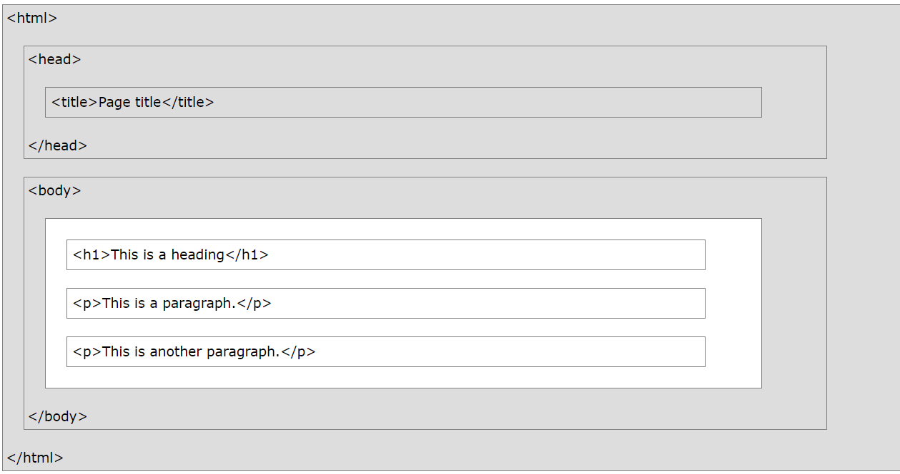
HTML Page Structure

Slide 91
HTML Basics
HTML Documents
All HTML documents must start with a document type declaration: <!DOCTYPE html>.
The HTML document itself begins with <html> and ends with </html>.
The visible part of the HTML document is between <body> and </body>
The <!DOCTYPE> Declaration
The <!DOCTYPE> declaration represents the document type, and helps browsers to display web pages correctly.
It must only appear once, at the top of the page (before any HTML tags).
The <!DOCTYPE> declaration is not case sensitive.

Slide 92
How To View HTML Source?
View HTML Source Code:
Right-click in an HTML page and select "View Page Source" (in Chrome) or "View Source" (in Edge), or similar in other browsers.
This will open a window containing the HTML source code of the page.
Inspect an HTML Element:
Right-click on an element (or a blank area), and choose "Inspect" or "Inspect Element" to see what elements are made up of (you will see both the HTML and the CSS).
You can also edit the HTML or CSS on-the-fly in the Elements or Styles panel that opens.

Slide 93
HTML Editors
A simple text editor can be used to write html code
Web pages can be created and modified by using professional HTML editors.
Steps to create web page using notepad
Open any text editor
Write HTML code
Save the HTML file with .htm extension and preferable encoding is UTF – 8
View the HTML page in the browser

Slide 94
Fundamental Syntax And Semantics

Slide 95
What is an HTML Element?
An HTML element is defined by a start tag, some content, and an end tag:
<tagname> Content goes here... </tagname>
The HTML element is everything from the start tag to the end tag:
<h1> My First Heading </h1>
<p> My first paragraph. </p>
Start Tag | Element content | End Tag
<h1> | My First Heading | </h1>
<p> | My First Paragraph | </p>
<br> | None | none

Slide 96
Nested HTML ELEMENT
<!DOCTYPE html> <html> <head> <title>Page Title</title> </head> <body> <h1>My First Heading</h1> <p>My first paragraph.</p> </body> </html>
HTML elements can be nested
It means that elements can contain other elements
All HTML documents consist of nested HTML elements.

Slide 97
HTML Element
Few Tips:
Never skip end tag
Document may be displayed incorrectly
HTML is not case sensitive
Empty HTML elements
<br> tag is without end tag: Used to break the line

Slide 98
HTML Attributes
All HTML elements can have attributes
Attributes provide additional information about elements
Attributes are always specified in the start tag
Attributes usually come in name/value pairs like: name="value"

Slide 99
HTML Attributes
<!DOCTYPE html> <html> <head> <title>Page Title</title> </head> <body> <h1>My First Heading</h1>
<a href="https://www.w3schools.com">Visit W3Schools</a>
<p>My first paragraph.</p> </body> </html>
<a> tag defines hyperlink
Attribute --
href: This attribute specifies the URL where it will go to

Slide 100
HTML Attributes
<img> tag is used to embed an image in an HTML page.
Attribute --
src: This attribute specifies the path to the image to be displayed
There are two ways to specify the URL in the src attribute:
Absolute URL - Links to an external image that is hosted on another website.
Example: src=https://www.w3schools.com/images/img_girl.jpg
2. Relative URL
Links to an image that is hosted within the website.
The URL does not include the domain name.
If the URL begins without a slash, it will be relative to the current page.
Example: src="img_girl.jpg".
If the URL begins with a slash, it will be relative to the domain. Example: src="/images/img_girl.jpg".
<!DOCTYPE html> <html> <head> <title>Page Title</title> </head> <body> <h1>My First Heading</h1>
<a href="https://www.w3schools.com">Visit W3Schools</a>
<img src="img_girl.jpg">
<p>My first paragraph.</p> </body> </html>
Note:
External images might be under copyright.
If you do not get permission to use it, you may be in violation of copyright laws.
In addition, you cannot control external images; it can suddenly be removed or changed.

Slide 101
HTML Attributes
<!DOCTYPE html> <html> <head> <title>Page Title</title> </head> <body> <h1>My First Heading</h1>
<a href="https://www.w3schools.com">Visit W3Schools</a>
<img src="img_girl.jpg“ width="500" height="600">
<p>My first paragraph.</p> </body> </html>
The <img> tag
Attribute --
The width and height: It specifies the width and height of the image (in pixels)

Slide 102
HTML Attributes
<!DOCTYPE html> <html> <head> <title>Page Title</title> </head> <body> <h1>My First Heading</h1>
<a href="https://www.w3schools.com">Visit W3Schools</a>
<img src="img_girl.jpg“ width="500" height="600“ alt=“Sample Image">
<p>My first paragraph.</p> </body> </html>
The <img> tag
Attribute --
alt: It specifies an alternate text for an image, if the image for some reason cannot be displayed.
This can be due to slow connection, or an error in the src attribute, or if the user uses a screen reader.

Slide 103
HTML Attributes
<!DOCTYPE html> <html> <head> <title>Page Title</title> </head> <body> <h1>My First Heading</h1>
<a href="https://www.w3schools.com">Visit W3Schools</a>
<img src="img_girl.jpg“width="500" height="600“ alt=“Sample Image">
<p style="color:red;">This is a red paragraph.</p> </body> </html>
The style attribute:
The style attribute is used to add styles to an element, such as color, font, size, and more.

Slide 104
HTML Attributes
The lang attribute:
You should always include the lang attribute inside the <html> tag
It is used to declare the language of the Web page.
This is meant to assist search engines and browsers.
Country codes can also be added to the language code in the lang attribute.
The first two characters define the language of the HTML page
The last two characters define the country.
<!DOCTYPE html> <html lang = "en-US"> <head> <title>Page Title</title> </head> <body> <h1>My First Heading</h1>
<a href="https://www.w3schools.com">Visit W3Schools</a>
<img src="img_girl.jpg“ width="500" height="600“ alt=“Sample Image">
<p style="color:red;">This is a red paragraph.</p> </body> </html>

Slide 105
HTML Attributes
<!DOCTYPE html> <html lang = "en-US"> <head> <title>Page Title</title> </head> <body> <h1>My First Heading</h1>
<a href="https://www.w3schools.com">Visit W3Schools</a>
<img src="img_girl.jpg“ width="500" height="600“ alt=“Sample Image">
<p style="color:red;">This is a red paragraph.</p>
<p title="I'm a tooltip">This is a paragraph.</p>
</body> </html>
The title attribute:
The title attribute defines some extra information about an element.
The value of the title attribute will be displayed as a tooltip when you mouse over the element

Slide 106
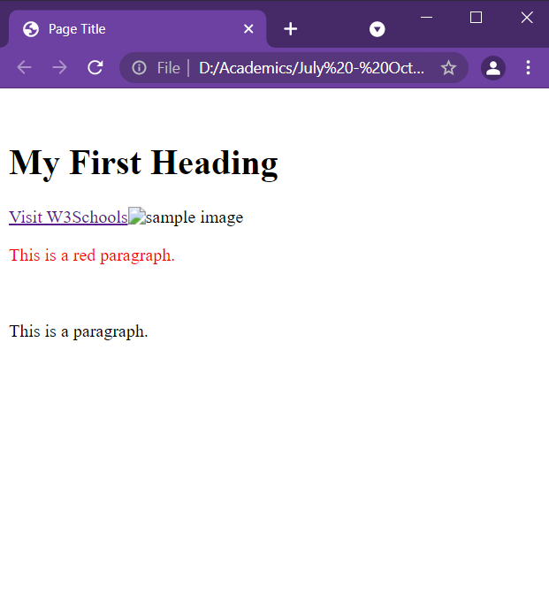
HTML Attributes
<!DOCTYPE html> <html lang = "en-US"> <head> <title>Page Title</title> </head> <body> <h1>My First Heading</h1>
<a href="https://www.w3schools.com">Visit W3Schools</a>
<img src="img_girl.jpg“ width="500" height="600“ alt=“Sample Image">
<p style="color:red;">This is a red paragraph.</p>
<p title="I'm a tooltip">This is a paragraph.</p>
</body> </html>

Slide 107
HTML Headings
HTML headings are titles or subtitles that to be displayed on a webpage.
Search engines use the headings to index the structure and content of your web pages.
Users often skim a page by its headings.
It is important to use headings to show the document structure.
<h1> headings should be used for main headings, followed by <h2> headings, then the less important <h3>, and so on.
Each HTML heading has a default size.
The size of any heading can be specified with the style attribute,
The font-size property of CSS can be used
<!DOCTYPE html> <html lang = "en-US"> <head> <title>Heading</title> </head> <body>
<h1>Heading 1</h1> <h2>Heading 2</h2> <h3>Heading 3</h3> <h4>Heading 4</h4> <h5>Heading 5</h5> <h6>Heading 6</h6>
<h1 style="font-size:60px;">Heading 1</h1>
</body>
</html>

Slide 108
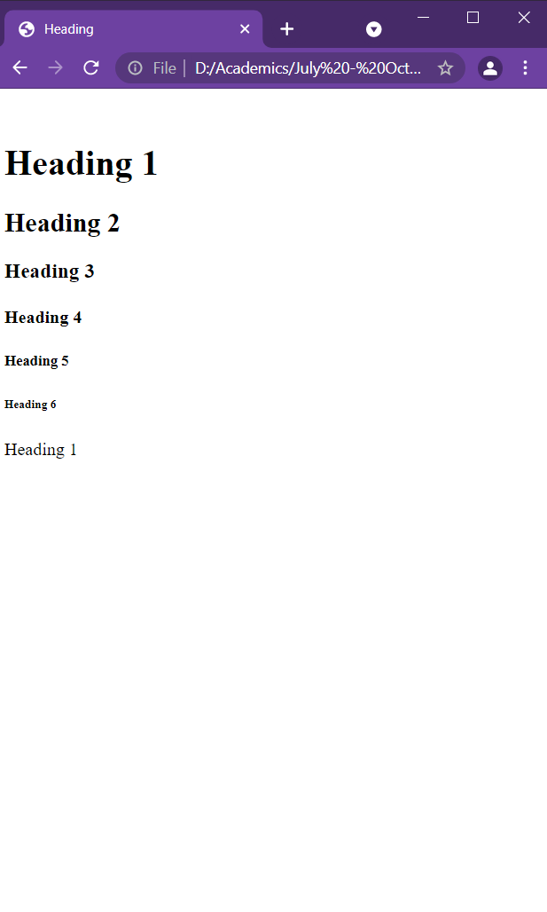
HTML Headings
<!DOCTYPE html> <html lang = "en-US"> <head> <title>Heading</title> </head> <body>
<h1>Heading 1</h1> <h2>Heading 2</h2> <h3>Heading 3</h3> <h4>Heading 4</h4> <h5>Heading 5</h5> <h6>Heading 6</h6>
<h1 style="font-size:60px;">Heading 1</h1>
</body>
</html>

Slide 109
HTML Paragraph
A paragraph always starts on a new line, and is usually a block of text.
The HTML <p> element defines a paragraph.
Browsers automatically add some white space (a margin) before and after a paragraph.
Note:
It is not sure how HTML will be displayed.
Large or small screens, and resized windows will create different results.
In HTML, display can’t be changed by adding extra spaces or extra lines in HTML code.
The browser will automatically remove any extra spaces and lines when the page is displayed:
<!DOCTYPE html> <html lang = "en-US"> <head> <title>Paragraph</title> </head> <body>
<p> This paragraph contains a lot of lines in the source code, but the browser ignores it. </p> <p> This paragraph contains a lot of spaces in the source code, but the browser ignores it. </p>
</body>
</html>

Slide 110
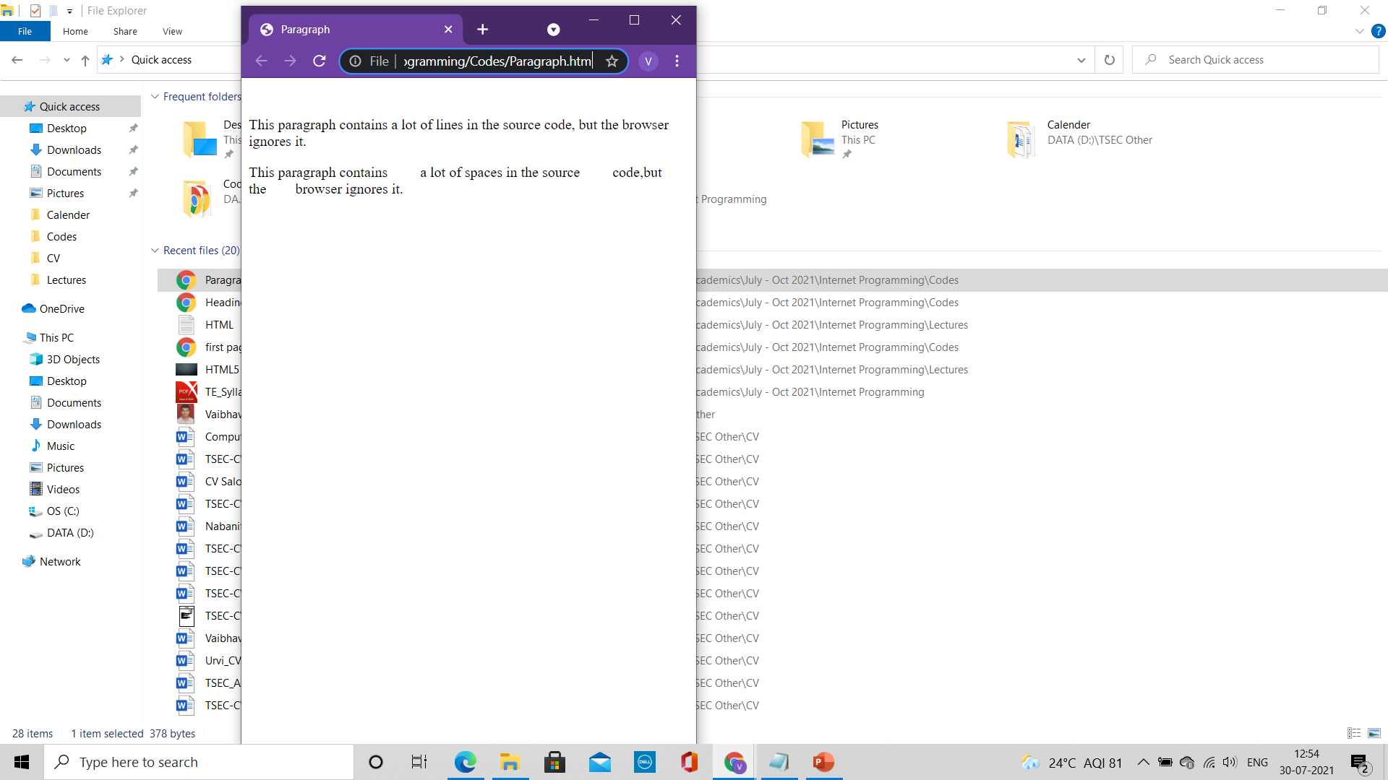
HTML Paragraph
<!DOCTYPE html> <html lang = "en-US"> <head> <title>Paragraph</title> </head> <body>
<p> This paragraph contains a lot of lines in the source code, but the browser ignores it. </p> <p> This paragraph contains a lot of spaces in the source code, but the browser ignores it. </p>
</body>
</html>

Slide 111
HTML Paragraph
HTML Horizontal Rule
The <hr> tag defines a thematic break in an HTML page,
It is most often displayed as a horizontal rule.
The <hr> element is used to separate content (or define a change) in an HTML page
HTML Line Breaks
The HTML <br> element defines a line break.
Use <br> tag to make a line break (a new line) without starting a new paragraph
The <br> tag is an empty tag
<!DOCTYPE html> <html lang = "en-US"> <head> <title>Paragraph1</title> </head> <body>
<h1>This is heading 1</h1> <p>This is some text.</p> <hr>
<h2>This is heading 2</h2> <p>This is some other text.</p> <hr>
<p>This is<br>a paragraph<br>with line breaks.</p>
</body>
</html>

Slide 112
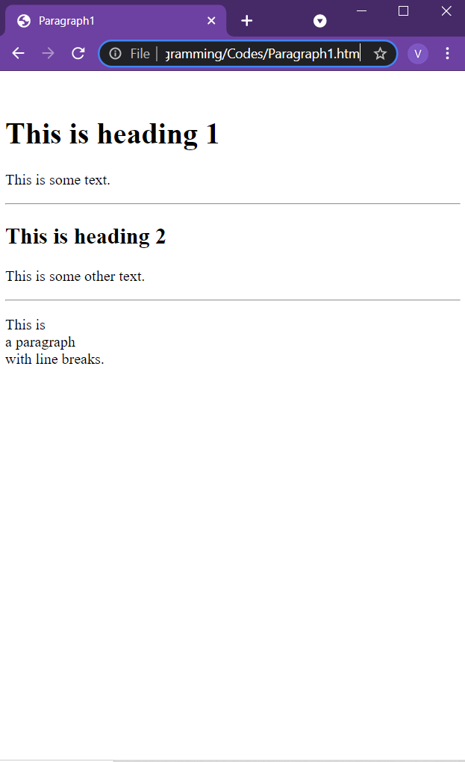
HTML Paragraph
<!DOCTYPE html> <html lang = "en-US"> <head> <title>Paragraph1</title> </head> <body>
<h1>This is heading 1</h1> <p>This is some text.</p> <hr>
<h2>This is heading 2</h2> <p>This is some other text.</p> <hr>
<p>This is<br>a paragraph<br>with line breaks.</p>
</body>
</html>

Slide 113
HTML Paragraph
<!DOCTYPE html> <html lang = "en-US"> <head> <title>Paragraph2</title> </head> <body>
<pre> My Bonnie lies over the ocean. My Bonnie lies over the sea. My Bonnie lies over the ocean. Oh, bring back my Bonnie to me. </pre>
</body>
</html>
HTML <pre> element
The HTML <pre> element defines preformatted text.
The text inside a <pre> element is displayed in a fixed-width font (usually Courier),
It preserves both spaces and line breaks:

Slide 114
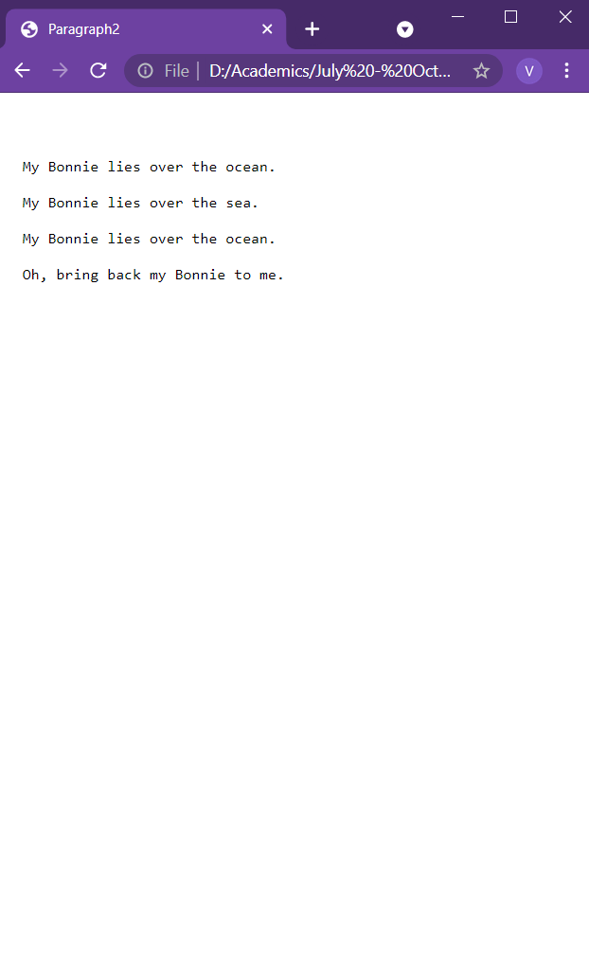
HTML Paragraph
<!DOCTYPE html> <html lang = "en-US"> <head> <title>Paragraph2</title> </head> <body>
<pre> My Bonnie lies over the ocean. My Bonnie lies over the sea. My Bonnie lies over the ocean. Oh, bring back my Bonnie to me. </pre>
</body>
</html>

Slide 115
HTML Styles
The HTML style attribute is used to add styles to an element, such as color, font, size, and more.
Setting the style of an HTML element, can be done with the style attribute.
The HTML style attribute has the following syntax:
<tagname style="property:value;">
The property is a CSS property.
The value is a CSS value.
Properties:
Background Colour
The CSS background-color property defines the background color for an HTML element.
2. Text Color
The CSS color property defines the text color for an HTML element
<!DOCTYPE html> <html lang = "en-US"> <head> <title>Style 1</title> </head> <body style= "background-color:orange;">
<h1 style="background-color:powderblue;">This is a heading</h1> <p style="background-color:tomato;">This is a paragraph.</p>
<h1 style="color:blue;">This is a heading</h1> <p style="color:red;">This is a paragraph.</p>
</body>
</html>

Slide 116
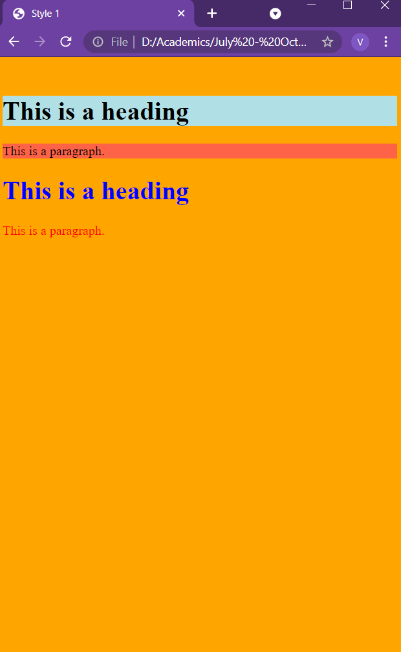
HTML Styles
<!DOCTYPE html> <html lang = "en-US"> <head> <title>Style 1</title> </head> <body style= "background-color:orange;">
<h1 style="background-color:powderblue;">This is a heading</h1> <p style="background-color:tomato;">This is a paragraph.</p>
<h1 style="color:blue;">This is a heading</h1> <p style="color:red;">This is a paragraph.</p>
</body>
</html>

Slide 117
HTML Styles
<!DOCTYPE html> <html lang = "en-US"> <head> <title>Style 2</title> </head> <body>
<h1 style="font-family:verdana;">This is a heading</h1> <p style="font-family:courier;">This is a paragraph.</p>
<h1 style="font-size:300%;">This is a heading</h1> <p style="font-size:160%;">This is a paragraph.</p>
<h1 style="text-align:center;">Centered Heading</h1> <p style="text-align:center;">Centered paragraph.</p>
</body>
</html>
Properties:
3. Font
The CSS font-family property defines the font to be used for an HTML element
4. Text size
The CSS font-size property defines the text size for an HTML element
5. Text Alignment
The CSS text-align property defines the horizontal text alignment for an HTML element

Slide 118
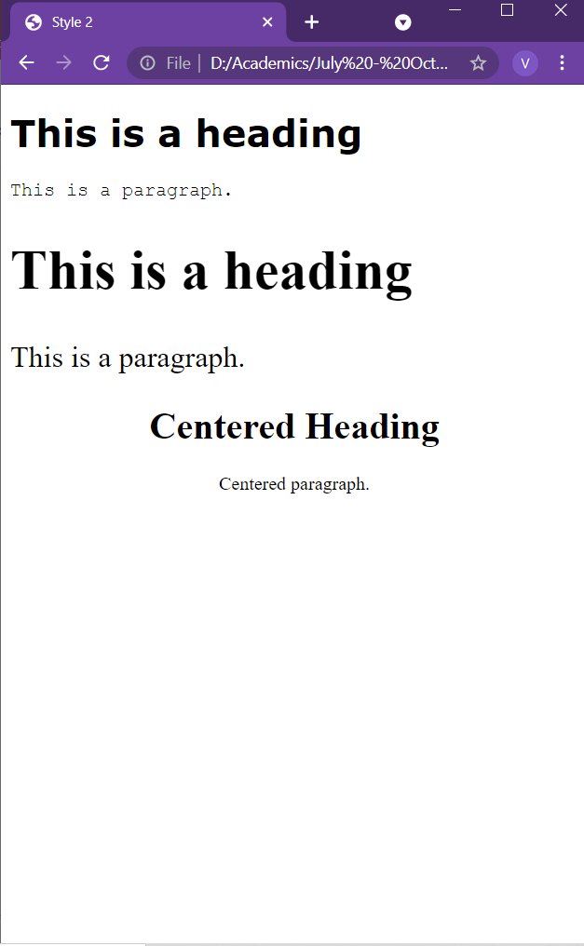
HTML Styles
<!DOCTYPE html> <html lang = "en-US"> <head> <title>Style 2</title> </head> <body>
<h1 style="font-family:verdana;">This is a heading</h1> <p style="font-family:courier;">This is a paragraph.</p>
<h1 style="font-size:300%;">This is a heading</h1> <p style="font-size:160%;">This is a paragraph.</p>
<h1 style="text-align:center;">Centered Heading</h1> <p style="text-align:center;">Centered paragraph.</p>
</body>
</html>

Slide 119
HTML Formatting Elements
HTML <b> Element
It defines bold text, without any extra importance
The HTML <strong> element
It defines text with strong importance.
The content inside is typically displayed in bold.
The HTML <i> element
It defines a part of text in an alternate voice or mood.
The content inside is typically displayed in italic.
The <i> tag is often used to indicate a technical term, a phrase from another language, a thought, a ship name, etc.
The HTML <em> element
It defines emphasized text.
The content inside is typically displayed in italic.
A screen reader will pronounce the words in <em> with an emphasis, using verbal stress.
<!DOCTYPE html> <html lang = "en-US"> <head> <title>Formatting</title> </head> <body>
<p><b>This text is bold</b></p>
<p><strong>This text is important!</strong></p>
<p><i>This text is italic</i></p>
<p><em>This text is emphasized</em></p>
</body>
</html>

Slide 120
HTML Formatting Elements
HTML <small> Element
It defines smaller text
HTML <mark> Element
It defines text that should be marked or highlighted
The HTML <del> element
It defines text that has been deleted from a document.
Browsers will usually strike a line through deleted text
HTML <ins> Element
It defines a text that has been inserted into a document.
Browsers will usually underline inserted text:
<!DOCTYPE html> <html lang = "en-US"> <head> <title>Paragraph</title> </head> <body>
<p><b>This text is bold</b></p>
<p><strong>This text is important!</strong></p>
<p><i>This text is italic</i></p>
<p><em>This text is emphasized</em></p>
<p><small>This is some smaller text.</small></p>
<p>Do not forget to buy <mark>milk</mark> today.</p>
<p>My favorite color is <del>blue</del> <ins>red</ins>.</p>
</body>
</html>

Slide 121
HTML Formatting Elements
<!DOCTYPE html> <html lang = "en-US"> <head> <title>Paragraph</title> </head> <body>
<p><b>This text is bold</b></p>
<p><strong>This text is important!</strong></p>
<p><i>This text is italic</i></p>
<p><em>This text is emphasized</em></p>
<p><small>This is some smaller text.</small></p>
<p>Do not forget to buy <mark>milk</mark> today.</p>
<p>My favorite color is <del>blue</del> <ins>red</ins>.</p>
<p>This is <sub>subscripted</sub> text.</p>
<p>This is <sup>superscripted</sup> text.</p>
</body>
</html>
The HTML <sub> element
It defines subscript text.
Subscript text appears half a character below the normal line, and is sometimes rendered in a smaller font.
Subscript text can be used for chemical formulas, like H₂O
The HTML <sup> element
It defines superscript text.
Superscript text appears half a character above the normal line, and is sometimes rendered in a smaller font.
Superscript text can be used for footnotes, like WWW^{[1]}

Slide 122
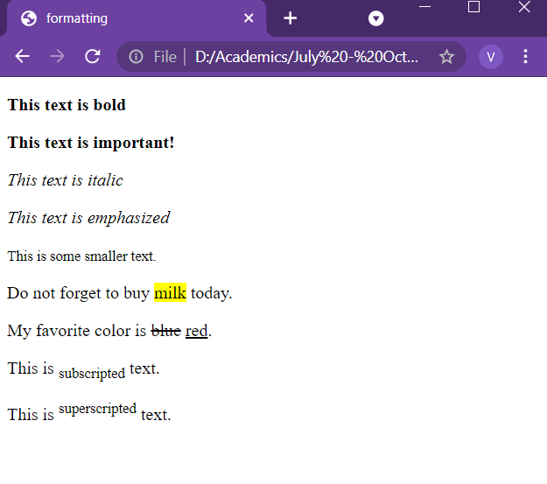
HTML Formatting Elements
<!DOCTYPE html> <html lang = "en-US"> <head> <title>Paragraph</title> </head> <body>
<p><b>This text is bold</b></p>
<p><strong>This text is important!</strong></p>
<p><i>This text is italic</i></p>
<p><em>This text is emphasized</em></p>
<p><small>This is some smaller text.</small></p>
<p>Do not forget to buy <mark>milk</mark> today.</p>
<p>My favorite color is <del>blue</del> <ins>red</ins>.</p>
<p>This is <sub>subscripted</sub> text.</p>
<p>This is <sup>superscripted</sup> text.</p>
</body>
</html>

Slide 123
HTML5

Slide 124
Content
HTML Links
HTML Tables
HTML Lists

Slide 125
HTML Links
Links are found in nearly all web pages. Links allow users to click their way from page to page.
HTML links are hyperlinks.
You can click on a link and jump to another document.
When you move the mouse over a link, the mouse arrow will turn into a little hand.
A link does not have to be text.
A link can be an image or any other HTML element
The HTML <a> tag defines a hyperlink. It has the following syntax:
<a href="url">link text</a>
The most important attribute of the <a> element is the href attribute, which indicates the link's destination.
The link text is the part that will be visible to the reader.
Clicking on the link text, will send the reader to the specified URL address.

Slide 126
HTML Links
By default, links will appear as follows in all browsers:
An unvisited link is underlined and blue
A visited link is underlined and purple
An active link is underlined and red
Links can be styled with CSS, to get another look
By default, the linked page will be displayed in the current browser window.
To change this, specify another target for the link.
The target attribute specifies where to open the linked document.
The target attribute can have one of the following values:
_self - Default. Opens the document in the same window/tab as it was clicked
_blank - Opens the document in a new window or tab
_parent - Opens the document in the parent frame
_top - Opens the document in the full body of the window
<!DOCTYPE html> <html lang = "en-US"> <head> <title>Link</title> </head> <body>
<a href="https://www.w3schools.com/">Visit W3Schools.com!</a>
<a href="https://www.w3schools.com/" target="_blank">Visit W3Schools!</a>
</body>
</html>

Slide 127
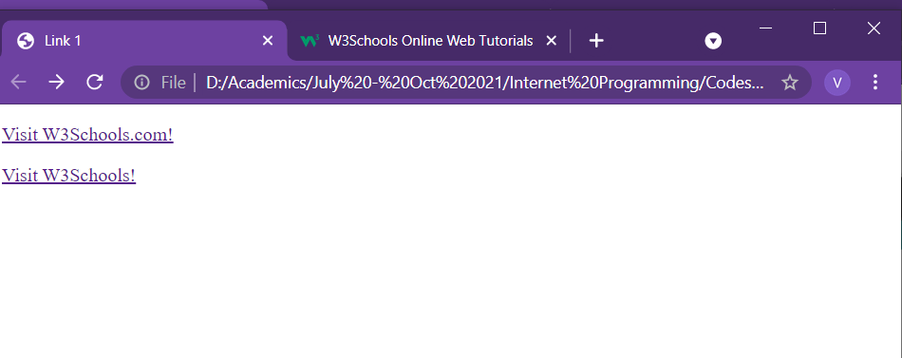
HTML Links
<!DOCTYPE html> <html lang = "en-US"> <head> <title>Link</title> </head> <body>
<a href="https://www.w3schools.com/">Visit W3Schools.com!</a>
<a href="https://www.w3schools.com/" target="_blank">Visit W3Schools!</a>
</body>
</html>

Slide 128
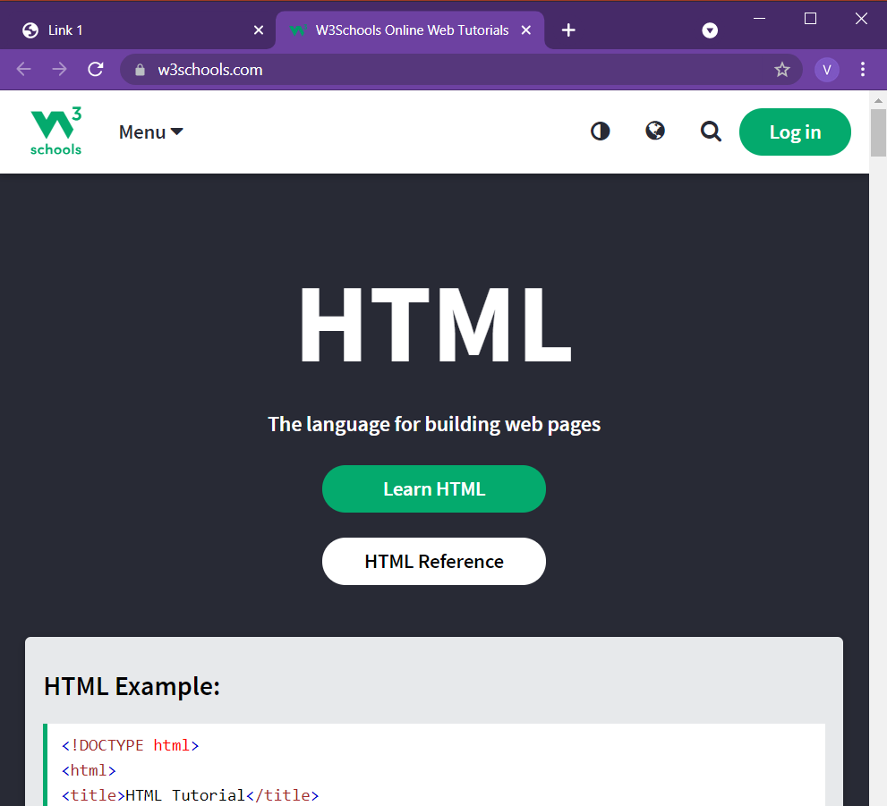
HTML Links
<!DOCTYPE html> <html lang = "en-US"> <head> <title>Link</title> </head> <body>
<a href="https://www.w3schools.com/">Visit W3Schools.com!</a>
<a href="https://www.w3schools.com/" target="_blank">Visit W3Schools!</a>
</body>
</html>

Slide 129
HTML Links
<!DOCTYPE html> <html lang = "en-US"> <head> <title>Link 2</title> </head> <body>
<h2>Absolute URLs</h2> <p><a href="https://www.w3.org/">W3C</a></p> <p><a href="https://www.google.com/">Google</a></p> <h2>Relative URLs</h2> <p><a href="html_images.asp">HTML Images</a></p> <p><a href="/css/default.asp">CSS Tutorial</a></p>
</body>
</html>
Absolute and Relative URL
Absolute URL: Full web address in the href attribute
Relative URL: A local link – page within the same website

Slide 130
HTML Links
<!DOCTYPE html> <html lang = "en-US"> <head> <title>Link 2</title> </head> <body>
<a href="default.asp"> <img src="smiley.jpeg" alt="HTML tutorial" style="width:42px;height:42px;"> </a>
<a href="mailto:someone@example.com">Send email</a>
<button onclick="document.location='default.asp’”>Formatting Page</button>
</body>
</html>
Use an Image as a link
To use an image as a link, just put the <img> tag inside the <a> tag
Link to an Email Address
Use mailto: inside the href attribute to create a link that opens the user's email program (to let them send a new mail)
Button as a link
JavaScript allows you to specify what happens at certain events, such as a click of a button

Slide 131
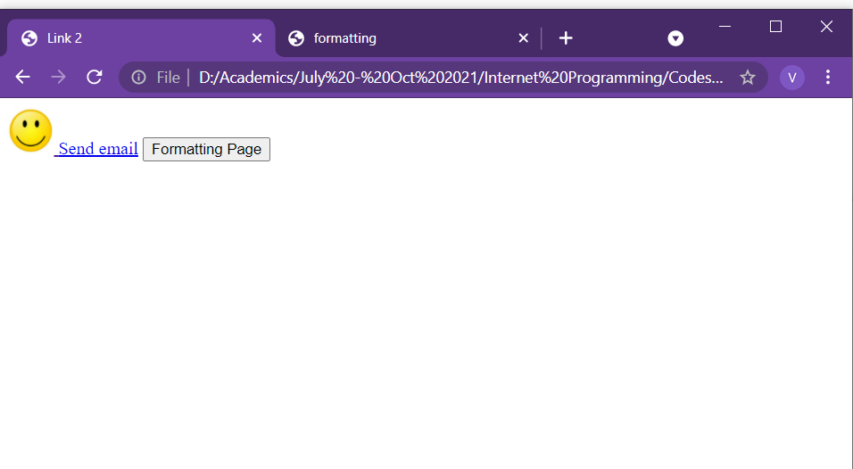
HTML Links
<!DOCTYPE html> <html lang = "en-US"> <head> <title>Link 2/title> </head> <body>
<a href="default.asp"> <img src="smiley.jpeg" alt="HTML tutorial" style="width:42px;height:42px;"> </a>
<a href="mailto:someone@example.com">Send email</a>
<button onclick="document.location='default.asp’”>Formatting Page</button>
</body>
</html>

Slide 132
HTML Tables
<!DOCTYPE html> <html lang = "en-US"> <head> <title>Table</title> </head> <body>
<table style="width:100%"> <tr> <th>Firstname</th> <th>Lastname</th> <th>Age</th> </tr> <tr> <td>Suresh</td> <td>Kumar</td> <td>50</td> </tr> <tr> <td>Nageshwar</td> <td>Rao</td> <td>65</td> </tr> </table>
</body>
</html>
It allows web developers to arrange data into rows and columns
<table> tag: defines an HTML table.
<tr> tag: It defines row in the table
<th> tag: It defines table header
<td> tag: It defines table data/cell
By default, the text in <th> elements are bold and centered.
By default, the text in <td> elements are regular and left-aligned.

Slide 133
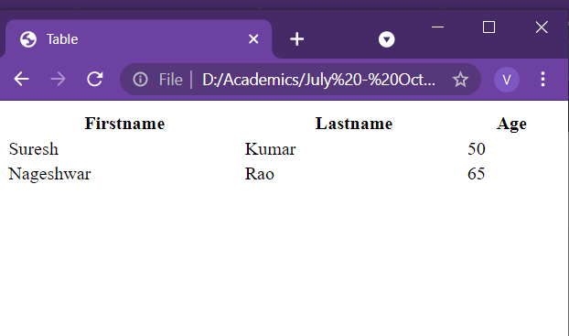
HTML Tables
<!DOCTYPE html> <html lang = "en-US"> <head> <title>Table</title> </head> <body>
<table> <tr> <th>Firstname</th> <th>Lastname</th> <th>Age</th> </tr> <tr> <td>Suresh</td> <td>Kumar</td> <td>50</td> </tr> <tr> <td>Nageshwar</td> <td>Rao</td> <td>65</td> </tr> </table>
</body>
</html>

Slide 134
HTML Tables
Border for Table
To add a border to a table, use the CSS border property
Put the following code in head tag
<style>
table, th, td {
border: 1px solid black;
}
</style>
<!DOCTYPE html> <html lang = "en-US"> <head> <title>Table</title>
<style>
table, th, td { border: 1px solid black; }
</style>
</head> <body>
<table> <tr> <th>Firstname</th> <th>Lastname</th> <th>Age</th> </tr> <tr> <td>Suresh</td> <td>Kumar</td> <td>50</td> </tr> <tr> <td>Nageshwar</td> <td>Rao</td> <td>65</td> </tr> </table>
</body>
</html>

Slide 135
HTML Tables
Collapsed Border
To let the borders collapse into one border, add the CSS border-collapse property:
<style>
table, th, td {
border: 1px solid black;
border-collapse: collapse;
}
</style>
<!DOCTYPE html> <html lang = "en-US"> <head> <title>Table</title>
<style>
table, th, td { border: 1px solid black;
border-collapse: collapse; }
</style>
</head> <body>
<table> <tr> <th>Firstname</th> <th>Lastname</th> <th>Age</th> </tr> <tr> <td>Suresh</td> <td>Kumar</td> <td>50</td> </tr> <tr> <td>Nageshwar</td> <td>Rao</td> <td>65</td> </tr> </table>
</body>
</html>

Slide 136
HTML Tables
Cell Padding
Cell padding specifies the space between the cell content and its borders.
If padding is not specified, the table cells will be displayed without padding.
To set the padding, use the CSS padding property:
th, td {
padding: 15px;
}
Left Align Headings
By default, table headings are bold and centered.
To left-align the table headings, use the CSS text-align property:
th {
text-align: left;
}
Border Spacing
Border spacing specifies the space between the cells.
If the table has collapsed borders, border-spacing has no effect.
To set the border spacing for a table, use the CSS border-spacing property:
table {
border-spacing: 5px;
}
<!DOCTYPE html> <html lang = "en-US"> <head> <title>Table</title>
<style>
table, th, td { border: 1px solid black;
border-collapse: collapse; }
th, td { padding: 15px; }
</style>
</head> <body>
<table> <tr> <th>Firstname</th> <th>Lastname</th> <th>Age</th> </tr> <tr> <td>Suresh</td> <td>Kumar</td> <td>50</td> </tr> <tr> <td>Nageshwar</td> <td>Rao</td> <td>65</td> </tr> </table>
</body>
</html>

Slide 137
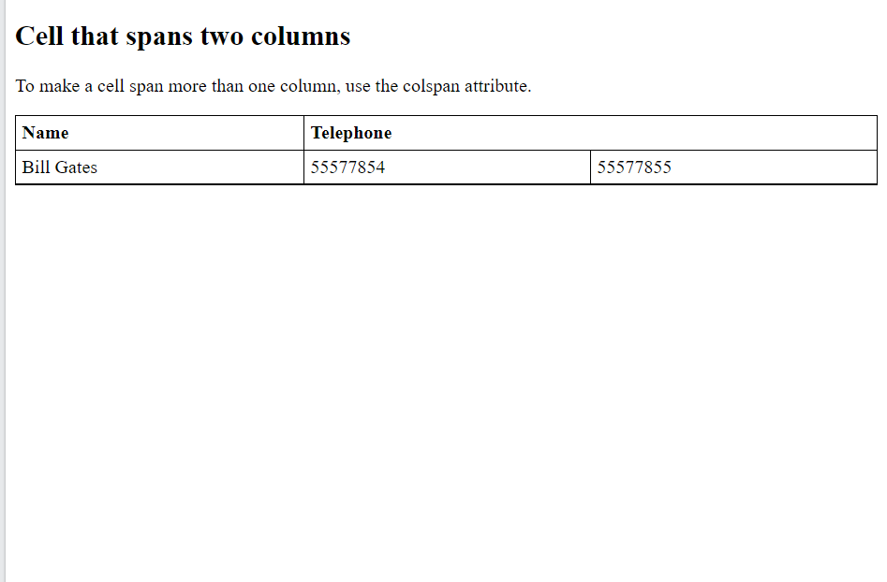
HTML Tables
<!DOCTYPE html> <html lang = "en-US"> <head> <title>Table</title>
<style>
table, th, td { border: 1px solid black;
border-collapse: collapse; }
th, td { padding: 5px;
text-align: left; }
</style>
</head> <body>
<table style="width:100%"> <tr> <th>Name</th> <th colspan="2">Telephone</th> </tr> <tr> <td>Bill Gates</td> <td>55577854</td> <td>55577855</td> </tr> </table>
</body>
</html>
Cell that spans many columns
To make a cell span more than one column, use the colspan attribute:

Slide 138
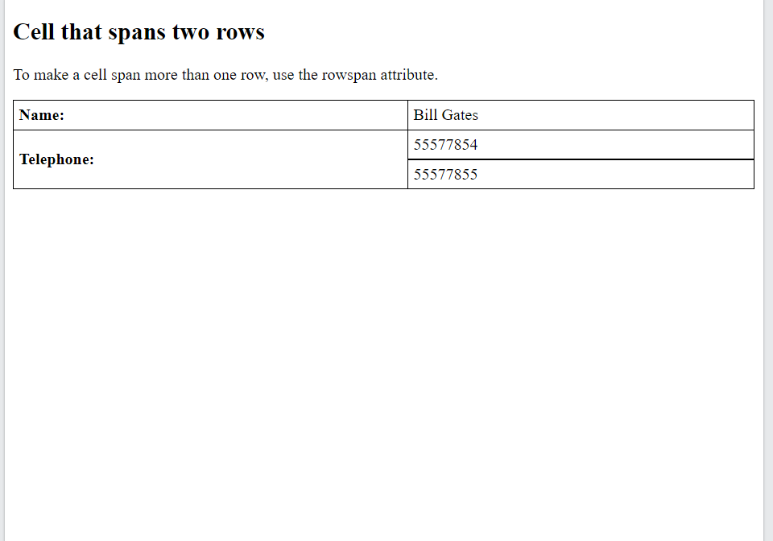
HTML Tables
<!DOCTYPE html> <html lang = "en-US"> <head> <title>Table</title>
<style>
table, th, td { border: 1px solid black;
border-collapse: collapse; }
th, td { padding: 5px;
text-align: left; }
</style>
</head> <body>
<table style="width:100%"> <tr> <th>Name:</th> <td>Bill Gates</td> </tr> <tr> <th rowspan="2">Telephone:</th> <td>55577854</td> </tr> <tr> <td>55577855</td> </tr> </table>
</body>
</html>
Cell that spans many rows
To make a cell span more than one column, use the rowspan attribute

Slide 139
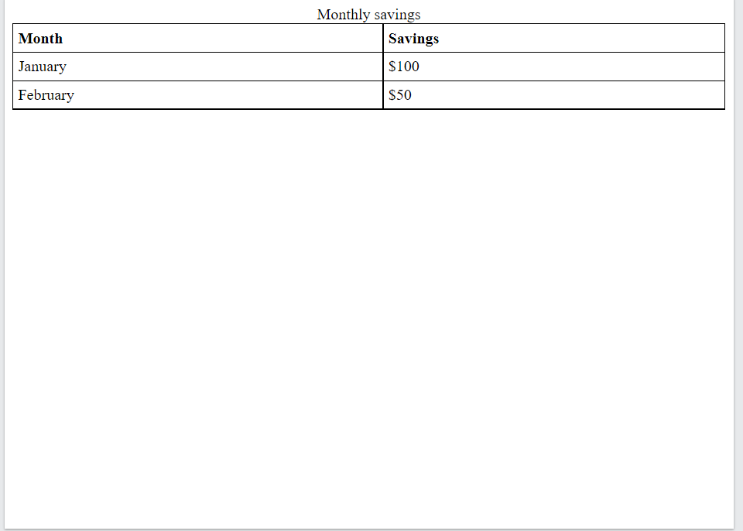
HTML Tables
<!DOCTYPE html> <html lang = "en-US"> <head> <title>Table</title>
<style>
table, th, td { border: 1px solid black;
border-collapse: collapse; }
th, td { padding: 5px;
text-align: left; }
</style>
</head> <body>
<table style="width:100%"> <caption>Monthly savings</caption> <tr> <th>Month</th> <th>Savings</th> </tr> <tr> <td>January</td> <td>$100</td> </tr> <tr> <td>February</td> <td>$50</td> </tr> </table>
</body>
</html>
Caption for the table
Use <caption> tag to add caption for table

Slide 140
HTML Lists
HTML lists allow web developers to group a set of related items in lists.
There are three types
Unordered lists
Ordered lists
Other lists

Slide 141
HTML Lists
Unordered list
An unordered list starts with the <ul> tag.
Each list item starts with the <li> tag.
The list items will be marked with bullets (small black circles) by default
The CSS list-style-type property is used to define the style of the list item marker.
It can have one of the following values:
Value Description
disc Sets the list item marker to a bullet (default)
circle Sets the list item marker to a circle
square Sets the list item marker to a square
none The list items will not be marked
<!DOCTYPE html> <html lang = "en-US"> <head> <title>List</title>
</head> <body>
<ul> <li>Coffee</li> <li>Tea</li> <li>Milk</li> </ul>
<ul style="list-style-type:disc;"> <li>Coffee</li> <li>Tea</li> <li>Milk</li> </ul>
<ul style="list-style-type:none;"> <li>Coffee</li> <li>Tea</li> <li>Milk</li> </ul>
</body>
</html>

Slide 142
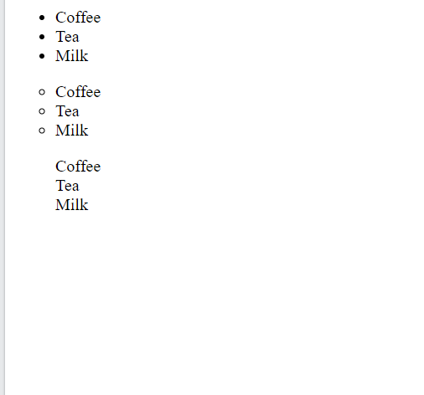
HTML Lists
<!DOCTYPE html> <html lang = "en-US"> <head> <title>List</title>
</head> <body>
<ul> <li>Coffee</li> <li>Tea</li> <li>Milk</li> </ul>
<ul style="list-style-type:disc;"> <li>Coffee</li> <li>Tea</li> <li>Milk</li> </ul>
<ul style="list-style-type:none;"> <li>Coffee</li> <li>Tea</li> <li>Milk</li> </ul>
</body>
</html>

Slide 143
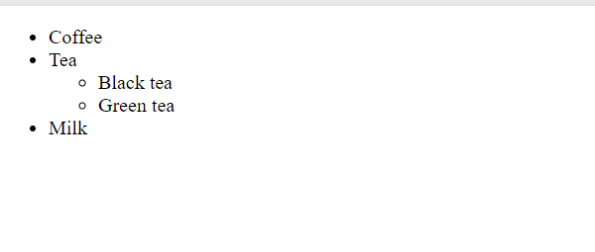
HTML Lists
<!DOCTYPE html> <html lang = "en-US"> <head> <title>List</title>
</head> <body>
<ul> <li>Coffee</li> <li>Tea <ul> <li>Black tea</li> <li>Green tea</li> </ul> </li> <li>Milk</li> </ul>
</body>
</html>
Nested list
Lists can be nested

Slide 144
HTML Lists
Ordered list
The HTML <ol> tag defines an ordered list.
An ordered list can be numerical or alphabetical.
An ordered list starts with the <ol> tag.
Each list item starts with the <li> tag.
The list items will be marked with numbers by default
The type attribute of the <ol> tag, defines the type of the list item marker:
Type Description
type="1" The list items will be numbered with numbers (default)
type="A" The list items will be numbered with uppercase letters
type="a" The list items will be numbered with lowercase letters
type="I" The list items will be numbered with uppercase roman numbers
type="i" The list items will be numbered with lowercase roman numbers
<!DOCTYPE html> <html lang = "en-US"> <head> <title>List</title>
</head> <body>
<ol> <li>Coffee</li> <li>Tea</li> <li>Milk</li> </ol>
<ol type="A"> <li>Coffee</li> <li>Tea</li> <li>Milk</li> </ol>
<ol type="I"> <li>Coffee</li> <li>Tea</li> <li>Milk</li> </ol>
</body>
</html>

Slide 145
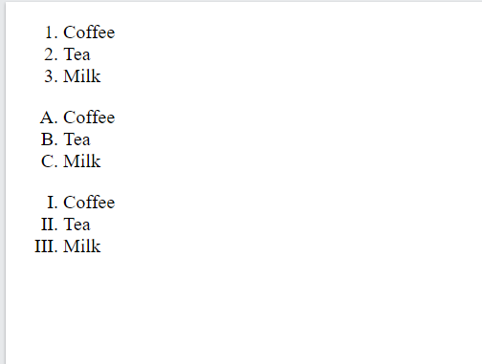
HTML Lists
<!DOCTYPE html> <html lang = "en-US"> <head> <title>List</title>
</head> <body>
<ol> <li>Coffee</li> <li>Tea</li> <li>Milk</li> </ol>
<ol type="A"> <li>Coffee</li> <li>Tea</li> <li>Milk</li> </ol>
<ol type="I"> <li>Coffee</li> <li>Tea</li> <li>Milk</li> </ol>
</body>
</html>

Slide 146
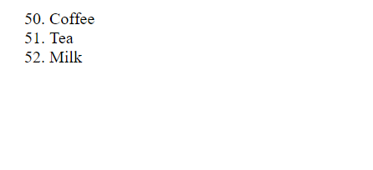
HTML Lists
<!DOCTYPE html> <html lang = "en-US"> <head> <title>List</title>
</head> <body>
<ol start="50"> <li>Coffee</li> <li>Tea</li> <li>Milk</li> </ol>
</body>
</html>
Control List counting
By default, an ordered list will start counting from 1.
If counting has to be started from a specified number, use the start attribute

Slide 147
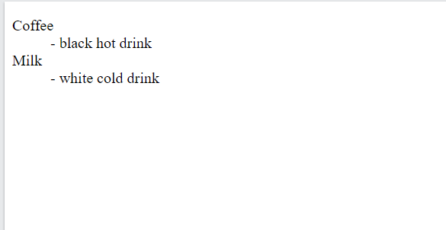
HTML Lists
Description list
A description list is a list of terms, with a description of each term.
The <dl> tag defines the description list
The <dt> tag defines the term (name)
The <dd> tag describes each term
<!DOCTYPE html> <html lang = "en-US"> <head> <title>List</title>
</head> <body>
<dl> <dt>Coffee</dt> <dd>- black hot drink</dd> <dt>Milk</dt> <dd>- white cold drink</dd> </dl>
</body>
</html>

Slide 148
HTML5

Slide 149
Content
Image
Control Elements

Slide 150
HTML Images
Images can improve the design and the appearance of a web page.
The HTML <img> tag is used to embed an image in a web page.
Images are not technically inserted into a web page; images are linked to web pages.
The <img> tag creates a holding space for the referenced image.
The <img> tag is empty, it contains attributes only, and does not have a closing tag.
The <img> tag has two required attributes:
src - Specifies the path to the image
alt - Specifies an alternate text for the image
The broken link icon and the alt text are shown if the browser cannot find the image.

Slide 151
HTML Images
<!DOCTYPE html> <html lang = "en-US"> <head> <title>Images</title> </head> <body>
<img src=“smiley.jpg" alt=“smiley image" width="500" height="600">
<img src="/images/html5.gif" alt="HTML5 Icon" style="width:128px;height:128px;">
<img src="https://www.w3schools.com/images/w3schools_green.jpg" alt="W3Schools.com">
</body>
</html>
Style attribute can be used to specify width and height of the image
Another alternative: Use width and height attribute.
Values are always mentioned in pixels
If images are in subfolder then include folder name in src attribute
Some web sites point to an image on another server.
To point to an image on another server, specify an absolute (full) URL in the src attribute
Animated images are also supported such as gif

Slide 152
HTML Images
<!DOCTYPE html> <html lang = "en-US"> <head> <title>Images</title> </head> <body>
<img src=“smiley.jpg" alt=“smiley image" width="500" height="600">
<img src="/images/html5.gif" alt="HTML5 Icon" style="width:128px;height:128px;">
<img src="https://www.w3schools.com/images/w3schools_green.jpg" alt="W3Schools.com">
</body>
</html>
Common Image Formats
The most common image file types, which are supported in all browsers:
Abbreviation File Format File Extension
APNG Animated Portable Network Graphics .apng
GIF Graphics Interchange Format .gif
ICO Microsoft Icon .ico, .cur
JPEG Joint Photographic Expert Group image .jpg, .jpeg, .jfif, .pjpeg, .pjp
PNG Portable Network Graphics .png
SVG Scalable Vector Graphics .svg

Slide 153
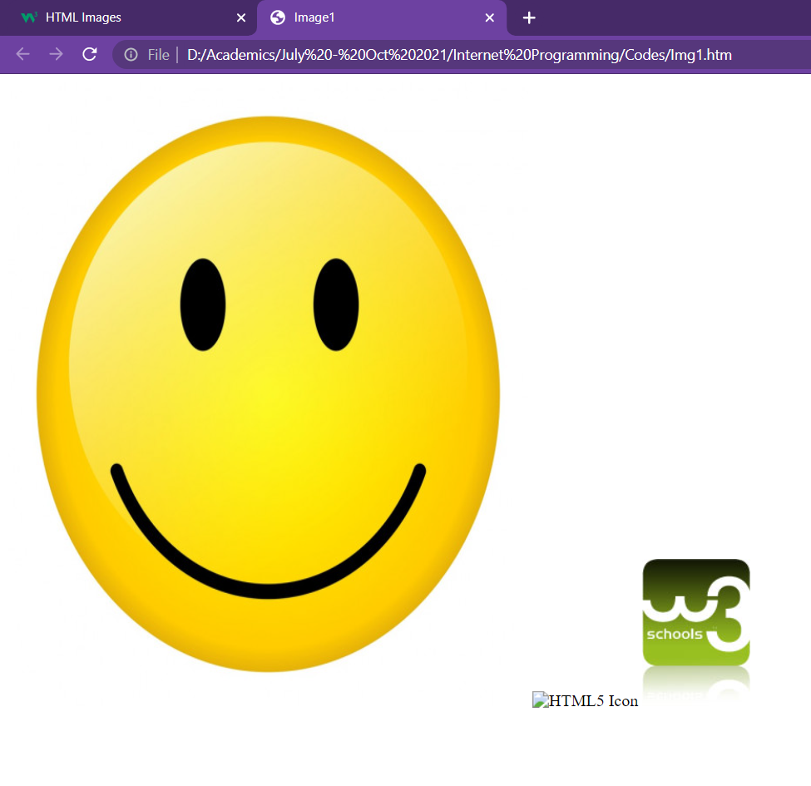
HTML Images
<!DOCTYPE html> <html lang = "en-US"> <head> <title>Images</title> </head> <body>
<img src=“smiley.jpg" alt=“smiley image" width="500" height="600">
<img src="/images/html5.gif" alt="HTML5 Icon" style="width:128px;height:128px;">
<img src="https://www.w3schools.com/images/w3schools_green.jpg" alt="W3Schools.com">
</body>
</html>

Slide 154
HTML Images
<!DOCTYPE html> <html> <head> <style> img { width: 100%; } </style> </head> <body> <img src="html5.gif" alt="HTML5 Icon" width="128" height="128"> <img src="html5.gif" alt="HTML5 Icon" style="width:128px;height:128px;"> </body> </html>
The width, height, and style attributes are all valid in HTML.
Using the style attribute is always preferable.
It prevents styles sheets from changing the size of images

Slide 155
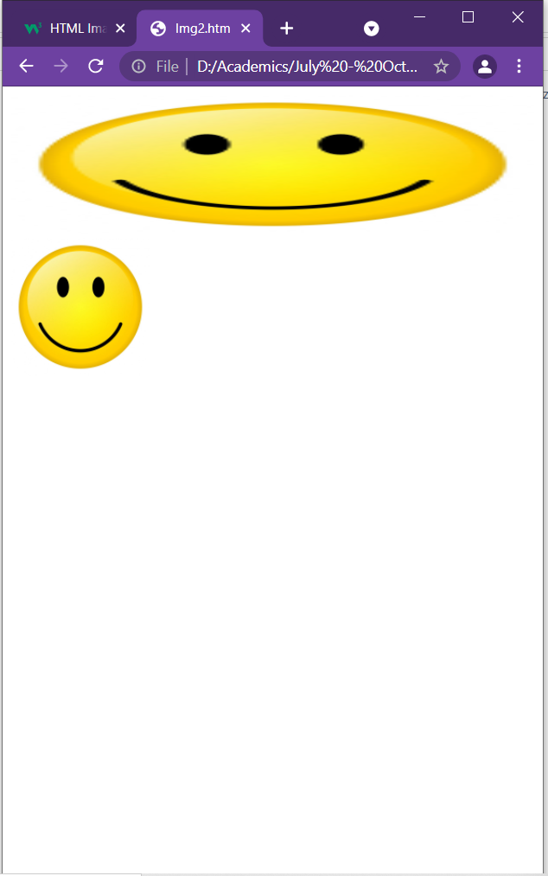
HTML Images
<!DOCTYPE html> <html> <head> <style> img { width: 100%; } </style> </head> <body> <img src="html5.gif" alt="HTML5 Icon" width="128" height="128"> <img src="html5.gif" alt="HTML5 Icon" style="width:128px;height:128px;"> </body> </html>

Slide 156
HTML Forms
An HTML form is used to collect user input.
The user input is most often sent to a server for processing.
The <form> Element
The HTML <form> element is used to create an HTML form for user input:
<form>
. . .
form elements
. . .
</form>
The <form> element is a container for different types of input elements, such as: text fields, checkboxes, radio buttons, submit buttons, etc.

Slide 157
HTML Form Elements
The HTML <form> element can contain one or more of the following form elements:
<input>
<label>
<select>
<textarea>
<button>
<fieldset>
<legend>
<datalist>
<output>
<option>
<optgroup>

Slide 158
HTML Form Elements
<!DOCTYPE html> <html> <head> </head> <body> <form> <label for="fname">First name:</label><br> <input type="text" id="fname" name="fname"><br> <label for="lname">Last name:</label><br> <input type="text" id="lname" name="lname"> </form> </body> </html>
The <input> Element
One of the most used form element is the <input> element.
The <input> element can be displayed in several ways, depending on the type attribute.
The <label> Element
It defines a label for several form elements.
It is useful for screen-reader users
The <label> element also help users who have difficulty clicking on very small regions
The for attribute of the <label> tag should be equal to the id attribute of the <input> element to bind them together.

Slide 159
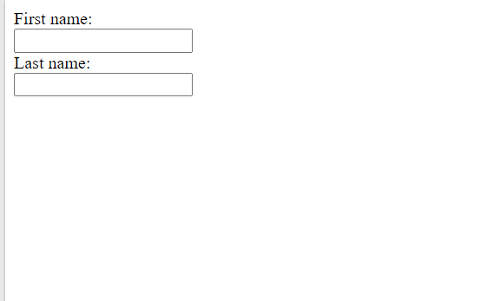
HTML Form Elements
<!DOCTYPE html> <html> <head> </head> <body> <form> <label for="fname">First name:</label><br> <input type="text" id="fname" name="fname"><br> <label for="lname">Last name:</label><br> <input type="text" id="lname" name="lname"> </form> </body> </html>

Slide 160
HTML Form Elements
<!DOCTYPE html> <html> <head> </head> <body> <form> <label for="fname">First name:</label><br> <input type="text" id="fname" name="fname"><br> <label for="lname">Last name:</label><br> <input type="text" id="lname" name="lname"><br>
<p>
<label for="cars">Choose a car:</label> <select id="cars" name="cars" size=“1"> <option value="volvo">Volvo</option> <option value="saab">Saab</option> <option value="fiat">Fiat</option> <option value="audi">Audi</option> </select>
</p> </form> </body> </html>
The <select> Element
It defines drop-down list
The <option> elements
It defines an option that can be selected.
By default, the first item in the drop-down list is selected.
To define a pre-selected option, add the selected attribute to the option
Use the multiple attribute to allow the user to select more than one value:
attribute of the <input> element to bind them together.

Slide 161
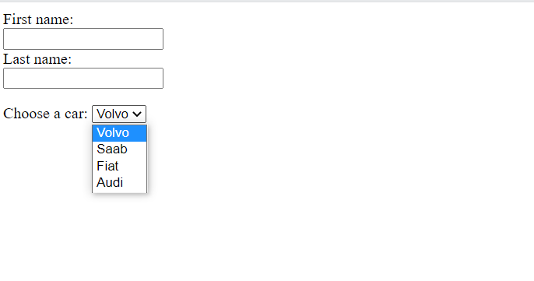
HTML Form Elements
<!DOCTYPE html> <html> <head> </head> <body> <form> <label for="fname">First name:</label><br> <input type="text" id="fname" name="fname"><br> <label for="lname">Last name:</label><br> <input type="text" id="lname" name="lname"><br>
<p>
<label for="cars">Choose a car:</label> <select id="cars" name="cars" size=“1"> <option value="volvo">Volvo</option> <option value="saab">Saab</option> <option value="fiat">Fiat</option> <option value="audi">Audi</option> </select>
</p> </form> </body> </html>

Slide 162
HTML Form Elements
<!DOCTYPE html> <html> <head> </head> <body> <form> <fieldset> <legend>Personalia:</legend> <label for="name">Name:</label><br> <input type="text" id="name" name="name" value="John"><br> <label for=“address">Address:</label><br> <textarea name="message" style="width:200px; height:200px;"> Mumbai </textarea> <br>
<button type="button" onclick="alert('Hello World!')">Click Me!</button> </fieldset>
</form> </body> </html>
The <textarea> Element
The <textarea> element defines a multi-line input field (a text area)
The rows attribute specifies the visible number of lines in a text area.
The cols attribute specifies the visible width of a text area.
The <button> element
It defines a clickable button
The <fieldset> and <legend> element
The <fieldset> element is used to group related data in a form.
The <legend> element defines a caption for the <fieldset> element.

Slide 163
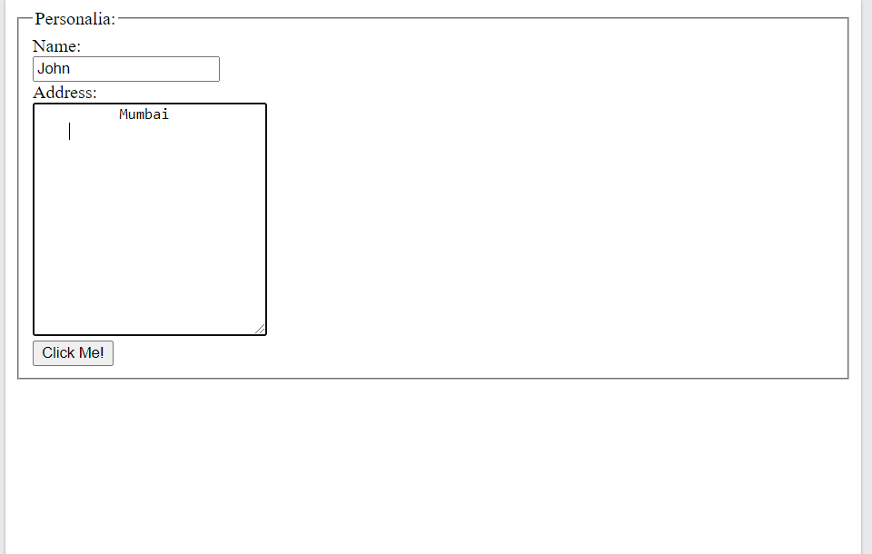
HTML Form Elements
<!DOCTYPE html> <html> <head> </head> <body> <form> <fieldset> <legend>Personalia:</legend> <label for="name">Name:</label><br> <input type="text" id="name" name="name" value="John"><br> <label for=“address">Address:</label><br> <textarea name="message" style="width:200px; height:200px;"> Mumbai </textarea> <br>
<button type="button" onclick="alert('Hello World!')">Click Me!</button> </fieldset>
</form> </body> </html>

Slide 164
HTML Form Elements
<!DOCTYPE html> <html> <head> </head> <body> <form> <label for="fname">First name:</label><br> <input type="text" id="fname" name="fname"><br> <label for="lname">Last name:</label><br> <input type="text" id="lname" name="lname"><br>
<p><label for=“browser">Browser</label><br>
<input list="browsers"> <datalist id="browsers"> <option value="Internet Explorer"> <option value="Firefox"> <option value="Chrome"> <option value="Opera"> <option value="Safari"> </datalist>
</p> </form> </body> </html>
The <datalist> Element
It specifies a list of pre-defined options for an <input> element.
Users will see a drop-down list of the pre-defined options as they input data.
The list attribute of the <input> element, must refer to the id attribute of the <datalist> element.

Slide 165
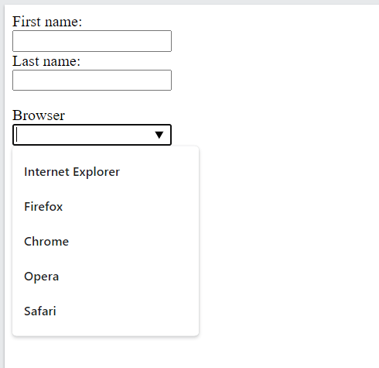
HTML Form Elements
<!DOCTYPE html> <html> <head> </head> <body> <form> <label for="fname">First name:</label><br> <input type="text" id="fname" name="fname"><br> <label for="lname">Last name:</label><br> <input type="text" id="lname" name="lname"><br>
<p><label for=“browser">Browser</label><br>
<input list="browsers"> <datalist id="browsers"> <option value="Internet Explorer"> <option value="Firefox"> <option value="Chrome"> <option value="Opera"> <option value="Safari"> </datalist>
</p> </form> </body> </html>

Slide 166
HTML Form Input Types
There are different input types can be used in HTML
<input type="button"> <input type="checkbox">
<input type="color"> <input type="date">
<input type="datetime-local"> <input type="email">
<input type="file"> <input type="hidden">
<input type="image"> <input type="month">
<input type="number"> <input type="password">
<input type="radio"> <input type="range">
<input type="reset"> <input type="search">
<input type="submit"> <input type="tel">
<input type="text"> <input type="time">
<input type="url"> <input type="week">
The default value of the type attribute is "text".

Slide 167
HTML Form Input Types
Input type Text
<input type="text"> defines a single-line text input field
Input type Password
<input type="password"> defines a password field
The characters in a password field are masked (shown as asterisks or circles)
Input type Submit
<input type="submit"> defines a button for submitting form data to a form-handler.
The form-handler is typically a server page with a script for processing input data.
The form-handler is specified in the form's action attribute
If you omit the submit button's value attribute, the button will get a default text
Input type Reset
<input type="reset"> defines a reset button that will reset all form values to their default values
<!DOCTYPE html> <html> <head> </head> <body> <form> <label for="fname">First name:</label><br> <input type="text" id="fname" name="fname"><br> <label for=“pwd">Password:</label><br> <input type=“password" id=“pwd" name=“pwd"><br><br> <input type="submit" value="Submit"> <input type="reset"> </form> </body> </html>

Slide 168
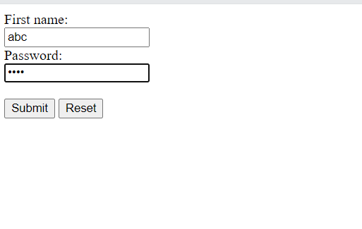
HTML Form Input Types
<!DOCTYPE html> <html> <head> </head> <body> <form> <label for="fname">First name:</label><br> <input type="text" id="fname" name="fname"><br> <label for=“pwd">Password:</label><br> <input type=“password" id=“pwd" name=“pwd"><br><br> <input type="submit" value="Submit"> <input type="reset"> </form> </body> </html>

Slide 169
HTML Form Input Types
<!DOCTYPE html> <html> <head> </head> <body> <form> <input type="radio" id="html" name="fav_language" value="HTML"> <label for="html">HTML</label><br> <input type="radio" id="css" name="fav_language" value="CSS"> <label for="css">CSS</label><br> <input type="radio" id="javascript" name="fav_language" value="JavaScript"> <label for="javascript">JavaScript</label> <hr>
<input type="checkbox" id="vehicle1" name="vehicle1" value="Bike"> <label for="vehicle1"> I have a bike</label><br> <input type="checkbox" id="vehicle2" name="vehicle2" value="Car"> <label for="vehicle2"> I have a car</label><br> <input type="checkbox" id="vehicle3" name="vehicle3" value="Boat"> <label for="vehicle3"> I have a boat</label>
</form> </body> </html>
Input type Radio
<input type="radio"> defines a radio button.
Radio buttons let a user select ONLY ONE of a limited number of choices
Input type Checkbox
<input type="checkbox"> defines a checkbox.
Checkboxes let a user select ZERO or MORE options of a limited number of choices.

Slide 170
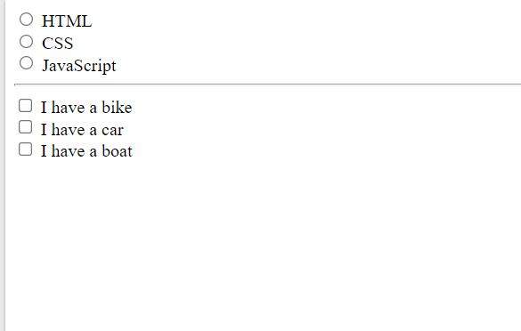
HTML Form Input Types
<!DOCTYPE html> <html> <head> </head> <body> <form> <input type="radio" id="html" name="fav_language" value="HTML"> <label for="html">HTML</label><br> <input type="radio" id="css" name="fav_language" value="CSS"> <label for="css">CSS</label><br> <input type="radio" id="javascript" name="fav_language" value="JavaScript"> <label for="javascript">JavaScript</label> <hr>
<input type="checkbox" id="vehicle1" name="vehicle1" value="Bike"> <label for="vehicle1"> I have a bike</label><br> <input type="checkbox" id="vehicle2" name="vehicle2" value="Car"> <label for="vehicle2"> I have a car</label><br> <input type="checkbox" id="vehicle3" name="vehicle3" value="Boat"> <label for="vehicle3"> I have a boat</label>
</form> </body> </html>

Slide 171
HTML Form Input Types
Input type Button
<input type="button"> defines a button
Input type Color
The <input type="color"> is used for input fields that should contain a color.
Depending on browser support, a color picker can show up in the input field.
Input type Date
The <input type="date"> is used for input fields that should contain a date.
Depending on browser support, a date picker can show up in the input field.
You can also use the min and max attributes to add restrictions to dates
Input type File
The <input type="file"> defines a file-select field and a "Browse" button for file uploads.
Input type Email
The <input type="email"> is used for input fields that should contain an e-mail address.
The e-mail address can be automatically validated when submitted.
Some smartphones recognize the email type, and add ".com" to the keyboard to match email input.
<!DOCTYPE html> <html> <head> </head> <body> <form> <input type="button" onclick="alert('Hello World!')" value="Click Me!"> <hr>
<label for="favcolor">Select your favorite color:</label> <input type="color" id="favcolor" name="favcolor"> <hr>
<label for="datemax">Enter a date before 1980-01-01:</label> <input type="date" id="datemax" name="datemax" max="1979-12-31"><br><br> <label for="datemin">Enter a date after 2000-01-01:</label> <input type="date" id="datemin" name="datemin" min="2000-01-02"> <hr>
<label for="myfile">Select a file:</label> <input type="file" id="myfile" name="myfile"> <hr>
<label for="email">Enter your email:</label> <input type="email" id="email" name="email">
</form> </body> </html>

Slide 172
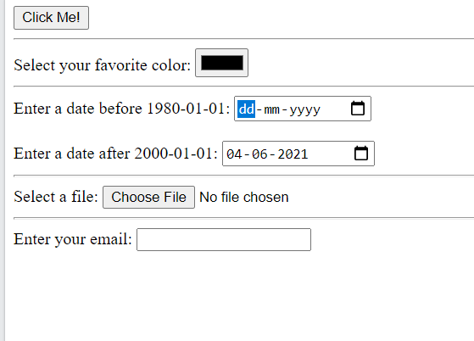
HTML Form Input Types
<!DOCTYPE html> <html> <head> </head> <body> <form> <input type="button" onclick="alert('Hello World!')" value="Click Me!"> <hr>
<label for="favcolor">Select your favorite color:</label> <input type="color" id="favcolor" name="favcolor"> <hr>
<label for="datemax">Enter a date before 1980-01-01:</label> <input type="date" id="datemax" name="datemax" max="1979-12-31"><br><br> <label for="datemin">Enter a date after 2000-01-01:</label> <input type="date" id="datemin" name="datemin" min="2000-01-02"> <hr>
<label for="myfile">Select a file:</label> <input type="file" id="myfile" name="myfile"> <hr>
<label for="email">Enter your email:</label> <input type="email" id="email" name="email">
</form> </body> </html>

Slide 173
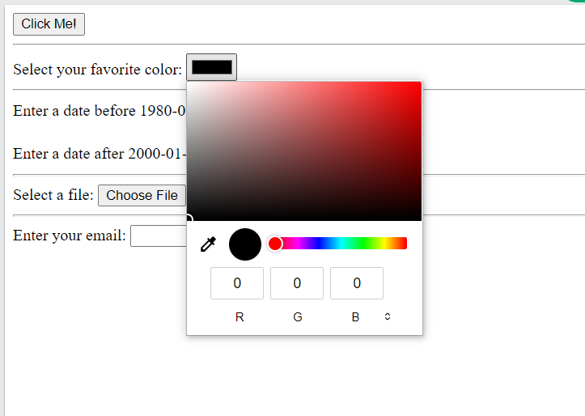
HTML Form Input Types
<!DOCTYPE html> <html> <head> </head> <body> <form> <input type="button" onclick="alert('Hello World!')" value="Click Me!"> <hr>
<label for="favcolor">Select your favorite color:</label> <input type="color" id="favcolor" name="favcolor"> <hr>
<label for="datemax">Enter a date before 1980-01-01:</label> <input type="date" id="datemax" name="datemax" max="1979-12-31"><br><br> <label for="datemin">Enter a date after 2000-01-01:</label> <input type="date" id="datemin" name="datemin" min="2000-01-02"> <hr>
<label for="myfile">Select a file:</label> <input type="file" id="myfile" name="myfile"> <hr>
<label for="email">Enter your email:</label> <input type="email" id="email" name="email">
</form> </body> </html>

Slide 174
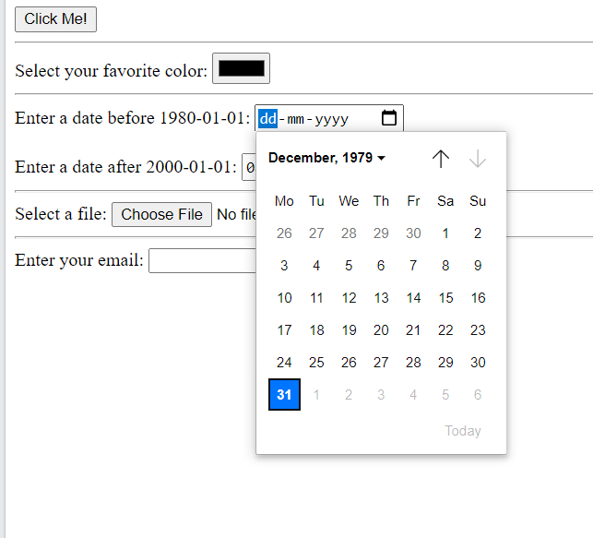
HTML Form Input Types
<!DOCTYPE html> <html> <head> </head> <body> <form> <input type="button" onclick="alert('Hello World!')" value="Click Me!"> <hr>
<label for="favcolor">Select your favorite color:</label> <input type="color" id="favcolor" name="favcolor"> <hr>
<label for="datemax">Enter a date before 1980-01-01:</label> <input type="date" id="datemax" name="datemax" max="1979-12-31"><br><br> <label for="datemin">Enter a date after 2000-01-01:</label> <input type="date" id="datemin" name="datemin" min="2000-01-02"> <hr>
<label for="myfile">Select a file:</label> <input type="file" id="myfile" name="myfile"> <hr>
<label for="email">Enter your email:</label> <input type="email" id="email" name="email">
</form> </body> </html>

Slide 175
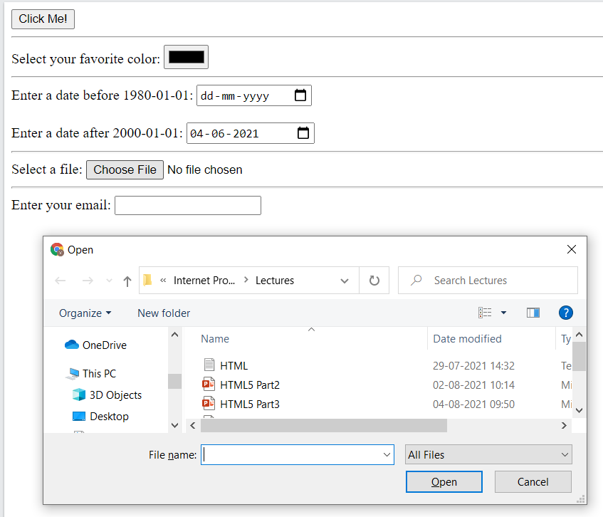
HTML Form Input Types
<!DOCTYPE html> <html> <head> </head> <body> <form> <input type="button" onclick="alert('Hello World!')" value="Click Me!"> <hr>
<label for="favcolor">Select your favorite color:</label> <input type="color" id="favcolor" name="favcolor"> <hr>
<label for="datemax">Enter a date before 1980-01-01:</label> <input type="date" id="datemax" name="datemax" max="1979-12-31"><br><br> <label for="datemin">Enter a date after 2000-01-01:</label> <input type="date" id="datemin" name="datemin" min="2000-01-02"> <hr>
<label for="myfile">Select a file:</label> <input type="file" id="myfile" name="myfile"> <hr>
<label for="email">Enter your email:</label> <input type="email" id="email" name="email">
</form> </body> </html>

Slide 176
HTML Form Attributes
The Action Attribute
The action attribute defines the action to be performed when the form is submitted.
Usually, the form data is sent to a file on the server when the user clicks on the submit button.
The Target Attribute
The target attribute specifies where to display the response that is received after submitting the form.
The target attribute can have one of the following values:
Value Description
_blank The response is displayed in a new window or tab
_self The response is displayed in the current window
_parent The response is displayed in the parent frame
_top The response is displayed in the full body of the window
framename The response is displayed in a named iframe

Slide 177
HTML Form Attributes
The Method Attribute
The method attribute specifies the HTTP method to be used when submitting the form data.
The form-data can be sent as URL variables (with method="get") or as HTTP post transaction (with method="post").
The default HTTP method when submitting form data is GET.
Example: <form action="/action_page.php" method="get">
Important points about GET:
Appends the form data to the URL, in name/value pairs
NEVER use GET to send sensitive data! (the submitted form data is visible in the URL!)
The length of a URL is limited (2048 characters)
Useful for form submissions where a user wants to bookmark the result
GET is good for non-secure data, like query strings in Google

Slide 178
HTML Form Attributes
The Method Attribute
The method attribute specifies the HTTP method to be used when submitting the form data.
The form-data can be sent as URL variables (with method="get") or as HTTP post transaction (with method="post").
The default HTTP method when submitting form data is GET.
Example: <form action="/action_page.php" method=“POST">
Important points on POST:
Appends the form data inside the body of the HTTP request (the submitted form data is not shown in the URL)
POST has no size limitations, and can be used to send large amounts of data.
Form submissions with POST cannot be bookmarked
Always use POST if the form data contains sensitive or personal information!

Slide 179
HTML Form Attributes
The Autocomplete Attribute
The autocomplete attribute specifies whether a form should have autocomplete on or off.
When autocomplete is on, the browser automatically complete values based on values that the user has entered before.
Example: <form action="/action_page.php" autocomplete="on">
The Novalidate attribute
The novalidate attribute is a boolean attribute.
When present, it specifies that the form-data (input) should not be validated when submitted.

Slide 180
HTML5

Slide 181
Content
Semantic Elements
Control Elements
Semantic Elements

Slide 182
HTML Semantic Elements
Semantic Elements – Element with meaning
A semantic element clearly describes its meaning to both the browser and the developer.
Examples of non-semantic elements: <div> and <span> - Tells nothing about its content.
Examples of semantic elements: <form>, <table>, and <article> - Clearly defines its content.
Many web sites contain HTML code like:
<div id="nav"> <div class="header"> <div id="footer">
to indicate navigation, header, and footer.
In HTML there are some semantic elements that can be used to define different parts of a web page

Slide 183
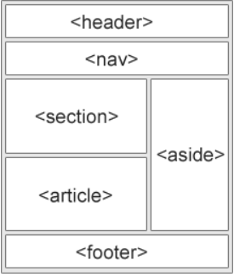
HTML Semantic Elements
A semantic Web allows data to be shared and reused across applications, enterprises, and communities.
Some of the examples:
Tag Description
<article> Defines independent, self-contained content
<aside> Defines content aside from the page content
<details> Defines additional details that the user can view or hide
<figcaption> Defines a caption for a <figure> element
<figure> Specifies self-contained content, like illustrations, diagrams, photos, code
<footer> Defines a footer for a document or section
<header> Specifies a header for a document or section
<main> Specifies the main content of a document
<mark> Defines marked/highlighted text
<nav> Defines navigation links
<section> Defines a section in a document
<summary> Defines a visible heading for a <details> element
<time> Defines a date/time

Slide 184
HTML Semantic Element
<!DOCTYPE html> <html lang = "en-US"> <head> <title>Images</title> </head> <body>
<section> <h1>WWF</h1> <p>The World Wide Fund for Nature (WWF) is an international organization working on issues regarding the conservation, research and restoration of the environment, formerly named the World Wildlife Fund. WWF was founded in 1961.</p> </section> <section> <h1>WWF's Panda symbol</h1> <p>The Panda has become the symbol of WWF. The well-known panda logo of WWF originated from a panda named Chi Chi that was transferred from the Beijing Zoo to the London Zoo in the same year of the establishment of WWF.</p> </section>
</body>
</html>
HTML <section> Element
The <section> element defines a section in a document.
"A section is a thematic grouping of content, typically with a heading."
A web page could normally be split into sections for introduction, content, and contact information.
Example:
Two sections in a document

Slide 185
HTML Semantic Element
HTML <article> Element
The <article> element specifies independent, self-contained content.
An article should make sense on its own, and it should be possible to distribute it independently from the rest of the web site.
Examples of where an <article> element can be used:
Forum post
Blog post
Newspaper article
Example:
Three articles with independent, self-contained content:
<!DOCTYPE html> <html lang = "en-US"> <head> <title>Images</title> </head> <body>
<article> <h2>Google Chrome</h2> <p>Google Chrome is a web browser developed by Google, released in 2008. Chrome is the world's most popular web browser today!</p> </article> <article> <h2>Mozilla Firefox</h2> <p>Mozilla Firefox is an open-source web browser developed by Mozilla. Firefox has been the second most popular web browser since January, 2018.</p> </article> <article> <h2>Microsoft Edge</h2> <p>Microsoft Edge is a web browser developed by Microsoft, released in 2015. Microsoft Edge replaced Internet Explorer.</p> </article>
</body>
</html>

Slide 186
HTML Semantic Element
<!DOCTYPE html> <html lang = "en-US"> <head> <title>Images</title> </head> <body>
<article> <h2>Google Chrome</h2> <p>Google Chrome is a web browser developed by Google, released in 2008. Chrome is the world's most popular web browser today!</p> </article> <article> <h2>Mozilla Firefox</h2> <p>Mozilla Firefox is an open-source web browser developed by Mozilla. Firefox has been the second most popular web browser since January, 2018.</p> </article> <article> <h2>Microsoft Edge</h2> <p>Microsoft Edge is a web browser developed by Microsoft, released in 2015. Microsoft Edge replaced Internet Explorer.</p> </article>
</body>
</html>
HTML <article> Element
The <article> element specifies independent, self-contained content.
The <section> element defines section in a document.
We can’t use the definitions to decide how to nest those elements
So, we can find HTML pages with <section> elements containing <article> elements, and <article> elements containing <section> elements.

Slide 187
HTML Semantic Element
<!DOCTYPE html> <html lang = "en-US"> <head> <title>Images</title> </head> <body>
<article> <header> <h1>What Does WWF Do?</h1> <p>WWF's mission:</p> </header> <p>WWF's mission is to stop the degradation of our planet's natural environment, and build a future in which humans live in harmony with nature.</p> </article>
</body>
</html>
HTML <header> Element
The <header> element represents a container for introductory content or a set of navigational links.
A <header> element typically contains:
one or more heading elements (<h1> - <h6>)
logo or icon
authorship information
We can have several <header> elements in one HTML document.
<header> cannot be placed within a <footer>, <address> or another <header> element.

Slide 188
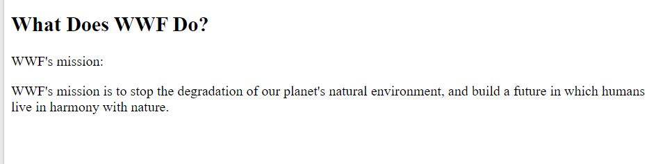
HTML Semantic Element
<!DOCTYPE html> <html lang = "en-US"> <head> <title>Images</title> </head> <body>
<article> <header> <h1>What Does WWF Do?</h1> <p>WWF's mission:</p> </header> <p>WWF's mission is to stop the degradation of our planet's natural environment, and build a future in which humans live in harmony with nature.</p> </article>
</body>
</html>

Slide 189
HTML Semantic Element
HTML <footer> Element
The <footer> element defines a footer for a document or section.
A <footer> element typically contains:
authorship information
copyright information
contact information
sitemap
back to top links
related documents
We can have several <footer> elements in one document.
<!DOCTYPE html> <html lang = "en-US"> <head> <title>Images</title> </head> <body>
<article> <header> <h1>What Does WWF Do?</h1> <p>WWF's mission:</p> </header> <p>WWF's mission is to stop the degradation of our planet's natural environment, and build a future in which humans live in harmony with nature.</p> </article>
<footer> <p>Author: Hege Refsnes</p> <p><a href="mailto:hege@example.com">hege@example.com</a></p> </footer>
</body>
</html>

Slide 190
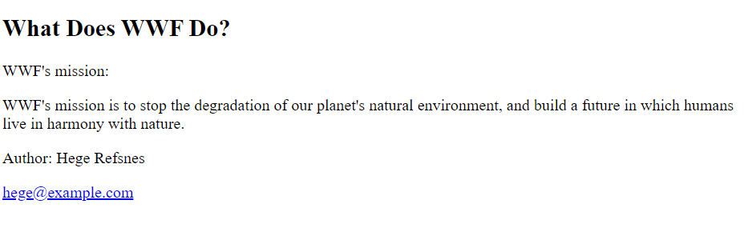
HTML Semantic Element
<!DOCTYPE html> <html lang = "en-US"> <head> <title>Images</title> </head> <body>
<article> <header> <h1>What Does WWF Do?</h1> <p>WWF's mission:</p> </header> <p>WWF's mission is to stop the degradation of our planet's natural environment, and build a future in which humans live in harmony with nature.</p> </article>
<footer> <p>Author: Hege Refsnes</p> <p><a href="mailto:hege@example.com">hege@example.com</a></p> </footer>
</body>
</html>

Slide 191
HTML Semantic Element
<!DOCTYPE html> <html lang = "en-US"> <head> <title>Images</title> </head> <body>
<nav> <a href="/html/">HTML</a> | <a href="/css/">CSS</a> | <a href="/js/">JavaScript</a> | <a href="/jquery/">jQuery</a> </nav>
<article> <header> <h1>What Does WWF Do?</h1> <p>WWF's mission:</p> </header> <p>WWF's mission is to stop the degradation of our planet's natural environment, and build a future in which humans live in harmony with nature.</p> </article>
<footer> <p>Author: Hege Refsnes</p> <p><a href="mailto:hege@example.com">hege@example.com</a></p> </footer>
</body>
</html>
HTML <nav> Element
The <nav> element defines a set of navigation links.
Notice that NOT all links of a document should be inside a <nav> element.
The <nav> element is intended only for major block of navigation links.

Slide 192
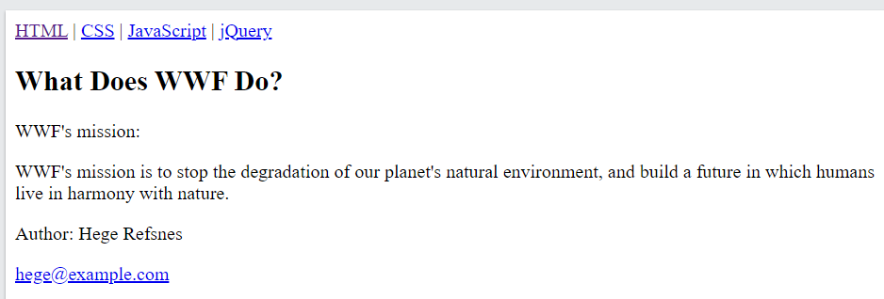
HTML Semantic Element
<!DOCTYPE html> <html lang = "en-US"> <head> <title>Images</title> </head> <body>
<nav> <a href="/html/">HTML</a> | <a href="/css/">CSS</a> | <a href="/js/">JavaScript</a> | <a href="/jquery/">jQuery</a> </nav>
<article> <header> <h1>What Does WWF Do?</h1> <p>WWF's mission:</p> </header> <p>WWF's mission is to stop the degradation of our planet's natural environment, and build a future in which humans live in harmony with nature.</p> </article>
<footer> <p>Author: Hege Refsnes</p> <p><a href="mailto:hege@example.com">hege@example.com</a></p> </footer>
</body>
</html>

Slide 193
HTML Semantic Element
<html> <head> <style> aside { width: 30%; padding-left: 15px; margin-left: 15px; float: right; font-style: italic; background-color: lightgray; } </style> </head> <body> <p>My family and I visited The Epcot center this summer. The weather was nice, and Epcot was amazing! I had a great summer together with my family!</p> <aside> <p>The Epcot center is a theme park at Walt Disney World Resort featuring exciting attractions, international pavilions, award-winning fireworks and seasonal special events.</p> </aside> <p>My family and I visited The Epcot center this summer. The weather was nice, and Epcot was amazing! I had a great summer together with my family!</p>
</body>
</html>
HTML <aside> Element
The <aside> element defines some content aside from the content it is placed in (like a sidebar).
The <aside> content should be indirectly related to the surrounding content.

Slide 194
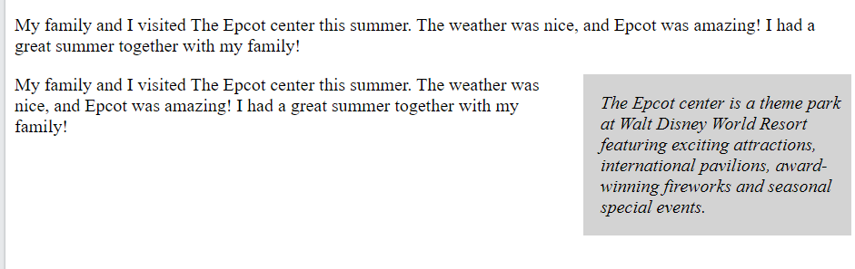
HTML Semantic Element
<html> <head> <style> aside { width: 30%; padding-left: 15px; margin-left: 15px; float: right; font-style: italic; background-color: lightgray; } </style> </head> <body> <p>My family and I visited The Epcot center this summer. The weather was nice, and Epcot was amazing! I had a great summer together with my family!</p> <aside> <p>The Epcot center is a theme park at Walt Disney World Resort featuring exciting attractions, international pavilions, award-winning fireworks and seasonal special events.</p> </aside> <p>My family and I visited The Epcot center this summer. The weather was nice, and Epcot was amazing! I had a great summer together with my family!</p>
</body>
</html>

Slide 195
HTML Semantic Element
<html> <head>
<title>Images</title> </head> <body> <figure> <img src="pic_trulli.jpg" alt="Trulli"> <figcaption>Fig1. - Trulli, Puglia, Italy.</figcaption> </figure>
</body>
</html>
HTML <figure> and <figcaption> Element
The <figure> tag specifies self-contained content, like illustrations, diagrams, photos, code listings, etc.
The <figcaption> tag defines a caption for a <figure> element.
The <figcaption> element can be placed as the first or as the last child of a <figure> element.
The <img> element defines the actual image/illustration.

Slide 196
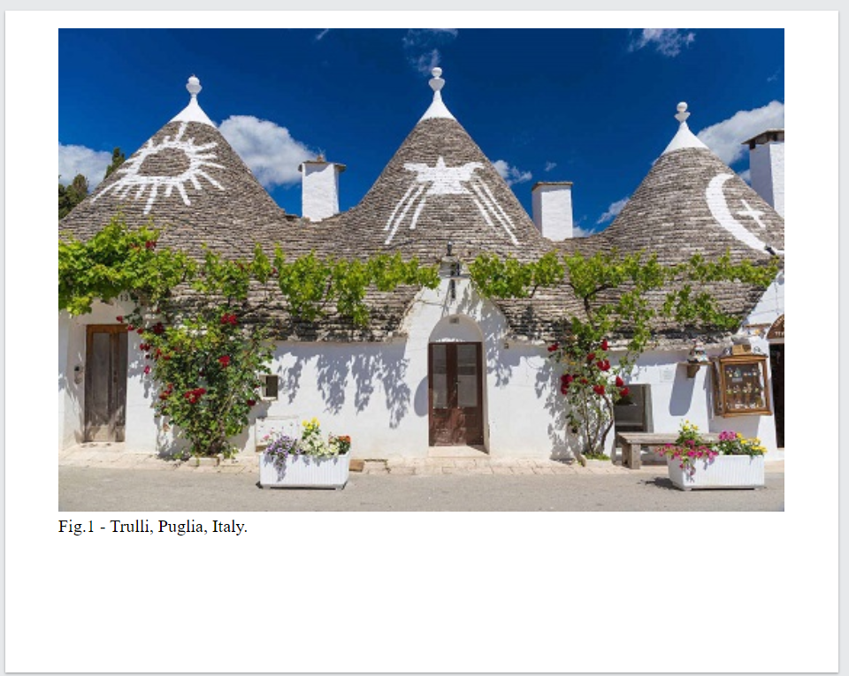
HTML Semantic Element
<html> <head>
<title>Images</title> </head> <body> <figure> <img src="pic_trulli.jpg" alt="Trulli"> <figcaption>Fig1. - Trulli, Puglia, Italy.</figcaption> </figure>
</body>
</html>

Slide 198
HTML Audio
The HTML <audio> element is used to play an audio file on a web page.
The controls attribute adds audio controls, like play, pause, and volume.
The <source> element allows you to specify alternative audio files which the browser may choose from.
The browser will use the first recognized format.
The text between the <audio> and </audio> tags will only be displayed in browsers that do not support the <audio> element.
To start an audio file automatically, use the autoplay attribute
Add muted after autoplay to let your audio file start playing automatically (but muted)
<!DOCTYPE html> <html lang = "en-US"> <head> <title>Images</title> </head> <body>
<audio controls autoplay muted> <source src="horse.ogg" type="audio/ogg"> <source src="horse.mp3" type="audio/mpeg"> Your browser does not support the audio element. </audio>
</body>
</html>

Slide 199
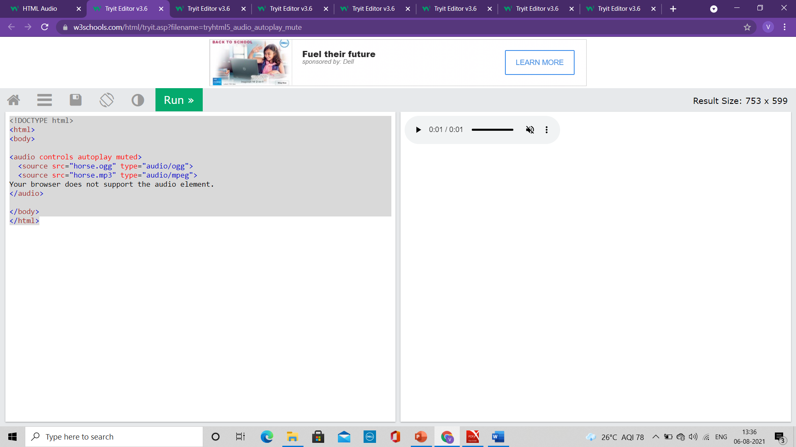
HTML Audio
<!DOCTYPE html> <html lang = "en-US"> <head> <title>Images</title> </head> <body>
<audio controls autoplay muted> <source src="horse.ogg" type="audio/ogg"> <source src="horse.mp3" type="audio/mpeg"> Your browser does not support the audio element. </audio>
</body>
</html>

Slide 200
HTML Audio
<!DOCTYPE html> <html lang = "en-US"> <head> <title>Images</title> </head> <body>
<audio controls autoplay muted> <source src="horse.ogg" type="audio/ogg"> <source src="horse.mp3" type="audio/mpeg"> Your browser does not support the audio element. </audio>
</body>
</html>
HTML Audio - Media Types
File Format Media Type
MP3 audio/mpeg
OGG audio/ogg
WAV audio/wav

Slide 201
HTML Video
The HTML <video> element is used to show a video on a web page.
The controls attribute adds video controls, like play, pause, and volume.
It is a good idea to always include width and height attributes.
If height and width are not set, the page might flicker while the video loads.
The <source> element allows you to specify alternative video files which the browser may choose from.
The browser will use the first recognized format.
The text between the <video> and </video> tags will only be displayed in browsers that do not support the <video> element.
Add muted after autoplay to let your video start playing automatically (but muted)
<!DOCTYPE html> <html lang = "en-US"> <head> <title>Images</title> </head> <body>
<video width="320" height="240" autoplay muted> <source src="movie.mp4" type="video/mp4"> <source src="movie.ogg" type="video/ogg"> Your browser does not support the video tag. </video>
</body>
</html>

Slide 202
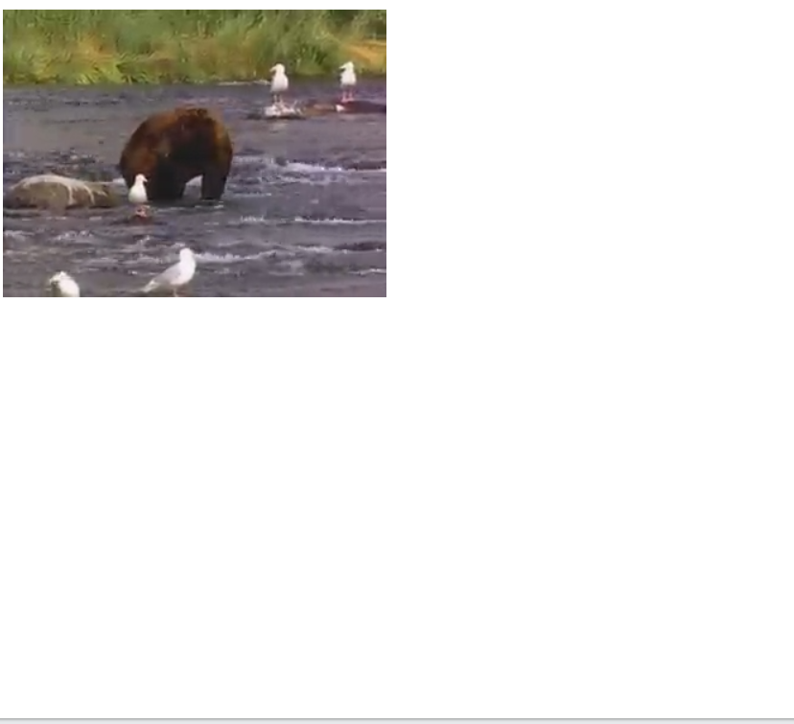
HTML Video
<!DOCTYPE html> <html lang = "en-US"> <head> <title>Images</title> </head> <body>
<video width="320" height="240" autoplay muted> <source src="movie.mp4" type="video/mp4"> <source src="movie.ogg" type="video/ogg"> Your browser does not support the video tag. </video>
</body>
</html>

Slide 203
HTML Video
<!DOCTYPE html> <html lang = "en-US"> <head> <title>Images</title> </head> <body>
<video width="320" height="240" autoplay muted> <source src="movie.mp4" type="video/mp4"> <source src="movie.ogg" type="video/ogg"> Your browser does not support the video tag. </video>
</body>
</html>
HTML Video - Media Types
File Format Media Type
MP4 video/mp4
WebM video/webm
Ogg video/ogg

Slide 204
HTML Video
HTML Video - Methods, Properties, and Events
The HTML DOM defines methods, properties, and events for the <video> element.
This allows you to load, play, and pause videos, as well as setting duration and volume.
There are also DOM events that can notify you when a video begins to play, is paused, etc.

Slide 205
HTML Audio/Video Methods
Method Description
addTextTrack() Adds a new text track to the audio/video
canPlayType() Checks if the browser can play the specified audio/video type
load() Re-loads the audio/video element
play() Starts playing the audio/video
pause() Pauses the currently playing audio/vide

Slide 206
HTML Drag and Drop
In HTML, any element can be dragged and dropped.
Drag and drop is a very common feature.
It is when you "grab" an object and drag it to a different location.

Slide 207
HTML Drag and Drop
<!DOCTYPE HTML> <html> <head> <script> function allowDrop(ev) { ev.preventDefault(); } function drag(ev) { ev.dataTransfer.setData("text", ev.target.id); } function drop(ev) { ev.preventDefault(); var data = ev.dataTransfer.getData("text"); ev.target.appendChild(document.getElementById(data)); } </script> </head> <body> <div id="div1" ondrop="drop(event)" ondragover="allowDrop(event)"></div> <img id="drag1" src="img_logo.gif" draggable="true" ondragstart="drag(event)" width="336" height="69"> </body>
Make an Element Draggable
To make an element draggable, set the draggable attribute to true:
<img draggable="true">
What to Drag - ondragstart and setData()
Specify what should happen when the element is dragged.
In the example, the ondragstart attribute calls a function, drag(event), that specifies what data to be dragged.
The dataTransfer.setData() method sets the data type and the value of the dragged data:
function drag(ev) {
ev.dataTransfer.setData("text", ev.target.id);
}
In this case, the data type is "text" and the value is the id of the draggable element ("drag1").

Slide 208
HTML Drag and Drop
<!DOCTYPE HTML> <html> <head> <script> function allowDrop(ev) { ev.preventDefault(); } function drag(ev) { ev.dataTransfer.setData("text", ev.target.id); } function drop(ev) { ev.preventDefault(); var data = ev.dataTransfer.getData("text"); ev.target.appendChild(document.getElementById(data)); } </script> </head> <body> <div id="div1" ondrop="drop(event)" ondragover="allowDrop(event)"></div> <img id="drag1" src="img_logo.gif" draggable="true" ondragstart="drag(event)" width="336" height="69"> </body>
Where to Drop - ondragover
The ondragover event specifies where the dragged data can be dropped.
By default, data/elements cannot be dropped in other elements.
To allow a drop, we must prevent the default handling of the element.
This is done by calling the event.preventDefault()
method for the ondragover event:
event.preventDefault()

Slide 209
HTML Drag and Drop
<!DOCTYPE HTML> <html> <head> <script> function allowDrop(ev) { ev.preventDefault(); } function drag(ev) { ev.dataTransfer.setData("text", ev.target.id); } function drop(ev) { ev.preventDefault(); var data = ev.dataTransfer.getData("text"); ev.target.appendChild(document.getElementById(data)); } </script> </head> <body> <div id="div1" ondrop="drop(event)" ondragover="allowDrop(event)"></div> <img id="drag1" src="img_logo.gif" draggable="true" ondragstart="drag(event)" width="336" height="69"> </body>
Do the Drop - ondrop
When the dragged data is dropped, a drop event occurs.
In the example above, the ondrop attribute calls a function, drop(event):
function drop(ev) {
ev.preventDefault();
var data = ev.dataTransfer.getData("text");
ev.target.appendChild(document.getElementById(data));
}

Slide 210
HTML Drag and Drop
<!DOCTYPE HTML> <html> <head> <script> function allowDrop(ev) { ev.preventDefault(); } function drag(ev) { ev.dataTransfer.setData("text", ev.target.id); } function drop(ev) { ev.preventDefault(); var data = ev.dataTransfer.getData("text"); ev.target.appendChild(document.getElementById(data)); } </script> </head> <body> <div id="div1" ondrop="drop(event)" ondragover="allowDrop(event)"></div> <img id="drag1" src="img_logo.gif" draggable="true" ondragstart="drag(event)" width="336" height="69"> </body>
Explanation of Code
Call preventDefault() to prevent the browser default handling of the data (default is open as link on drop)
Get the dragged data with the dataTransfer.getData() method. This method will return any data that was set to the same type in the setData() method
The dragged data is the id of the dragged element ("drag1")
Append the dragged element into the drop element

Slide 211

Cascading Style Sheet
CSS

Slide 212
Content
Introduction
CSS Syntax
CSS Selectors
<div> tag

Slide 213
Introduction
CSS is the language we use to style a Web page
CSS stands for Cascading Style Sheets
CSS describes how HTML elements are to be displayed on screen, paper, or in other media
CSS can control the layout of multiple web pages all at once
External stylesheets are stored in CSS files

Slide 214
Why to use CSS
CSS is used to define
Styles for web pages
The design, layout and variations in display for different devices and screen sizes
CSS removed the style formatting from the HTML page
The style definitions are normally saved in external .css files.
With an external stylesheet file, you can change the look of an entire website by changing just one file!

Slide 215
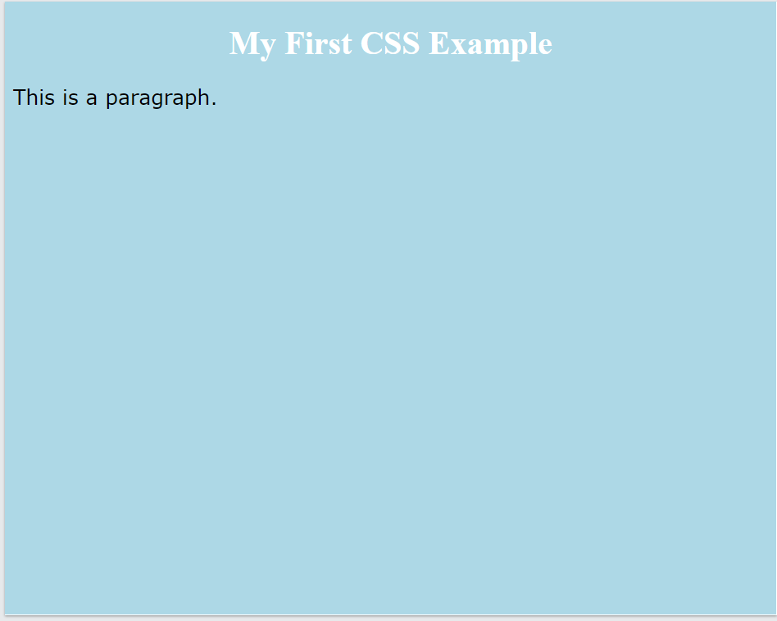
CSS Example
<!DOCTYPE html> <html lang = "en-US"> <head> <style>
body { background-color: lightblue; }
h1 { color: white; text-align: center; }
p { font-family: verdana; font-size: 20px; }
</style> </head>
<body>
<h1>My First CSS Example</h1> <p>This is a paragraph</p>
</body>
</html>

Slide 216
CSS Syntax
A CSS rule consists of a selector and a declaration block.
h1 { color:blue; font-size:12px; }
The selector points to the HTML element you want to style.
h1 is selector
The declaration block contains one or more declarations separated by semicolons.
Each declaration includes a CSS property name and a value, separated by a colon.
Properties are color, font-size
The values are blue, 12px
Multiple CSS declarations are separated with semicolons, and declaration blocks are surrounded by curly braces.

Slide 217
CSS Syntax
<!DOCTYPE html> <html lang = "en-US"> <head> <style>
p { color: red; text-align: center; }
</style> </head>
<body>
<h1> Hello World! </h1> <p>These paragraphs are styled with CSS</p>
</body>
</html>
p is a selector in CSS (it points to the HTML element you want to style: <p>).
color is a property, and red is the property value
text-align is a property, and center is the property value

Slide 218
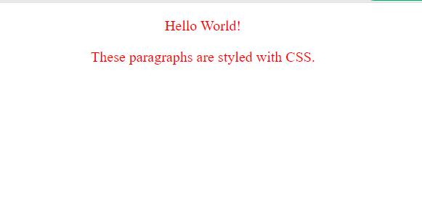
CSS Syntax
<!DOCTYPE html> <html lang = "en-US"> <head> <style>
p { color: red; text-align: center; }
</style> </head>
<body>
<p> Hello World! </p> <p>These paragraphs are styled with CSS</p>
</body>
</html>

Slide 219
CSS Selectors
CSS selectors are used to "find" or select the HTML elements we want to style.
CSS selectors are divided into five categories:
Simple selectors: Select elements based on name, id, class
Combinator selectors: Select elements based on a specific relationship between them
Pseudo-class selectors: Select elements based on a certain state
Pseudo-elements selectors: Select and style a part of an element
Attribute selectors: Select elements based on an attribute or attribute value

Slide 220
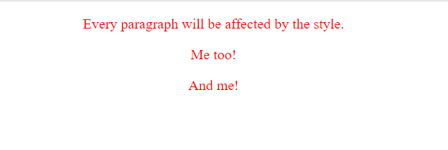
CSS Selectors
<!DOCTYPE html> <html lang = "en-US"> <head> <style>
p { color: red; text-align: center; }
</style> </head>
<body>
<p>Every paragraph will be affected by the style</p>
<p id = ”para1”> Me too !</p>
<p>And me</p>
</body>
</html>
The CSS Element Selector
The element selector selects HTML elements based on the element name.
Here, all <p> elements on the page will be center-aligned, with a red text color

Slide 221
CSS Selectors
<!DOCTYPE html> <html lang = "en-US"> <head> <style>
#para1 { color: red; text-align: center; }
</style> </head>
<body>
<p>This paragraph is not affected by the style</p>
<p id = ”para1”> Hello World</p>
</body>
</html>
The CSS id Selector
The id selector uses the id attribute of an HTML element to select a specific element.
The id of an element is unique within a page, so the id selector is used to select one unique element!
To select an element with a specific id, write a hash (#) character, followed by the id of the element.
An id name can’t start with a number

Slide 222
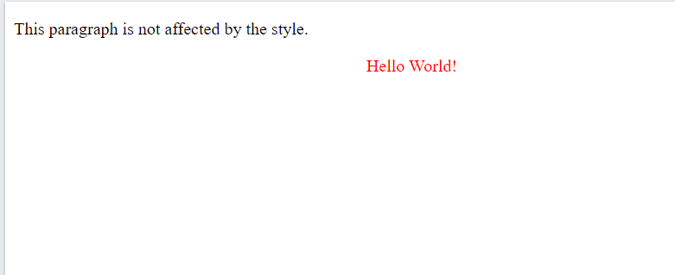
CSS Selectors
<!DOCTYPE html> <html lang = "en-US"> <head> <style>
#para1 { color: red; text-align: center; }
</style> </head>
<body>
<p>This paragraph is not affected by the style</p>
<p id = ”para1”> Hello World</p>
</body>
</html>

Slide 223
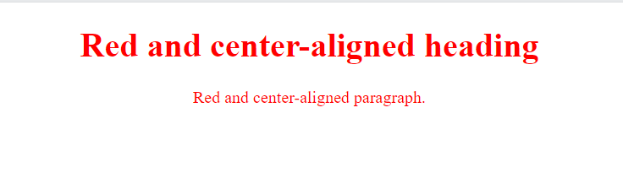
CSS Selectors
<!DOCTYPE html> <html lang = "en-US"> <head> <style>
.center { color: red; text-align: center; }
</style> </head>
<body>
<h1 class = ”center” > Red and Center aligned Heading </h1>
<p class = ”center” > Red and Center aligned Paragraph </p>
</body>
</html>
The CSS class Selector
The class selector selects HTML elements with a specific class attribute.
To select elements with a specific class, write a period (.) character, followed by the class name.
In this example all HTML elements with class="center" will be red and center-aligned:

Slide 224
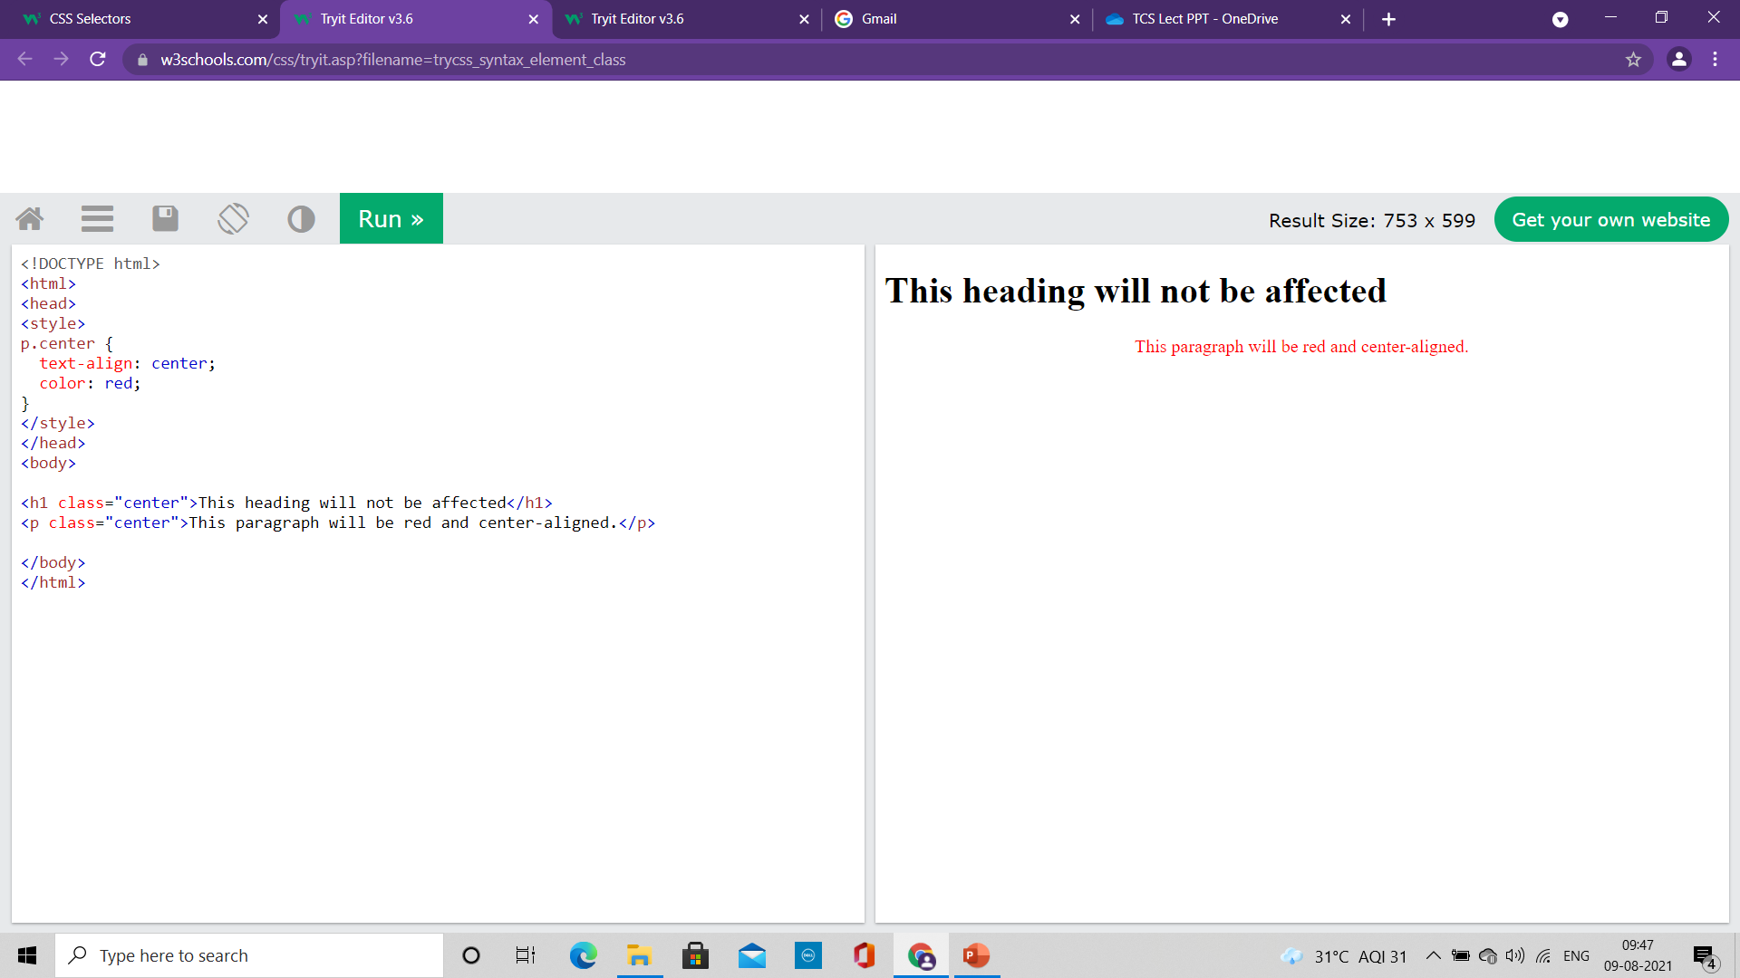
CSS Selectors
<!DOCTYPE html> <html lang = "en-US"> <head> <style>
p.center { color: red; text-align: center; }
</style> </head>
<body>
<h1 class = ”center” > This Heading will not be affected </h1>
<p class = ”center” > Red and Center aligned Paragraph </p>
</body>
</html>
The CSS class Selector
Only specific HTML elements can be specified that should be affected by a class.
In this example only <p> elements with class="center" will be red and center-aligned

Slide 225
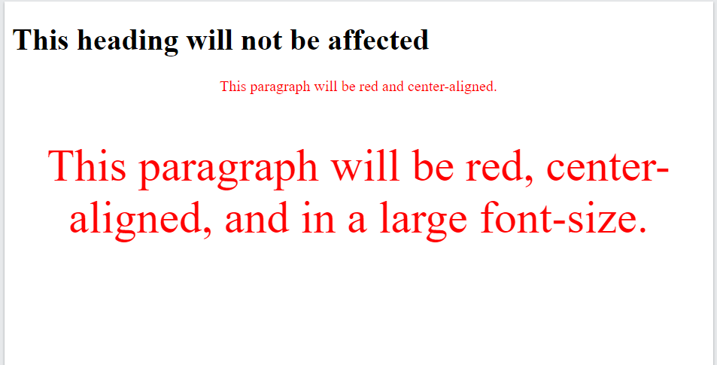
CSS Selectors
<!DOCTYPE html> <html lang = "en-US"> <head> <style>
p.center { color: red; text-align: center; }
p.large { font-size: 300%; }
</style> </head>
<body>
<h1 class = ”center” > This Heading will not be affected </h1>
<p class = ”center” > This paragraph will be red and center-aligned </p>
<p class = ”center large” > This paragraph will be red, center-aligned and in large font-size </p>
</body>
</html>
The CSS class Selector
HTML elements can also refer to more than one class.
In this example the <p> element will be styled according to class="center" and to class="large“
A class name cannot start with a number!

Slide 226
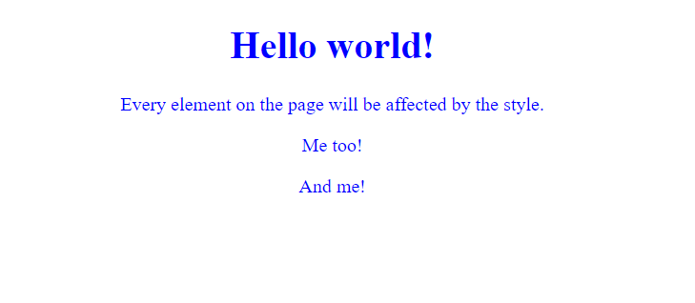
CSS Selectors
<!DOCTYPE html>
<html>
<head>
<style>
* {
text-align: center;
color: blue;
}
</style>
</head>
<body>
<h1>Hello world!</h1>
<p>Every element on the page will be affected by the style.</p>
<p id="para1">Me too!</p>
<p>And me!</p>
</body>
</html>
The CSS Universal Selector
The universal selector (*) selects all HTML elements on the page.
The CSS rule below will affect every HTML element on the page:

Slide 227
CSS Selectors
<!DOCTYPE html>
<html>
<head>
<style>
h1, h2, p {
text-align: center;
color: red;
}
</style>
</head>
<body>
<h1>Hello World!</h1>
<h2>Smaller heading!</h2>
<p>This is a paragraph.</p>
</body>
</html>
The CSS Grouping Selector
The grouping selector selects all the HTML elements with the same style definitions.
In the CSS code, the h1, h2, and p elements have the same style definitions
h1 {
text-align: center;
color: red;
}
h2 {
text-align: center;
color: red;
}
p {
text-align: center;
color: red;
}

Slide 228

CSS Selectors
<!DOCTYPE html>
<html>
<head>
<style>
h1, h2, p {
text-align: center;
color: red;
}
</style>
</head>
<body>
<h1>Hello World!</h1>
<h2>Smaller heading!</h2>
<p>This is a paragraph.</p>
</body>
</html>
The CSS Grouping Selector
It will be better to group the selectors, to minimize the code.
To group selectors, separate each selector with a comma.

Slide 229
CSS Selectors
All CSS Simple Selectors
Selector Example Example description
#id #firstname Selects the element with id="firstname"
.class .intro Selects all elements with class="intro"
element.class p.intro Selects only <p> elements with class="intro"
* * Selects all elements
element p Selects all <p> elements
element,element,.. div, p Selects all <div> elements and all <p> elements

Slide 230
The <div> tag
The <div> tag defines a division or a section in an HTML document.
The <div> tag is used as a container for HTML elements - which is then styled with CSS or manipulated with JavaScript.
The <div> tag is easily styled by using the class or id attribute.
Any sort of content can be put inside the <div> tag!
By default, browsers always place a line break before and after the <div> element.

Slide 231

<div> Element
<!DOCTYPE html>
<html>
<head>
<style>
.myDiv {
border: 5px outset red;
background-color: lightblue;
text-align: center;
}
</style>
</head>
<body>
<h1>The div element</h1>
<div class="myDiv">
<h2>This is a heading in a div element</h2>
<p>This is some text in a div element.</p>
</div>
<p>This is some text outside the div element.</p>
</body>
</html>

Slide 232
Cascading Style Sheet
CSS

Slide 233
Content
How to insert CSS?

Slide 234
How to insert CSS?
When a browser reads a style sheet, it will format the HTML document according to the information in the style sheet.
There are three ways of inserting a style sheet:
External CSS
Internal CSS
Inline CSS

Slide 235
External CSS
<!DOCTYPE html> <html> <head> <link rel="stylesheet" href="mystyle.css"> </head> <body> <h1>This is a heading</h1> <p>This is a paragraph.</p> </body> </html>
With an external style sheet, we can change the look of an entire website by changing just one file
Each HTML page must include a reference to the external style sheet file inside the <link> element
It is written inside the head section.
body { background-color: lightblue; } h1 { color: navy; margin-left: 20px; }
mystyle.css

Slide 236

External CSS
<!DOCTYPE html> <html> <head> <link rel="stylesheet" href="mystyle.css"> </head> <body> <h1>This is a heading</h1> <p>This is a paragraph.</p> </body> </html>
With an external style sheet, we can change the look of an entire website by changing just one file
Each HTML page must include a reference to the external style sheet file inside the <link> element
It is written inside the head section.
body { background-color: lightblue; } h1 { color: navy; margin-left: 20px; }
mystyle.css

Slide 237
Internal CSS
<!DOCTYPE html> <html> <head> <style> body { background-color: linen; } h1 { color: maroon; margin-left: 40px; } </style> </head> <body> <h1>This is a heading</h1> <p>This is a paragraph.</p> </body> </html>
An internal style sheet may be used if one single HTML page has a unique style.
The internal style is defined inside the <style> element, inside the head section.

Slide 238

Internal CSS
<!DOCTYPE html> <html> <head> <style> body { background-color: linen; } h1 { color: maroon; margin-left: 40px; } </style> </head> <body> <h1>This is a heading</h1> <p>This is a paragraph.</p> </body> </html>
An internal style sheet may be used if one single HTML page has a unique style.
The internal style is defined inside the <style> element, inside the head section.

Slide 239
Inline CSS
<!DOCTYPE html> <html> <body> <h1 style="color:blue;text-align:center;">This is a heading</h1> <p style="color:red;">This is a paragraph.</p> </body> </html>
An inline style may be used to apply a unique style for a single element.
To use inline styles, add the style attribute to the relevant element.
The style attribute can contain any CSS property.
An inline style loses many of the advantages of a style sheet

Slide 240

Inline CSS
<!DOCTYPE html> <html> <body> <h1 style="color:blue;text-align:center;">This is a heading</h1> <p style="color:red;">This is a paragraph.</p> </body> </html>
An inline style may be used to apply a unique style for a single element.
To use inline styles, add the style attribute to the relevant element.
The style attribute can contain any CSS property.
An inline style loses many of the advantages of a style sheet

Slide 241

Multiple Style Sheets
<!DOCTYPE html> <html> <head> <link rel="stylesheet" type="text/css" href="mystyle.css"> <style> h1 { color: orange; } </style> </head>
<body> <h1>This is a heading</h1> <p>The style of this document is a combination of an external stylesheet, and internal style</p> </body> </html>
If some properties have been defined for the same selector (element) in different style sheets, the value from the last read style sheet will be used.
h1 { color: navy; }
mystyle.css

Slide 242

Multiple Style Sheets
<!DOCTYPE html> <html> <head> <style> h1 { color: orange; } </style>
<link rel="stylesheet" type="text/css" href="mystyle.css"> </head>
<body> <h1>This is a heading</h1> <p>The style of this document is a combination of an external stylesheet, and internal style</p> </body> </html>
If some properties have been defined for the same selector (element) in different style sheets, the value from the last read style sheet will be used.
h1 { color: navy; }
mystyle.css

Slide 243
Cascading Order
If there is more than one style specified for an HTML element then cascading order will be defined
All the styles in a page will "cascade" into a new "virtual" style sheet by the following rules, where number one has the highest priority:
Inline style (inside an HTML element)
External and internal style sheets (in the head section)
Browser default
An inline style has the highest priority, and will override external and internal styles and browser defaults.

Slide 244
Rule Cascading
The cascade takes
Input: An unordered list of declared values for a given property on a given element
Process: It sorts them by their declaration’s precedence
Output: a single cascaded value

Slide 245
Cascade Sorting Order
The cascade sorts declarations according to the following criteria, in descending order of priority:
Origin and Importance
Specificity
Order of Appearance
The output of the cascade is a (potentially empty) sorted list of declared values for each property on each element.

Slide 246
Cascading Origin
Each style rule has a cascade origin, which determines where it enters the cascade.
CSS defines three core origins:
Author Origin
The author specifies style sheets for a source document according to the conventions of the document language.
For instance, in HTML, style sheets may be included in the document or linked externally.
User Origin
The user may be able to specify style information for a particular document.
Example 1: the user may specify a file that contains a style sheet
Example 2: the user agent may provide an interface that generates a user style sheet (or behaves as if it did).
User-Agent Origin
Conforming user agents must apply a default style sheet (or behave as if they did).
A user agent’s default style sheet should present the elements of the document language in ways that satisfy general presentation expectations for the document language
(e.g., for visual browsers, the EM element in HTML is presented using an italic font).

Slide 247
Cascading Origin
Extensions to CSS define the following additional origins:
4. Animation Origin
CSS Animations [css-animations-1] generate “virtual” rules representing their effects when running.
5. Transition Origin
Like CSS Animations, CSS Transitions generate “virtual” rules representing their effects when running.

Slide 248
Important Declarations
It is mentioned using the !important annotation
CSS attempts to create a balance of power between author and user style sheets.
By default, rules in an author’s style sheet override those in a user’s style sheet, which override those in the user-agent’s default style sheet.
For balancing overriding mechanism, a declaration can be marked important
It increases its weight in the cascade and inverts the order of precedence.
A declaration is important if it has a !important annotation
If the last two (non-whitespace, non-comment) tokens in its value are the delimiter token ! followed by the identifier token important.
All other declarations are normal (non-important).
Example:
[hidden] { display: none !important; }

Slide 249
Important Declarations
An important declaration takes precedence over a normal declaration.
Author and user style sheets may contain important declarations, with user-origin important declarations overriding author-origin important declarations.
This CSS feature improves accessibility of documents by giving users with special requirements (large fonts, color combinations, etc.) control over presentation.
Important declarations from all origins take precedence over animations.
This allows authors to override animated values in important cases. (Animated values normally override all other rules.)
User-agent style sheets may also contain important declarations. These override all author and user declarations.

Slide 250
Example
/* From the user’s style sheet */
p { text-indent: 1em !important }
p { font-style: italic !important }
p { font-size: 18pt }
/* From the author’s style sheet */
p { text-indent: 1.5em !important }
p { font: normal 12pt sans-serif !important }
p { font-size: 24pt }
Property Winning value
text-indent 1em
font-style italic
font-size 12pt
font-family sans-serif

Slide 251
Specificity
The Selectors describes how to compute the specificity of a selector.
Each declaration has the same specificity as the style rule it appears in.
For the purpose of this step, declarations that do not belong to a style rule (such as the contents of a style attribute) are considered to have a specificity higher than any selector.
The declaration with the highest specificity wins.
Highest to lowest specificity are
ID selectors
Class and pseudo-class selectors
Descendant and type selectors (the more element type names, the more specific)
Universal selectors

Slide 252
Order of Appearance
The last declaration in document order wins.
For this purpose:
Declarations from imported style sheets are ordered as if their style sheets were substituted in place of the @import rule.
Declarations from style sheets independently linked by the originating document are treated as if they were concatenated in linking order, as determined by the host document language.
Declarations from style attributes are ordered according to the document order of the element the style attribute appears on, and are all placed after any style sheets.

Slide 253
Example
<!DOCTYPE html> <html> <head>
<style type="text/css">
p { color:red }
</style>
<link rel="stylesheet" type="text/css" href="imp1.css" />
<style type="text/css">
p { color:yellow }
</style>
</head>
<body> <h1>This is a heading</h1> <p>The style of this document is a combination of an external stylesheet, and internal style</p> </body> </html>
Here the style rulesets are effectively in the order
p { color:red }
p { color:blue }
p { color:green }
p { color:yellow }
@import url("imp2.css");
p { color:green }
p { color:blue }
imp1.css
imp2.css

Slide 254
Rule Cascading
Select style sheets and insert
rules for HTML attributes
Prioritize declarations by origin and weight
Break ties based on specificity (style attribute or most specific selector)
Alternate Style Sheets
Break ties based on position within style sheet (last occuring wins)

Slide 255
Style Inheritance
Inheritance is based on the tree structure of the document itself.
An element inherits a value for one of its properties from its parent’s value.
The parent may in turn inherit its property value from its parent, and so on.
The searching mechanism can be described as:
To inherit a property value, an element will search upward through its tree of ancestor elements
The searching begin with its parent and ending either at the root html element or at the first element that has a value for the property.
If the search ends at an element with a value for the property, that value will be used as its property value.
If no ancestor element has a value for the property, then value specified for each property by the CSS specification will be used (property’s initial value)

Slide 256
Style Inheritance
<!DOCTYPE html>
<html>
<head>
<title>
Inherit.html
</title>
<style type="text/css">
body { font-weight:bold }
li { font-style:italic }
p { font-size:larger }
span { font-weight:normal }
</style>
</head>
<body>
<ul>
<li>List item outside and <span>inside </span> a span.
<p>Embedded paragraph outside and <span>inside</span> a span. </p>
</li>
</ul>
</body>
</html>
For span element, font-weight is specified by an author rule
Elements inside body element: font-weight property value will be inherited from body element
span element do inherit other properties from body element (Other than font-weight)
The first span inherits italicization from its parent li element
The second span inherits a larger font size from its p element parent and italicization from its li element grandparent.
The <p> element similarly inherits italicization from its <li> parent.

Slide 257

Style Inheritance
<!DOCTYPE html>
<html>
<head>
<title>
Inherit.html
</title>
<style type="text/css">
body { font-weight:bold }
li { font-style:italic }
p { font-size:larger }
span { font-weight:normal }
</style>
</head>
<body>
<ul>
<li>List item outside and <span>inside</span> a span.
<p>Embedded paragraph outside and <span>inside</span> a span.</p>
</li>
</ul>
</body>
</html>

Slide 259
Cascading Style Sheet
CSS

Slide 260
Content
Background
Border Images
Color
shadows

Slide 261
CSS Background
The CSS background properties are used to add background effects for elements.
Different Properties:
background-color
background-image
background-repeat
background-attachment
background-position
background

Slide 262
CSS background-color
The background-color property specifies the background color of an element.
With CSS, a color is most often specified by:
a valid color name - like "red"
a HEX value - like "#ff0000"
an RGB value - like "rgb(255,0,0)“
Example:
body {
background-color: lightblue;
}

Slide 263
Opacity/Transparency
The opacity property specifies the opacity/transparency of an element.
It can take a value from 0.0 - 1.0.
The lower value, the more transparent
Example:
div {
background-color: green;
opacity: 0.3;
}
When using the opacity property to add transparency to the background of an element, all of its child elements inherit the same transparency.
This can make the text inside a fully transparent element hard to read.

Slide 264
Transparency using RGBA
If we do not want to apply opacity to child elements use RGBA color values.
The following example sets the opacity for the background color and not the text:
div {
background: rgba(0, 128, 0, 0.3) /* Green background with 30% opacity */
}
In addition to RGB, we can use an RGB color value with an alpha channel (RGBA) - which specifies the opacity for a color.
An RGBA color value is specified with: rgba(red, green, blue, alpha).
The alpha parameter is a number between 0.0 (fully transparent) and 1.0 (fully opaque).

Slide 265
CSS background-Image
The background-image property specifies an image to use as the background of an element.
By default, the image is repeated so it covers the entire element.
Example:
body {
background-image: url("paper.gif");
}
The background image can also be set for specific elements, like the <p> element
Example:
p {
background-image: url("paper.gif");
}

Slide 266
CSS background-repeat
By default, the background-image property repeats an image both horizontally and vertically.
Some images should be repeated only horizontally or vertically
To repeat image only horizontally set the value as:
background-repeat: repeat-x;
To repeat image only vertically set the value as:
background-repeat: repeat-y;
Showing the background image only once is also specified
background-repeat: no-repeat;

Slide 267
CSS background-position
The background-position property is used to specify the position of the background image.
Example:
body {
background-image: url("img_tree.png");
background-repeat: no-repeat;
background-position: right top;
}

Slide 268
CSS background-attachment
The background-attachment property specifies whether the background image should scroll or be fixed
If it is fixed then it will not scroll with the rest of the page
Example:
body {
background-image: url("img_tree.png");
background-repeat: no-repeat;
background-position: right top;
background-attachment: fixed;
}

Slide 269
CSS background shorthand property
To shorten the code, it is also possible to specify all the background properties in one single property.
This is called a shorthand property.
When using the shorthand property the order of the property values is:
background-color
background-image
background-repeat
background-attachment
background-position
It does not matter if one of the property values is missing, as long as the other ones are in this order

Slide 270
CSS background shorthand property
body {
background-color: #ffffff;
background-image: url("img_tree.png");
background-repeat: no-repeat;
background-position: right top;
}
body {
background: #ffffff url("img_tree.png") no-repeat right top;
}

Slide 271
CSS border-image property
The border-image property allows you to specify an image to be used as the border around an element.
The border-image property is a shorthand property for:
border-image-source
border-image-slice
border-image-width
border-image-outset
border-image-repeat
Omitted values are set to their default values.

Slide 272
CSS border-image property
Property Values
Value Description
border-image-source The path to the image to be used as a border
border-image-slice How to slice the border image
border-image-width The width of the border image
border-image-outset The amount by which the border image area extends beyond the border box
border-image-repeat Whether the border image should be repeated, rounded or stretched
initial Sets this property to its default value.
inherit Inherits this property from its parent element. Read about inherit

Slide 273
CSS Colors
Colors are specified using
predefined color names
RGB
HEX
HSL
RGBA
HSLA

Slide 274
RGB Colors
An RGB color value represents RED, GREEN and BLUE light sources.
In CSS, a color can be specified as an RGB value, using this formula:
rgb (red, green, blue)
Each parameter (red, green, and blue) defines the intensity of the color between 0 and 255.
For example:
rgb (255, 0, 0) is displayed as red, because red is set to its highest value (255) and the others are set to 0.
To display black, set all color parameters to 0, like this: rgb(0, 0, 0).
To display white, set all color parameters to 255, like this: rgb(255, 255, 255).
Shades of gray are often defined using equal values for all the 3 light sources

Slide 275
RGBA values
RGBA color values are an extension of RGB color values with an alpha channel - which specifies the opacity for a color.
An RGBA color value is specified with:
rgba(red, green, blue, alpha)
The alpha parameter is a number between 0.0 (fully transparent) and 1.0 (not transparent at all)

Slide 276
HEX Colors
A hexadecimal color is specified with: #RRGGBB,
where the RR (red), GG (green) and BB (blue) hexadecimal integers specify the components of the color.
In CSS, a color can be specified using a hexadecimal value in the form:
#rrggbb
Here rr (red), gg (green) and bb (blue) are hexadecimal values between 00 and ff
(same as decimal 0-255).
For example,
#ff0000 is displayed as red, because red is set to its highest value (ff) and the others are set to the lowest value (00).
Shades of gray are often defined using equal values for all the 3 light sources

Slide 277
HEX Colors
3 Digit HEX value
Sometimes you will see a 3-digit hex code in the CSS source.
The 3-digit hex code is a shorthand for some 6-digit hex codes.
The 3-digit hex code has the following form:
#rgb
Where r, g, and b represents the red, green, and blue components with values between 0 and f.
The 3-digit hex code can only be used when both the values (RR, GG, and BB) are the same for each components.
So, if we have #ff00cc, it can be written like this: #f0c.

Slide 278
HSL Colors
HSL stands for hue, saturation, and lightness.
HSL Value
In CSS, a color can be specified using hue, saturation, and lightness (HSL) in the form:
hsl(hue, saturation, lightness)
Hue is a degree on the color wheel from 0 to 360. 0 is red, 120 is green, and 240 is blue.
Saturation is a percentage value, 0% means a shade of gray, and 100% is the full color.
Lightness is also a percentage, 0% is black, 50% is neither light or dark, 100% is white

Slide 279
HSL Colors
Saturation
Saturation can be described as the intensity of a color.
100% is pure color, no shades of gray
50% is 50% gray, but you can still see the color.
0% is completely gray, you can no longer see the color.
Lightness
The lightness of a color can be described as how much light you want to give the color,
where 0% means no light (black),
50% means 50% light (neither dark nor light)
100% means full lightness (white)
Shades of gray are often defined by setting the hue and saturation to 0, and adjust the lightness from 0% to 100% to get darker/lighter shades:

Slide 280
HSL Colors
HSLA Value
HSLA color values are an extension of HSL color values with an alpha channel - which specifies the opacity for a color.
An HSLA color value is specified with:
hsla(hue, saturation, lightness, alpha)
The alpha parameter is a number between 0.0 (fully transparent) and 1.0 (not transparent at all):

Slide 282
Cascading Style Sheet
CSS

Slide 283
Content
Shadow
Text
Transformation
Transition
Animation

Slide 284
CSS Shadow
With CSS shadow can be added to text and to elements.
We will learn two type of shadow effects:
text-shadow
box-shadow

Slide 285

CSS Text Shadow
<!DOCTYPE html> <html> <head> <style>
h1 { text-shadow: 2px 2px; }
</style> </head> <body> <h1>Text-shadow effect!</h1> </body> </html>
The CSS text-shadow property applies shadow to text.
In its simplest use, only specify the horizontal shadow (2px) and the vertical shadow (2px):

Slide 286

CSS Text Shadow
<!DOCTYPE html> <html> <head> <style>
h1 { text-shadow: 2px 2px red; }
</style> </head> <body> <h1>Text-shadow effect!</h1> </body> </html>
Adding Color to shadow

Slide 287

CSS Text Shadow
<!DOCTYPE html> <html> <head> <style>
h1 { text-shadow: 2px 2px 2px red; }
</style> </head> <body> <h1>Text-shadow effect!</h1> </body> </html>
Adding blur effect and Color to shadow

Slide 288

CSS Text Shadow
<!DOCTYPE html> <html> <head> <style>
h1 { text-shadow: 0 0 3px #FF0000, 0 0 5px #0000FF;
}
</style> </head> <body> <h1>Text-shadow effect!</h1> </body> </html>
Multiple Shadows
To add more than one shadow to the text, you can add a comma-separated list of shadows.

Slide 289

CSS Text Shadow
<!DOCTYPE html> <html> <head> <style>
h1 { color: yellow; text-shadow: -1px 0 black, 0 1px black, 1px 0 black, 0 -1px black;
}
</style> </head> <body> <h1>Text-shadow effect!</h1> </body> </html>
Create plain border using text-shadow property

Slide 290

CSS Box Shadow
<!DOCTYPE html>
<html>
<head>
<style>
div {
width: 300px;
height: 100px;
padding: 15px;
background-color: yellow;
box-shadow: 10px 10px;
}
</style>
</head>
<body>
<h1>The box-shadow Property</h1>
<div>This is a div element with a box-shadow</div>
</body>
</html>
The CSS box-shadow property applies shadow to elements.
In its simplest use, you only specify the horizontal shadow and the vertical shadow:

Slide 291

CSS Box Shadow
<!DOCTYPE html>
<html>
<head>
<style>
div {
width: 300px;
height: 100px;
padding: 15px;
background-color: yellow;
box-shadow: 10px 10px 20px blue;
}
</style>
</head>
<body>
<div>This is a div element with a box-shadow</div>
</body>
</html>
Add color and blur effect to shadows

Slide 292

CSS Box Shadow
<!DOCTYPE html>
<html>
<head>
<style>
div.card {
width: 250px;
box-shadow: 0 4px 8px 0 rgba(0, 0, 0, 0.2), 0 6px 20px 0 rgba(0, 0, 0, 0.19);
text-align: center;
}
div.header {
background-color: #4CAF50;
color: white;
padding: 10px;
font-size: 40px;
}
div.container {
padding: 10px;
}
</style>
</head>
<body>
<h2>Cards</h2>
<p>The box-shadow property can be used to create paper-like cards:</p>
<div class="card">
<div class="header">
<h1>1</h1>
</div>
<div class="container">
<p>January 1, 2016</p>
</div>
</div>
</body>
</html>
Box-shadow property can be used to create paper-like cards

Slide 293
CSS Text
CSS has a lot of properties for formatting text.
Color
To specify the color of text: color
To specify the color of background: background-color
Alignment:
The text-align property: set the horizontal alignment of a text
Possible values of text-align property: center, left, right, justify
For justify property, each line is stretched so that every line has equal width, and the left and right margins are straight
The vertical-align property: Sets the vertical alignment of an element
Possible Values: baseline, text-top, text-bottom, sub, super
Decoration
The text-decoration property is used to set or remove decorations from text.
The value text-decoration: none; is often used to remove underlines from links
Possible values are: overline, line-through, underline

Slide 294
CSS Text
CSS has a lot of properties for formatting text.
Transformation
The text-transform property is used to specify uppercase and lowercase letters in a text.
It can be used to turn everything into uppercase or lowercase letters, or capitalize the first letter of each word
Possible values: uppercase, lowercase, capitalize
Spacing
The text-indent property: To specify the indentation of the first line of a text
The letter-spacing property: To specify the space between the characters in a text.
The line-height property: To specify the space between lines
The word-spacing property: To specify the space between the words in a text(Values: wrap/nowrap)
Shadow

Slide 295
CSS 2D Transformation
CSS transforms allow to move, rotate, scale, and skew elements.
The CSS transform property can use the following 2D transformation methods
1. The translate() method
It moves an element from its current position according to the parameters given for the X-axis and the Y-axis
2. The rotate() method
It rotates an element clockwise or counter-clockwise according to a given degree
Using negative values will rotate the element counter-clockwise.
div { transform: translate(50px, 100px); }
div { transform: rotate(20deg); }

Slide 296
CSS 2D Transformation
3. The scale() method
It increases or decreases the size of an element (according to the parameters given for the width and height).
The example increases the <div> element to be two times of its original width, and three times of its original height
4. The scaleX() method
The scaleX() method increases or decreases the width of an element.
5. The scaleY() method
The scaleY() method increases or decreases the height of an element.
div { transform: scale(2, 3); }
div { transform: scaleX(2); }
div { transform: scaleY(2); }

Slide 297
CSS 2D Transformation
6. The skewX() method
It skews an element along the X-axis by the given angle.
7. The skewY() method
It skews an element along the Y-axis by the given angle.
8. The skew() method
The skew() method skews an element along the X and Y-axis by the given angles.
div { transform: skewX(20deg); }
div { transform: skewY(20deg); }
div { transform: skew(20deg, 10deg); }

Slide 298
CSS 3D Transformation
The CSS transform property you can use the following 3D transformation methods:
rotateX(): rotates an element around its X-axis at a given degree
rotateY(): rotates an element around its Y-axis at a given degree
rotateZ(): rotates an element around its Z-axis at a given degree
div { transform: rotateX(20deg); }
div { transform: rotateY(20deg); }
div { transform: rotateZ(20deg); }

Slide 299
CSS Transition
CSS transitions allows you to change property values smoothly, over a given duration.
To create a transition effect, you must specify two things:
The CSS property you want to add an effect to
The duration of the effect
If the duration part is not specified, the transition will have no effect, because the default value is 0.
Example:
The transition effect will start when the specified CSS property (width) changes value.
specify a new value for the width property when a user mouses over the <div> element
When the cursor mouses out of the element, it will gradually change back to its original style.
div { width: 100px; height: 100px; background: red; transition: width 2s; }
div:hover { width: 300px; }

Slide 300
CSS Transition
Change Several Property Values:
The example adds a transition effect for both the width and height property, with a duration of 2 seconds for the width and 4 seconds for the height:
div { width: 100px; height: 100px; background: red; transition: width 2s height 4s; }

Slide 301
CSS Transition
Speed Curve of Transition
The transition-timing-function property specifies the speed curve of the transition effect.
The transition-timing-function property can have the following values:
ease - specifies a transition effect with a slow start, then fast, then end slowly (this is default)
linear - specifies a transition effect with the same speed from start to end
ease-in - specifies a transition effect with a slow start
ease-out - specifies a transition effect with a slow end
ease-in-out - specifies a transition effect with a slow start and end
cubic-bezier(n,n,n,n) - lets you define your own values in a cubic-bezier function
The transition-delay property specifies a delay (in seconds) for the transition effect.

Slide 302
CSS Animation
An animation lets an element gradually change from one style to another.
You can change as many CSS properties you want, as many times as you want.
To use CSS animation, you must first specify some keyframes for the animation.
Keyframes hold what styles the element will have at certain times.

Slide 303
CSS Animation
/* The animation code */ @keyframes example { from {background-color: red;} to {background-color: yellow;} } /* The element to apply the animation to */ div { width: 100px; height: 100px; background-color: red; animation-name: example; animation-duration: 4s; }
When you specify CSS styles inside the @keyframes rule, the animation will gradually change from the current style to the new style at certain times.
To get an animation to work, you must bind the animation to an element.
The example binds the "example" animation to the <div> element.
The animation will last for 4 seconds, and it will gradually change the background-color of the <div> element from "red" to "yellow":

Slide 304
CSS Animation
/* The animation code */ @keyframes example { from {background-color: red;} to {background-color: yellow;} } /* The element to apply the animation to */ div { width: 100px; height: 100px; background-color: red; animation-name: example; animation-duration: 4s; }
The animation-duration property defines how long an animation should take to complete.
If the animation-duration property is not specified, no animation will occur, because the default value is 0s (0 seconds).
In the example we have specified when the style will change by using the keywords "from" and "to" which represents 0% (start) and 100% (complete)
It is also possible to use percent. By using percent, you can add as many style changes as you like.

Slide 305
CSS Animation
/* The animation code */ @keyframes example { 0% {background-color: red;} 25% {background-color: yellow;} 50% {background-color: blue;} 100% {background-color: green;} } /* The element to apply the animation to */ div { width: 100px; height: 100px; background-color: red; animation-name: example; animation-duration: 4s; }
The example will change the background-color of the <div> element when the animation is 25% complete, 50% complete, and again when the animation is 100% complete:

Slide 306
CSS Animation
Delay in animation
The animation-delay property specifies a delay for the start of an animation.
Negative values are also allowed.
If using negative values, the animation will start as if it had already been playing for N seconds.
Animation Count
The animation-iteration-count property specifies the number of times an animation should run.
div { width: 100px; height: 100px; position: relative; background-color: red; animation-name: example; animation-duration: 4s; animation-delay: 2s;
animation-iteration-count: 3; }

Slide 307
CSS Animation
Run Animation in Reverse Direction or Alternate Cycles
The animation-direction property specifies whether an animation should be played forwards, backwards or in alternate cycles.
The animation-direction property can have the following values:
normal - The animation is played as normal (forwards). This is default
reverse - The animation is played in reverse direction (backwards)
alternate - The animation is played forwards first, then backwards
alternate-reverse - The animation is played backwards first, then forwards

Slide 308
CSS Animation
Speed Curve of the Animation
The animation-timing-function property specifies the speed curve of the animation.
The animation-timing-function property can have the following values:
ease - Specifies an animation with a slow start, then fast, then end slowly (this is default)
linear - Specifies an animation with the same speed from start to end
ease-in - Specifies an animation with a slow start
ease-out - Specifies an animation with a slow end
ease-in-out - Specifies an animation with a slow start and end
cubic-bezier(n,n,n,n) - Lets you define your own values in a cubic-bezier function

Slide 309
CSS Animation
Fill-mode for the Animation
CSS animations do not affect an element before the first keyframe is played or after the last keyframe is played.
The animation-fill-mode property can override this behavior.
The animation-fill-mode property specifies a style for the target element when the animation is not playing before it starts, after it ends, or both
The animation-fill-mode property can have the following values:
none - Default value. Animation will not apply any styles to the element before or after it is executing
forwards - The element will retain the style values that is set by the last keyframe (depends on animation-direction and animation-iteration-count)
backwards - The element will get the style values that is set by the first keyframe (depends on animation-direction), and retain this during the animation-delay period
both - The animation will follow the rules for both forwards and backwards, extending the animation properties in both directions

Slide 310
CSS Animation shorthand property
div {
animation-name: example;
animation-duration: 5s;
animation-timing-function: linear;
animation-delay: 2s;
animation-iteration-count: infinite;
animation-direction: alternate;
}
div {
animation: example 5s linear 2s infinite alternate;
}

Slide 311
Bootstrap

Slide 312
What is Bootstrap?
Bootstrap is a free front-end framework for faster and easier web development
Bootstrap includes HTML and CSS based design templates for
typography, forms, buttons, tables, navigation, modals, image carousels and many other
optional JavaScript plugins
Bootstrap also gives you the ability to easily create responsive designs
Responsive web design is about creating web sites which automatically adjust themselves to look good on all devices, from small phones to large desktops.

Slide 313
Why Use Bootstrap?
Advantages of Bootstrap:
Easy to use: Anybody with just basic knowledge of HTML and CSS can start using Bootstrap
Responsive features: Bootstrap's responsive CSS adjusts to phones, tablets, and desktops
Mobile-first approach: In Bootstrap 3, mobile-first styles are part of the core framework
Browser compatibility: Bootstrap is compatible with all modern browsers (Chrome, Firefox, Internet Explorer, Edge, Safari, and Opera)

Slide 314
Where to Get Bootstrap?
Download Bootstrap from getbootstrap.com
Go to getbootstrap.com, and follow the instructions there.
Include Bootstrap from a CDN
If you don't want to download and host Bootstrap yourself, you can include it from a CDN (Content Delivery Network).
MaxCDN provides CDN support for Bootstrap's CSS and JavaScript. You must also include jQuery:
<!-- Latest compiled and minified CSS -->
<link rel="stylesheet" href="https://maxcdn.bootstrapcdn.com/bootstrap/3.4.1/css/bootstrap.min.css">
<!-- jQuery library -->
<script src="https://ajax.googleapis.com/ajax/libs/jquery/3.5.1/jquery.min.js"></script>
<!-- Latest compiled JavaScript -->
<script src="https://maxcdn.bootstrapcdn.com/bootstrap/3.4.1/js/bootstrap.min.js"></script>

Slide 315
Create First Web Page With Bootstrap
1. Add the HTML5 doctype
Bootstrap uses HTML elements and CSS properties that require the HTML5 doctype.
Always include the HTML5 doctype at the beginning of the page, along with the lang attribute and the correct character set:
<!DOCTYPE html>
<html lang="en">
<head>
<meta charset="utf-8">
</head>
</html>

Slide 316
Create First Web Page With Bootstrap
2. Bootstrap 3 is mobile-first
Bootstrap 3 is designed to be responsive to mobile devices.
Mobile-first styles are part of the core framework.
To ensure proper rendering and touch zooming, add the following <meta> tag inside the <head> element:
<meta name="viewport" content="width=device-width, initial-scale=1">
The width=device-width part sets the width of the page to follow the screen-width of the device
(which will vary depending on the device).
The initial-scale=1 part sets the initial zoom level when the page is first loaded by the browser.

Slide 317

Create First Web Page With Bootstrap
3. Containers
Bootstrap also requires a containing element to wrap site contents.
There are two container classes to choose from:
The .container class provides a responsive fixed width container
The .container-fluid class provides a full width container, spanning the entire width of the viewport

Slide 318

Examples
<!DOCTYPE html>
<html lang="en">
<head>
<title>Bootstrap Example</title>
<meta charset="utf-8">
<meta name="viewport" content="width=device-width, initial-scale=1">
<link rel="stylesheet" href="https://maxcdn.bootstrapcdn.com/bootstrap/3.4.1/css/bootstrap.min.css">
<script src="https://ajax.googleapis.com/ajax/libs/jquery/3.5.1/jquery.min.js"></script>
<script src="https://maxcdn.bootstrapcdn.com/bootstrap/3.4.1/js/bootstrap.min.js"></script>
</head>
<body>
<div class="container">
<h1>My First Bootstrap Page</h1>
<p>This part is inside a .container class.</p>
<p>The .container class provides a responsive fixed width container.</p>
</div>
</body>
</html>

Slide 319

Examples
<!DOCTYPE html>
<html lang="en">
<head>
<title>Bootstrap Example</title>
<meta charset="utf-8">
<meta name="viewport" content="width=device-width, initial-scale=1">
<link rel="stylesheet" href="https://maxcdn.bootstrapcdn.com/bootstrap/3.4.1/css/bootstrap.min.css">
<script src="https://ajax.googleapis.com/ajax/libs/jquery/3.5.1/jquery.min.js"></script>
<script src="https://maxcdn.bootstrapcdn.com/bootstrap/3.4.1/js/bootstrap.min.js"></script>
</head>
<body>
<div class="container-fluid">
<h1>My First Bootstrap Page</h1>
<p>This part is inside a .container class.</p>
<p>The .container class provides a responsive fixed width container.</p>
</div>
</body>
</html>

Slide 320
Bootstrap Grid System

Slide 321

Bootstrap Grid System
Bootstrap's grid system allows up to 12 columns across the page.
If you do not want to use all 12 columns individually, you can group the columns together to create wider columns
Bootstrap's grid system is responsive, and the columns will re-arrange automatically depending on the screen size.

Slide 322
Grid Classes
The Bootstrap grid system has four classes:
xs (for phones - screens less than 768px wide)
sm (for tablets - screens equal to or greater than 768px wide)
md (for small laptops - screens equal to or greater than 992px wide)
lg (for laptops and desktops - screens equal to or greater than 1200px wide)
The classes above can be combined to create more dynamic and flexible layouts.

Slide 323
Grid Classes
Basic Structure of a Bootstrap Grid
<div class="row">
<div class="col-*-*"></div>
<div class="col-*-*"></div>
</div>
<div class="row">
<div class="col-*-*"></div>
<div class="col-*-*"></div>
<div class="col-*-*"></div>
</div>
<div class="row">
...
…
</div>
First: create a row (<div class="row">).
Add the desired number of columns (tags with appropriate .col-*-* classes).
Note that numbers in .col-*-* should always add up to 12 for each row.

Slide 324

Grid Classes
Three Equal Columns
<div class="row">
<div class="col-sm-4">.col-sm-4</div>
<div class="col-sm-4">.col-sm-4</div>
<div class="col-sm-4">.col-sm-4</div>
</div>
The example shows how to get a three equal-width columns starting at tablets and scaling to large desktops.
On mobile phones or screens that are less than 768px wide, the columns will automatically stack

Slide 325

Examples
<!DOCTYPE html>
<html lang="en">
<head>
<title>Bootstrap Example</title>
<meta charset="utf-8">
<meta name="viewport" content="width=device-width, initial-scale=1">
<link rel="stylesheet" href="https://maxcdn.bootstrapcdn.com/bootstrap/3.4.1/css/bootstrap.min.css">
<script src="https://ajax.googleapis.com/ajax/libs/jquery/3.5.1/jquery.min.js"></script>
<script src="https://maxcdn.bootstrapcdn.com/bootstrap/3.4.1/js/bootstrap.min.js"></script>
</head>
<body>
<div class="container-fluid">
<h1>Hello World!</h1>
<p>Resize the browser window to see the effect.</p>
<p>The columns will automatically stack on top of each other when the screen is less than 768px wide.</p>
<div class="row">
<div class="col-sm-4" style="background-color:lavender;">.col-sm-4</div>
<div class="col-sm-4" style="background-color:lavenderblush;">.col-sm-4</div>
<div class="col-sm-4" style="background-color:lavender;">.col-sm-4</div>
</div>
</div>
</body>
</html>

Slide 326
<!DOCTYPE html>
<html lang="en">
<head>
<title>Bootstrap Example</title>
<meta charset="utf-8">
<meta name="viewport" content="width=device-width, initial-scale=1">
<link rel="stylesheet" href="https://maxcdn.bootstrapcdn.com/bootstrap/3.4.1/css/bootstrap.min.css">
<script src="https://ajax.googleapis.com/ajax/libs/jquery/3.5.1/jquery.min.js"></script>
<script src="https://maxcdn.bootstrapcdn.com/bootstrap/3.4.1/js/bootstrap.min.js"></script>
</head>
<body>
<div class="container-fluid">
<h1>Hello World!</h1>
<p>Resize the browser window to see the effect.</p>
<p>The columns will automatically stack on top of each other when the screen is less than 768px wide.</p>
<div class="row">
<div class="col-sm-4" style="background-color:lavender;">.col-sm-4</div>
<div class="col-sm-4" style="background-color:lavenderblush;">.col-sm-4</div>
<div class="col-sm-4" style="background-color:lavender;">.col-sm-4</div>
</div>
</div>
</body>
</html>

Slide 327

Examples

Slide 328

Grid Classes
Two unequal Columns
<div class="row">
<div class="col-sm-4">.col-sm-4</div>
<div class="col-sm-8">.col-sm-8</div>
</div>
The example shows how to get two various-width columns starting at tablets and scaling to large desktops

Slide 329

Examples
<!DOCTYPE html>
<html lang="en">
<head>
<title>Bootstrap Example</title>
<meta charset="utf-8">
<meta name="viewport" content="width=device-width, initial-scale=1">
<link rel="stylesheet" href="https://maxcdn.bootstrapcdn.com/bootstrap/3.4.1/css/bootstrap.min.css">
<script src="https://ajax.googleapis.com/ajax/libs/jquery/3.5.1/jquery.min.js"></script>
<script src="https://maxcdn.bootstrapcdn.com/bootstrap/3.4.1/js/bootstrap.min.js"></script>
</head>
<body>
<div class="container-fluid">
<h1>Hello World!</h1>
<p>Resize the browser window to see the effect.</p>
<p>The columns will automatically stack on top of each other when the screen is less than 768px wide.</p>
<div class="row">
<div class="col-sm-4" style="background-color:lavender;">.col-sm-4</div>
<div class="col-sm-8" style="background-color:lavenderblush;">.col-sm-8</div>
</div>
</div>
</body>
</html>

Slide 330

Examples
<!DOCTYPE html>
<html lang="en">
<head>
<title>Bootstrap Example</title>
<meta charset="utf-8">
<meta name="viewport" content="width=device-width, initial-scale=1">
<link rel="stylesheet" href="https://maxcdn.bootstrapcdn.com/bootstrap/3.4.1/css/bootstrap.min.css">
<script src="https://ajax.googleapis.com/ajax/libs/jquery/3.5.1/jquery.min.js"></script>
<script src="https://maxcdn.bootstrapcdn.com/bootstrap/3.4.1/js/bootstrap.min.js"></script>
</head>
<body>
<div class="container-fluid">
<h1>Hello World!</h1>
<p>Resize the browser window to see the effect.</p>
<p>The columns will automatically stack on top of each other when the screen is less than 768px wide.</p>
<div class="row">
<div class="col-sm-4" style="background-color:lavender;">.col-sm-4</div>
<div class="col-sm-8" style="background-color:lavenderblush;">.col-sm-8</div>
</div>
</div>
</body>
</html>

Slide 331
Bootstrap Button

Slide 332

Bootstrap Buttons
Bootstrap provides different styles of buttons
To achieve the button styles above, Bootstrap has the following classes:
.btn
.btn-default
.btn-primary
.btn-success
.btn-info
.btn-warning
.btn-danger
.btn-link

Slide 333
Bootstrap Buttons
<!DOCTYPE html>
<html lang="en">
<head>
<title>Bootstrap Example</title>
<meta charset="utf-8">
<meta name="viewport" content="width=device-width, initial-scale=1">
<link rel="stylesheet" href="https://maxcdn.bootstrapcdn.com/bootstrap/3.4.1/css/bootstrap.min.css">
<script src="https://ajax.googleapis.com/ajax/libs/jquery/3.5.1/jquery.min.js"></script>
<script src="https://maxcdn.bootstrapcdn.com/bootstrap/3.4.1/js/bootstrap.min.js"></script>
</head>
<body>
<div class="container">
<h2>Button Styles</h2>
<button type="button" class="btn">Basic</button>
<button type="button" class="btn btn-default">Default</button>
<button type="button" class="btn btn-primary">Primary</button>
<button type="button" class="btn btn-success">Success</button>
<button type="button" class="btn btn-info">Info</button>
<button type="button" class="btn btn-warning">Warning</button>
<button type="button" class="btn btn-danger">Danger</button>
<button type="button" class="btn btn-link">Link</button>
</div>
</body>
</html>

Slide 334

Bootstrap Buttons
<!DOCTYPE html>
<html lang="en">
<head>
<title>Bootstrap Example</title>
<meta charset="utf-8">
<meta name="viewport" content="width=device-width, initial-scale=1">
<link rel="stylesheet" href="https://maxcdn.bootstrapcdn.com/bootstrap/3.4.1/css/bootstrap.min.css">
<script src="https://ajax.googleapis.com/ajax/libs/jquery/3.5.1/jquery.min.js"></script>
<script src="https://maxcdn.bootstrapcdn.com/bootstrap/3.4.1/js/bootstrap.min.js"></script>
</head>
<body>
<div class="container">
<h2>Button Styles</h2>
<button type="button" class="btn">Basic</button>
<button type="button" class="btn btn-default">Default</button>
<button type="button" class="btn btn-primary">Primary</button>
<button type="button" class="btn btn-success">Success</button>
<button type="button" class="btn btn-info">Info</button>
<button type="button" class="btn btn-warning">Warning</button>
<button type="button" class="btn btn-danger">Danger</button>
<button type="button" class="btn btn-link">Link</button>
</div>
</body>
</html>

Slide 335
Bootstrap Buttons
<!DOCTYPE html>
<html lang="en">
<head>
<title>Bootstrap Example</title>
<meta charset="utf-8">
<meta name="viewport" content="width=device-width, initial-scale=1">
<link rel="stylesheet" href="https://maxcdn.bootstrapcdn.com/bootstrap/3.4.1/css/bootstrap.min.css">
<script src="https://ajax.googleapis.com/ajax/libs/jquery/3.5.1/jquery.min.js"></script>
<script src="https://maxcdn.bootstrapcdn.com/bootstrap/3.4.1/js/bootstrap.min.js"></script>
</head>
<body>
<div class="container">
<h2>Button Tags</h2>
<a href="#" class="btn btn-info" role="button">Link Button</a>
<button type="button" class="btn btn-info">Button</button>
<input type="button" class="btn btn-info" value="Input Button">
<input type="submit" class="btn btn-info" value="Submit Button">
</div>
</body>
</html>
The button classes can be used on an <a>, <button>, or <input> element
we do not have any page to link it to, and we do not want to get a "404" message, we put # as the link in our examples. It should be a real URL to a specific page.

Slide 336
Bootstrap Buttons
<!DOCTYPE html>
<html lang="en">
<head>
<title>Bootstrap Example</title>
<meta charset="utf-8">
<meta name="viewport" content="width=device-width, initial-scale=1">
<link rel="stylesheet" href="https://maxcdn.bootstrapcdn.com/bootstrap/3.4.1/css/bootstrap.min.css">
<script src="https://ajax.googleapis.com/ajax/libs/jquery/3.5.1/jquery.min.js"></script>
<script src="https://maxcdn.bootstrapcdn.com/bootstrap/3.4.1/js/bootstrap.min.js"></script>
</head>
<body>
<div class="container">
<h2>Button Tags</h2>
<a href="#" class="btn btn-info" role="button">Link Button</a>
<button type="button" class="btn btn-info">Button</button>
<input type="button" class="btn btn-info" value="Input Button">
<input type="submit" class="btn btn-info" value="Submit Button">
</div>
</body>
</html>

Slide 337

Bootstrap Buttons
<!DOCTYPE html>
<html lang="en">
<head>
<title>Bootstrap Example</title>
<meta charset="utf-8">
<meta name="viewport" content="width=device-width, initial-scale=1">
<link rel="stylesheet" href="https://maxcdn.bootstrapcdn.com/bootstrap/3.4.1/css/bootstrap.min.css">
<script src="https://ajax.googleapis.com/ajax/libs/jquery/3.5.1/jquery.min.js"></script>
<script src="https://maxcdn.bootstrapcdn.com/bootstrap/3.4.1/js/bootstrap.min.js"></script>
</head>
<body>
<div class="container">
<h2>Button Tags</h2>
<a href="#" class="btn btn-info" role="button">Link Button</a>
<button type="button" class="btn btn-info">Button</button>
<input type="button" class="btn btn-info" value="Input Button">
<input type="submit" class="btn btn-info" value="Submit Button">
</div>
</body>
</html>

Slide 338

Bootstrap Button Sizes
<!DOCTYPE html>
<html lang="en">
<head>
<title>Bootstrap Example</title>
<meta charset="utf-8">
<meta name="viewport" content="width=device-width, initial-scale=1">
<link rel="stylesheet" href="https://maxcdn.bootstrapcdn.com/bootstrap/3.4.1/css/bootstrap.min.css">
<script src="https://ajax.googleapis.com/ajax/libs/jquery/3.5.1/jquery.min.js"></script>
<script src="https://maxcdn.bootstrapcdn.com/bootstrap/3.4.1/js/bootstrap.min.js"></script>
</head>
<body>
<div class="container">
<h2>Button Sizes</h2>
<button type="button" class="btn btn-primary btn-lg">Large</button>
<button type="button" class="btn btn-primary">Normal</button>
<button type="button" class="btn btn-primary btn-sm">Small</button>
<button type="button" class="btn btn-primary btn-xs">XSmall</button>
</div>
</body>
</html>
Bootstrap provides four button sizes:
The classes that define the different sizes are:
.btn-lg
.btn-sm
.btn-xs

Slide 339
Bootstrap Button Sizes
<!DOCTYPE html>
<html lang="en">
<head>
<title>Bootstrap Example</title>
<meta charset="utf-8">
<meta name="viewport" content="width=device-width, initial-scale=1">
<link rel="stylesheet" href="https://maxcdn.bootstrapcdn.com/bootstrap/3.4.1/css/bootstrap.min.css">
<script src="https://ajax.googleapis.com/ajax/libs/jquery/3.5.1/jquery.min.js"></script>
<script src="https://maxcdn.bootstrapcdn.com/bootstrap/3.4.1/js/bootstrap.min.js"></script>
</head>
<body>
<div class="container">
<h2>Button Sizes</h2>
<button type="button" class="btn btn-primary btn-lg">Large</button>
<button type="button" class="btn btn-primary">Normal</button>
<button type="button" class="btn btn-primary btn-sm">Small</button>
<button type="button" class="btn btn-primary btn-xs">XSmall</button>
</div>
</body>
</html>

Slide 340
Bootstrap Button Sizes
<!DOCTYPE html>
<html lang="en">
<head>
<title>Bootstrap Example</title>
<meta charset="utf-8">
<meta name="viewport" content="width=device-width, initial-scale=1">
<link rel="stylesheet" href="https://maxcdn.bootstrapcdn.com/bootstrap/3.4.1/css/bootstrap.min.css">
<script src="https://ajax.googleapis.com/ajax/libs/jquery/3.5.1/jquery.min.js"></script>
<script src="https://maxcdn.bootstrapcdn.com/bootstrap/3.4.1/js/bootstrap.min.js"></script>
</head>
<body>
<div class="container">
<h2>Button Sizes</h2>
<button type="button" class="btn btn-primary btn-lg">Large</button>
<button type="button" class="btn btn-primary">Normal</button>
<button type="button" class="btn btn-primary btn-sm">Small</button>
<button type="button" class="btn btn-primary btn-xs">XSmall</button>
</div>
</body>
</html>

Slide 341
Bootstrap Forms

Slide 342
Bootstrap Forms
Bootstrap Default Settings
Form controls automatically receive some global styling with Bootstrap:
All textual <input>, <textarea>, and <select> elements with class .form-control have a width of 100%.
Bootstrap Form Layouts
Bootstrap provides three types of form layouts:
Vertical form (this is default)
Horizontal form
Inline form
Standard rules for all three form layouts:
Wrap labels and form controls in <div class="form-group"> (needed for optimum spacing)
Add class .form-control to all textual <input>, <textarea>, and <select> elements

Slide 343
Bootstrap Vertical Form
<!DOCTYPE html>
<html lang="en">
<head>
<title>Bootstrap Example</title>
<meta charset="utf-8">
<meta name="viewport" content="width=device-width, initial-scale=1">
<link rel="stylesheet" href="https://maxcdn.bootstrapcdn.com/bootstrap/3.4.1/css/bootstrap.min.css">
<script src="https://ajax.googleapis.com/ajax/libs/jquery/3.5.1/jquery.min.js"></script>
<script src="https://maxcdn.bootstrapcdn.com/bootstrap/3.4.1/js/bootstrap.min.js"></script>
</head>
<body>
<div class="container">
<h2>Vertical (basic) form</h2>
<form action="/action_page.php">
<div class="form-group">
<label for="email">Email:</label>
<input type="email" class="form-control" id="email" placeholder="Enter email" name="email">
</div>
<div class="form-group">
<label for="pwd">Password:</label>
<input type="password" class="form-control" id="pwd" placeholder="Enter password" name="pwd">
</div>
<div class="checkbox">
<label><input type="checkbox" name="remember"> Remember me</label>
</div>
<button type="submit" class="btn btn-default">Submit</button>
</form>
</div>
</body>
</html>

Slide 344

Bootstrap Vertical Form
<!DOCTYPE html>
<html lang="en">
<head>
<title>Bootstrap Example</title>
<meta charset="utf-8">
<meta name="viewport" content="width=device-width, initial-scale=1">
<link rel="stylesheet" href="https://maxcdn.bootstrapcdn.com/bootstrap/3.4.1/css/bootstrap.min.css">
<script src="https://ajax.googleapis.com/ajax/libs/jquery/3.5.1/jquery.min.js"></script>
<script src="https://maxcdn.bootstrapcdn.com/bootstrap/3.4.1/js/bootstrap.min.js"></script>
</head>
<body>
<div class="container">
<h2>Vertical (basic) form</h2>
<form action="/action_page.php">
<div class="form-group">
<label for="email">Email:</label>
<input type="email" class="form-control" id="email" placeholder="Enter email" name="email">
</div>
<div class="form-group">
<label for="pwd">Password:</label>
<input type="password" class="form-control" id="pwd" placeholder="Enter password" name="pwd">
</div>
<div class="checkbox">
<label><input type="checkbox" name="remember"> Remember me</label>
</div>
<button type="submit" class="btn btn-default">Submit</button>
</form>
</div>
</body>
</html>

Slide 345
Bootstrap Inline Form
<!DOCTYPE html>
<html lang="en">
<head>
<title>Bootstrap Example</title>
<meta charset="utf-8">
<meta name="viewport" content="width=device-width, initial-scale=1">
<link rel="stylesheet" href="https://maxcdn.bootstrapcdn.com/bootstrap/3.4.1/css/bootstrap.min.css">
<script src="https://ajax.googleapis.com/ajax/libs/jquery/3.5.1/jquery.min.js"></script>
<script src="https://maxcdn.bootstrapcdn.com/bootstrap/3.4.1/js/bootstrap.min.js"></script>
</head>
<body>
<div class="container">
<h2>Inline form</h2>
<p>Make the viewport larger than 768px wide to see that all of the form elements are inline, left aligned, and the labels are alongside.</p>
<form class="form-inline" action="/action_page.php">
<div class="form-group">
<label for="email">Email:</label>
<input type="email" class="form-control" id="email" placeholder="Enter email" name="email">
</div>
<div class="form-group">
<label for="pwd">Password:</label>
<input type="password" class="form-control" id="pwd" placeholder="Enter password" name="pwd">
</div>
<div class="checkbox">
<label><input type="checkbox" name="remember"> Remember me</label>
</div>
<button type="submit" class="btn btn-default">Submit</button>
</form>
</div>
</body>
</html>
In an inline form, all of the elements are inline, left-aligned, and the labels are alongside.
Note: This only applies to forms within viewports that are at least 768px wide!
Additional rule for an inline form:
Add class .form-inline to the <form> element

Slide 346

Bootstrap Inline Form
<!DOCTYPE html>
<html lang="en">
<head>
<title>Bootstrap Example</title>
<meta charset="utf-8">
<meta name="viewport" content="width=device-width, initial-scale=1">
<link rel="stylesheet" href="https://maxcdn.bootstrapcdn.com/bootstrap/3.4.1/css/bootstrap.min.css">
<script src="https://ajax.googleapis.com/ajax/libs/jquery/3.5.1/jquery.min.js"></script>
<script src="https://maxcdn.bootstrapcdn.com/bootstrap/3.4.1/js/bootstrap.min.js"></script>
</head>
<body>
<div class="container">
<h2>Inline form</h2>
<p>Make the viewport larger than 768px wide to see that all of the form elements are inline, left aligned, and the labels are alongside.</p>
<form class="form-inline" action="/action_page.php">
<div class="form-group">
<label for="email">Email:</label>
<input type="email" class="form-control" id="email" placeholder="Enter email" name="email">
</div>
<div class="form-group">
<label for="pwd">Password:</label>
<input type="password" class="form-control" id="pwd" placeholder="Enter password" name="pwd">
</div>
<div class="checkbox">
<label><input type="checkbox" name="remember"> Remember me</label>
</div>
<button type="submit" class="btn btn-default">Submit</button>
</form>
</div>
</body>
</html>

Slide 347
Bootstrap Horizontal Form
A horizontal form means that the labels are aligned next to the input field (horizontal) on large and medium screens.
On small screens (767px and below), it will transform to a vertical form (labels are placed on top of each input).
Additional rules for a horizontal form:
Add class .form-horizontal to the <form> element
Add class .control-label to all <label> elements
Tip: Use Bootstrap's predefined grid classes to align labels and groups of form controls in a horizontal layout.
<body>
<div class="container">
<h2>Horizontal form</h2>
<form class="form-horizontal" action="/action_page.php">
<div class="form-group">
<label class="control-label col-sm-2" for="email">Email:</label>
<div class="col-sm-10">
<input type="email" class="form-control" id="email" placeholder="Enter email" name="email">
</div>
</div>
<div class="form-group">
<label class="control-label col-sm-2" for="pwd">Password:</label>
<div class="col-sm-10">
<input type="password" class="form-control" id="pwd" placeholder="Enter password" name="pwd">
</div>
</div>
<div class="form-group">
<div class="col-sm-offset-2 col-sm-10">
<div class="checkbox">
<label><input type="checkbox" name="remember"> Remember me</label>
</div>
</div>
</div>
<div class="form-group">
<div class="col-sm-offset-2 col-sm-10">
<button type="submit" class="btn btn-default">Submit</button>
</div>
</div>
</form>
</div>
</body>

Slide 348

Bootstrap Horizontal Form
A horizontal form means that the labels are aligned next to the input field (horizontal) on large and medium screens.
On small screens (767px and below), it will transform to a vertical form (labels are placed on top of each input).
Additional rules for a horizontal form:
Add class .form-horizontal to the <form> element
Add class .control-label to all <label> elements
Tip: Use Bootstrap's predefined grid classes to align labels and groups of form controls in a horizontal layout.
<body>
<div class="container">
<h2>Horizontal form</h2>
<form class="form-horizontal" action="/action_page.php">
<div class="form-group">
<label class="control-label col-sm-2" for="email">Email:</label>
<div class="col-sm-10">
<input type="email" class="form-control" id="email" placeholder="Enter email" name="email">
</div>
</div>
<div class="form-group">
<label class="control-label col-sm-2" for="pwd">Password:</label>
<div class="col-sm-10">
<input type="password" class="form-control" id="pwd" placeholder="Enter password" name="pwd">
</div>
</div>
<div class="form-group">
<div class="col-sm-offset-2 col-sm-10">
<div class="checkbox">
<label><input type="checkbox" name="remember"> Remember me</label>
</div>
</div>
</div>
<div class="form-group">
<div class="col-sm-offset-2 col-sm-10">
<button type="submit" class="btn btn-default">Submit</button>
</div>
</div>
</form>
</div>
</body>

Slide 349
Bootstrap Navigation Bar

Slide 350
Bootstrap Navigation Bar
<!DOCTYPE html>
<html lang="en">
<head>
<title>Bootstrap Example</title>
<meta charset="utf-8">
<meta name="viewport" content="width=device-width, initial-scale=1">
<link rel="stylesheet" href="https://maxcdn.bootstrapcdn.com/bootstrap/3.4.1/css/bootstrap.min.css">
<script src="https://ajax.googleapis.com/ajax/libs/jquery/3.5.1/jquery.min.js"></script>
<script src="https://maxcdn.bootstrapcdn.com/bootstrap/3.4.1/js/bootstrap.min.js"></script>
</head>
<body>
<nav class="navbar navbar-default">
<div class="container-fluid">
<div class="navbar-header">
<a class="navbar-brand" href="#">WebSiteName</a>
</div>
<ul class="nav navbar-nav">
<li class="active"><a href="#">Home</a></li>
<li><a href="#">Page 1</a></li>
<li><a href="#">Page 2</a></li>
<li><a href="#">Page 3</a></li>
</ul>
</div>
</nav>
<div class="container">
<h3>Basic Navbar Example</h3>
<p>A navigation bar is a navigation header that is placed at the top of the page.</p>
</div>
</body>
</html>
A navigation bar is a navigation header that is placed at the top of the page:
With Bootstrap, a navigation bar can extend or collapse, depending on the screen size.
A standard navigation bar is created with
<nav class="navbar navbar-default">.

Slide 351

Bootstrap Navigation Bar
<!DOCTYPE html>
<html lang="en">
<head>
<title>Bootstrap Example</title>
<meta charset="utf-8">
<meta name="viewport" content="width=device-width, initial-scale=1">
<link rel="stylesheet" href="https://maxcdn.bootstrapcdn.com/bootstrap/3.4.1/css/bootstrap.min.css">
<script src="https://ajax.googleapis.com/ajax/libs/jquery/3.5.1/jquery.min.js"></script>
<script src="https://maxcdn.bootstrapcdn.com/bootstrap/3.4.1/js/bootstrap.min.js"></script>
</head>
<body>
<nav class="navbar navbar-default">
<div class="container-fluid">
<div class="navbar-header">
<a class="navbar-brand" href="#">WebSiteName</a>
</div>
<ul class="nav navbar-nav">
<li class="active"><a href="#">Home</a></li>
<li><a href="#">Page 1</a></li>
<li><a href="#">Page 2</a></li>
<li><a href="#">Page 3</a></li>
</ul>
</div>
</nav>
<div class="container">
<h3>Basic Navbar Example</h3>
<p>A navigation bar is a navigation header that is placed at the top of the page.</p>
</div>
</body>
</html>

Slide 352

Bootstrap Navigation Bar
<!DOCTYPE html>
<html lang="en">
<head>
<title>Bootstrap Example</title>
<meta charset="utf-8">
<meta name="viewport" content="width=device-width, initial-scale=1">
<link rel="stylesheet" href="https://maxcdn.bootstrapcdn.com/bootstrap/3.4.1/css/bootstrap.min.css">
<script src="https://ajax.googleapis.com/ajax/libs/jquery/3.5.1/jquery.min.js"></script>
<script src="https://maxcdn.bootstrapcdn.com/bootstrap/3.4.1/js/bootstrap.min.js"></script>
</head>
<body>
<nav class="navbar navbar-default">
<div class="container-fluid">
<div class="navbar-header">
<a class="navbar-brand" href="#">WebSiteName</a>
</div>
<ul class="nav navbar-nav">
<li class="active"><a href="#">Home</a></li>
<li><a href="#">Page 1</a></li>
<li><a href="#">Page 2</a></li>
<li><a href="#">Page 3</a></li>
</ul>
</div>
</nav>
<div class="container">
<h3>Basic Navbar Example</h3>
<p>A navigation bar is a navigation header that is placed at the top of the page.</p>
</div>
</body>
</html>

Slide 353
Inverted Navigation Bar
<!DOCTYPE html>
<html lang="en">
<head>
<title>Bootstrap Example</title>
<meta charset="utf-8">
<meta name="viewport" content="width=device-width, initial-scale=1">
<link rel="stylesheet" href="https://maxcdn.bootstrapcdn.com/bootstrap/3.4.1/css/bootstrap.min.css">
<script src="https://ajax.googleapis.com/ajax/libs/jquery/3.5.1/jquery.min.js"></script>
<script src="https://maxcdn.bootstrapcdn.com/bootstrap/3.4.1/js/bootstrap.min.js"></script>
</head>
<body>
<nav class="navbar navbar-inverse">
<div class="container-fluid">
<div class="navbar-header">
<a class="navbar-brand" href="#">WebSiteName</a>
</div>
<ul class="nav navbar-nav">
<li class="active"><a href="#">Home</a></li>
<li><a href="#">Page 1</a></li>
<li><a href="#">Page 2</a></li>
<li><a href="#">Page 3</a></li>
</ul>
</div>
</nav>
<div class="container">
<h3>Basic Navbar Example</h3>
<p>A navigation bar is a navigation header that is placed at the top of the page.</p>
</div>
</body>
</html>
If you don't like the style of the default navigation bar, Bootstrap provides an alternative, black navbar
change the .navbar-default class into .navbar-inverse

Slide 354

Inverted Navigation Bar
<!DOCTYPE html>
<html lang="en">
<head>
<title>Bootstrap Example</title>
<meta charset="utf-8">
<meta name="viewport" content="width=device-width, initial-scale=1">
<link rel="stylesheet" href="https://maxcdn.bootstrapcdn.com/bootstrap/3.4.1/css/bootstrap.min.css">
<script src="https://ajax.googleapis.com/ajax/libs/jquery/3.5.1/jquery.min.js"></script>
<script src="https://maxcdn.bootstrapcdn.com/bootstrap/3.4.1/js/bootstrap.min.js"></script>
</head>
<body>
<nav class="navbar navbar-inverse">
<div class="container-fluid">
<div class="navbar-header">
<a class="navbar-brand" href="#">WebSiteName</a>
</div>
<ul class="nav navbar-nav">
<li class="active"><a href="#">Home</a></li>
<li><a href="#">Page 1</a></li>
<li><a href="#">Page 2</a></li>
<li><a href="#">Page 3</a></li>
</ul>
</div>
</nav>
<div class="container">
<h3>Basic Navbar Example</h3>
<p>A navigation bar is a navigation header that is placed at the top of the page.</p>
</div>
</body>
</html>
If you don't like the style of the default navigation bar, Bootstrap provides an alternative, black navbar
change the .navbar-default class into .navbar-inverse

Slide 355
Navigation Bar with drop-down
<!DOCTYPE html>
<html lang="en">
<head>
</head>
<body>
<nav class="navbar navbar-inverse">
<div class="container-fluid">
<div class="navbar-header">
<a class="navbar-brand" href="#">WebSiteName</a>
</div>
<ul class="nav navbar-nav">
<li class="active"><a href="#">Home</a></li>
<li class="dropdown"><a class="dropdown-toggle" data-toggle="dropdown" href="#">Page 1 <span class="caret"></span></a>
<ul class="dropdown-menu">
<li><a href="#">Page 1-1</a></li>
<li><a href="#">Page 1-2</a></li>
<li><a href="#">Page 1-3</a></li>
</ul>
</li>
<li><a href="#">Page 2</a></li>
<li><a href="#">Page 3</a></li>
</ul>
</div>
</nav>
<div class="container">
<h3>Navbar With Dropdown</h3>
<p>This example adds a dropdown menu for the "Page 1" button in the navigation bar.</p>
</div>
</body>
</html>
Navigation bars can also hold dropdown menus.

Slide 356

Navigation Bar with drop-down
<!DOCTYPE html>
<html lang="en">
<head>
</head>
<body>
<nav class="navbar navbar-inverse">
<div class="container-fluid">
<div class="navbar-header">
<a class="navbar-brand" href="#">WebSiteName</a>
</div>
<ul class="nav navbar-nav">
<li class="active"><a href="#">Home</a></li>
<li class="dropdown"><a class="dropdown-toggle" data-toggle="dropdown" href="#">Page 1 <span class="caret"></span></a>
<ul class="dropdown-menu">
<li><a href="#">Page 1-1</a></li>
<li><a href="#">Page 1-2</a></li>
<li><a href="#">Page 1-3</a></li>
</ul>
</li>
<li><a href="#">Page 2</a></li>
<li><a href="#">Page 3</a></li>
</ul>
</div>
</nav>
<div class="container">
<h3>Navbar With Dropdown</h3>
<p>This example adds a dropdown menu for the "Page 1" button in the navigation bar.</p>
</div>
</body>
</html>
Navigation bars can also hold dropdown menus.

